Slide 1
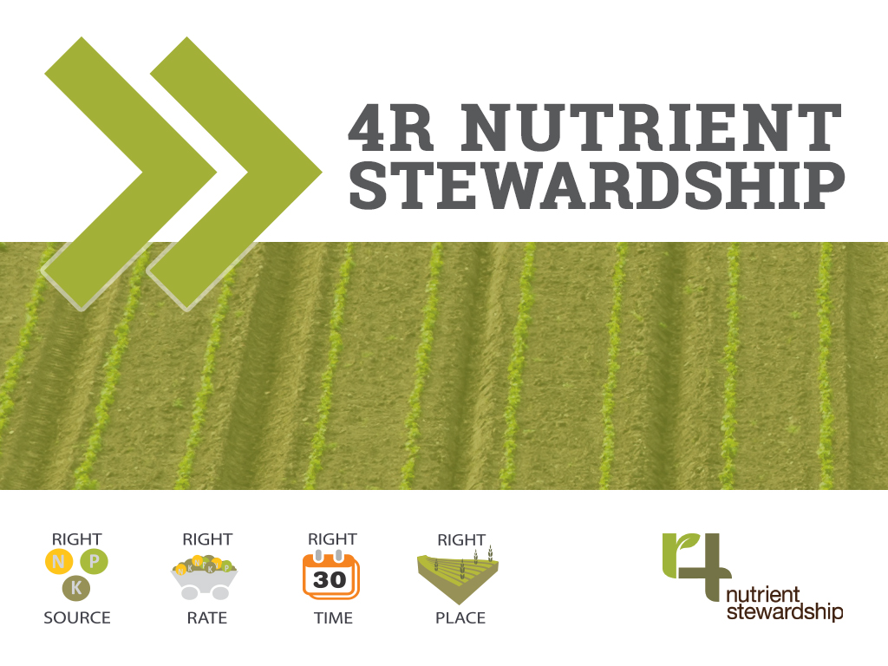
Ontario 4R Certification Program Public and Conservation Webinar
Notes:
Good afternoon and thank you for joining today’s Ontario 4R Certification Program webinar for the Public and Conservation Partners.

Slide 2
Housekeeping
The webinar and audio will be recorded
Audio is a separate conference call line (1-416-507-1717 code: 3649)
Please mute your phone while the webinar presentation is taking place
The webinar is scheduled from 1:00pm - 3:00pm EST
There will be a prompted pre and post webinar poll
Please save your questions for a Q&A period at the end of the session
Raise your hand using the GoToWebinar button
Type question in chat or email question at later date
The Public/ Conservation Webinar will be presented by:
Cassandra Cotton: Director, Sustainability, Fertilizer Canada
Anne Loeffler: Grand River Conservation Authority
Ron Campbell: Operations & Member Service Manager, OABA
Notes:
A few housekeeping items before we begin:
In order to document the webinar and provide a copy of the information to interested, but unavailable, participants - we will be recording the Webinar and Audio.
The audio is provided separately through Fertilizer Canada’s conference call line. If you are not already connected, please call 1-416-507-1717 code 3649. Also, please mute your phone during the presentation to reduce back round noise- Thank you!
This Public/ Conservation Partners Webinar is scheduled to take place from 1-3 pm but may end early depending on discussion time.
There will be a prompted poll before and after the webinar presentation. These questions will be available on the Webinar platform and automatically prompted by Fertilizer Canada. We ask that you answer these quick questions to help us better understand awareness levels of the 4R program.
There is a scheduled Q&A at the end of the webinar session and at the end of each standards section, for consistency and timing please save your questions for the designated Q&A. You may ask your question verbally over the phone during the Q&A- to do so please raise your hand on the GoToWebinar software by clicking the raise your hand button. You can also type a question into the chat/question bar- these chat questions will be answered over the conference call line unless specified. You may also email questions to myself, at Fertilizer Canada- contact information will be provided.
All presenters of the Ontario 4R Certification webinars are relevant members of the 4R Ontario Steering Committee, today’s speakers are
Cassandra Cotton – the Director of Sustainability at Fertilizer Canada
Anne Loeffler from the Grand River Conservation Authority, representing Conservation Ontario
And Ron Campbell the operations and member service manager at OABA

Slide 3
Agenda
Pre-webinar Poll
4R Nutrient Stewardship Overview
Implementation in Ontario
4R Ontario Certification Program
Development of Standards
Scope | Structure | Implementation
4R Ontario Certification Standards Review
Post-webinar Poll
Conclusion | Q&A
Notes:
The webinar will begin with a short survey for participants, then Cassandra Cotton from Fertilizer Canada will present the 4R Nutrient Stewardship program and outline the program’s initiatives across Canada and in Ontario. Then, Anne Loeffler from the Grand River Conservation Authority, representing Conservation Ontario will introduce the 4R Ontario Certification program by presenting the 4R ON Steering Committee members, explaining the development process of the purposed standards and outlining the scope, implementation process, and structure of the 4R Ontario Certification Program. Finally, Ron Campbell from the Ontario Agri-Business Association will outline the purposed standards (37 in total) in more detail. The webinar will be concluded with a short post webinar survey and list of key take away messages. Before the end of the webinar we have scheduled time for a Q&A period where the 4R Ontario speakers will be available to answer any of your questions or concerns.

Slide 4
Pre-Webinar Poll
How many people are watching the webinar with you (not including yourself)? Please indicate accordingly.
Rate your awareness of the 4R Nutrient Stewardship Program. Rate awareness on a scale of 1 to 5 (1 being unaware and 5 being very aware)
How important do you consider the 4Rs to reducing negative environmental impacts due to improper fertilizer use? Rate importance on a scale or 1 to 5 (1 being unimportant and 5 being very important)
Notes:
Let’s get started. At this time, you should be prompted with survey questions on your individual screens (there are 4 in total), where you can select your answer of 1 to 5 accordingly. Only you can see your answers and they are anonymous. We will only be collecting the aggregated answers.
We will give you all the next 2 minutes to answer the questions, after all 4 questions have been completed we will continue with the presentation.
Please let us know if you experience any technical difficulties during the poll. Thank you!

Slide 5
4R Nutrient Stewardship
An Overview
Notes:
Thank you everyone – that is much appreciated. I would now like to welcome our first speaker - Cassandra Cotton.
Thank you – and good afternoon everyone. I would like to start by providing a brief overview of what 4R is.

Slide 6
Notes:
4R Nutrient Stewardship is an innovative approach for fertilizer best management practices. This approach considers economic, social and environmental dimensions of nutrient stewardship and is essential to sustainability of agricultural systems.
The concept is simple – apply the right source of nutrient, at the right rate, at the right time and in the right place – but the implementation is knowledge-intensive and site-specific.
The agricultural industry, government, and conservation authorities in Ontario are committed to sustainable food production. 4R Nutrient Stewardship provides a science-based framework for implementing, validating, and communicating those efforts.
My presentation today will serve as an introduction to the 4Rs and help you to understand the economic, social and environmental benefits of putting these beneficial practices to work on your farm.
The Right Source means ensuring a balanced supply of essential plant nutrients including granular fertilizers, liquid fertilizers and/or manures.
The Right Rate is applying just enough fertilizer to meet the needs of the plant while accounting for the nutrients already in the soil.
The Right Time means applying fertilizer when the plant will get the most benefit and avoiding times when fertilizer can be lost to the environment.
The Right Place is where the plants can easily use it and where it is less likely to be lost to the water or air.

Slide 7
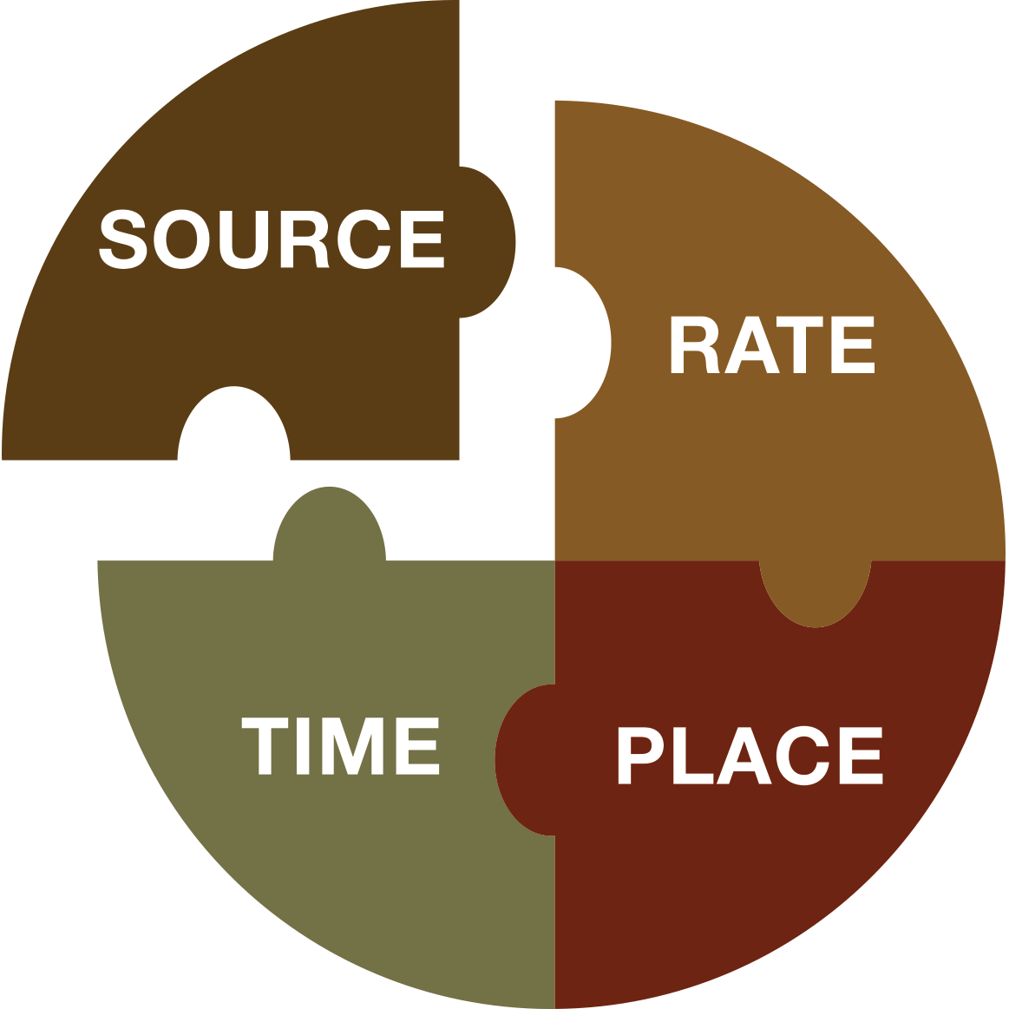
Right Source
Ensure Balanced Supply
Suit Soil Properties
Notes:
Let’s explore these 4R principles a little more. Starting with Right source.
The first key principle of right source is the idea of a balanced supply of nutrients. Since the nutrient in shortest supply limits growth, if you add a nutrient to soil that's already there in sufficient quantity, the crop will not respond to it, or at least not in a positive way. The other side of the coin is if you have two nutrients that are in short supply and you only add one of them, the crop will not respond, or at least not very much, until the second nutrient is added.
So when it comes to crop nutrients, don't add what's already there, and when you add things that aren't there, balance them.
The second important principle when making source decisions is to make sure that the source of nutrients is a good match for the soil. This means you have to take into account both soil properties like pH and soil conditions like moisture. For example, avoid applying urea to high pH soils due to higher risk of volatilization losses.

Slide 8
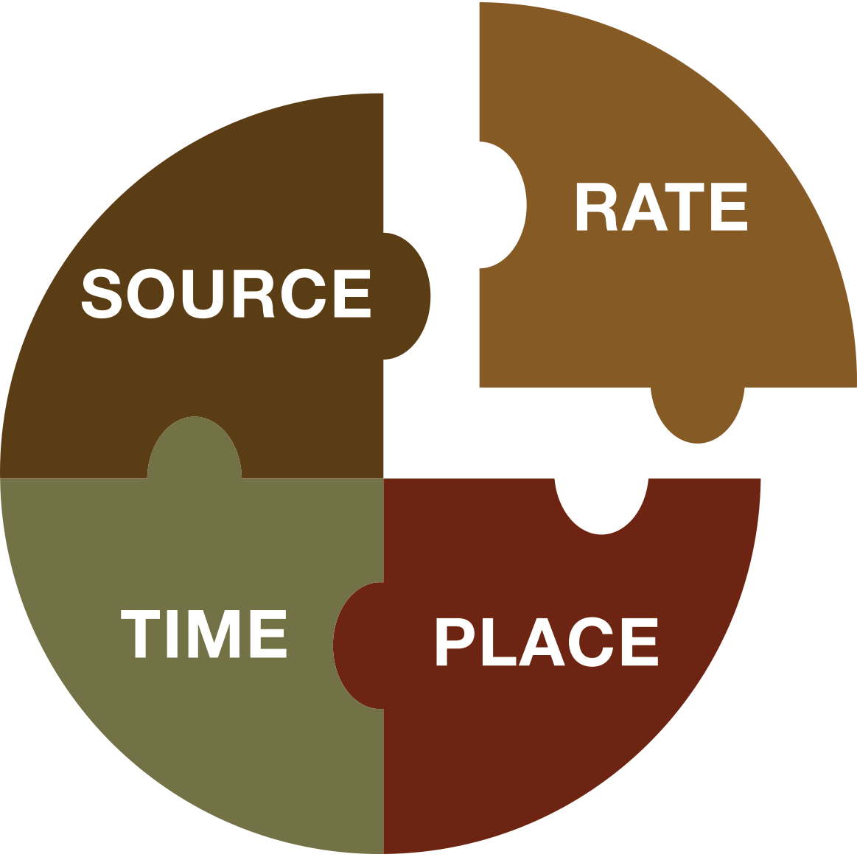
Right Rate
Assesses All Resources
Assesses Plant Demand
Notes:
The two most important scientific principles underlying right rate decisions are soil supply and plant demand.
The idea behind the supply side principal is that we need to assess all sources that are contributing nutrients to the crop when determining nutrient addition rates. While this is conceptually a pretty simple idea, it's often difficult to put into practice as a multitude of factors interact to control nutrient supply. Assessing nutrient supply is not an exact science but that said we do have some tools, for example soil testing, that give us good approximations of nutrient supply in the soil and when it comes to nutrients added as fertilizer or manure, we can directly measure the quantities added to the cropping system.
Demand is influenced by variables in the cropping system including: moisture, temperature, and soil type which all help determine crop growth and how much of each nutrient they will need. Demand also varies based on the crop type (wheat is different than corn) and even based on the variety of the chosen crop.
A useful way to think about crop demand is to think of it in terms of yield potential. For example, silt loam soils typically have a greater yield potential than heavy clay soils.. Since higher yields mean higher nutrient demands, we will need a greater supply of nutrients on the silt loam farms compared to the heavy clay.
Remember that it's important to assess both the nutrient supply and the crop demand when making rate decisions.

Slide 9
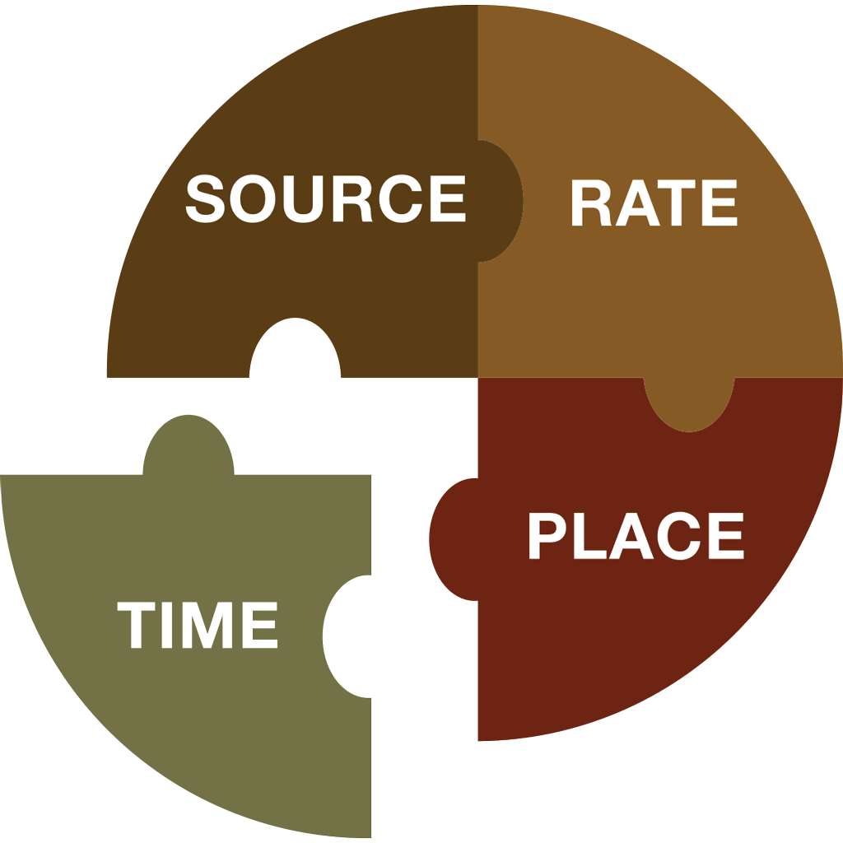
Right Time
Assesses Dynamics of Crop Uptake and Soil Supply
Determine Time of Loss Risk
Notes:
The Right time for nutrient additions is closely linked to the supply and demand idea we just covered in the right rate discussion.
If you think about the way a crop grows - let’s take an annual crop such as corn for our example - early in the season the crop is small and nutrient demand is fairly low. But in most parts of Canada, soils are still cold and the soil supply of nutrients like phosphorus can be too low to meet even that small demand. Once the crop is established, the growth rate accelerates and nutrient demand increases through the vegetative and early reproductive stages. Then, as the crop matures, the growth rate and nutrient uptake slows and then stops. As the season progresses, soil supply also tends to increase for nutrients like nitrogen that are supplied in part through mineralization of soil organic matter. So we want to make sure the nutrients are there when the crop needs them whether it’s early in the spring or mid-season and we want to take into account that the soil supply of these nutrients changes as the season progresses.
The second principle for right time is to consider the risk of nutrient loss when deciding the timing of your application. When nutrients are added to soil, they don’t just sit there until the crop takes them up. They can:
react with the soil chemically to form precipitates
be adsorbed onto surfaces
move below the rooting zone with water = leaching
Be lost to runoff
soil microbes can take them up
be transformed into gaseous forms and be lost to the atmosphere
All these processes can remove nutrients from the available nutrient pool. It’s important we consider these losses when we make our timing decisions both to ensure adequate supply for the crop and to minimize the environmental impact from losses.

Slide 10
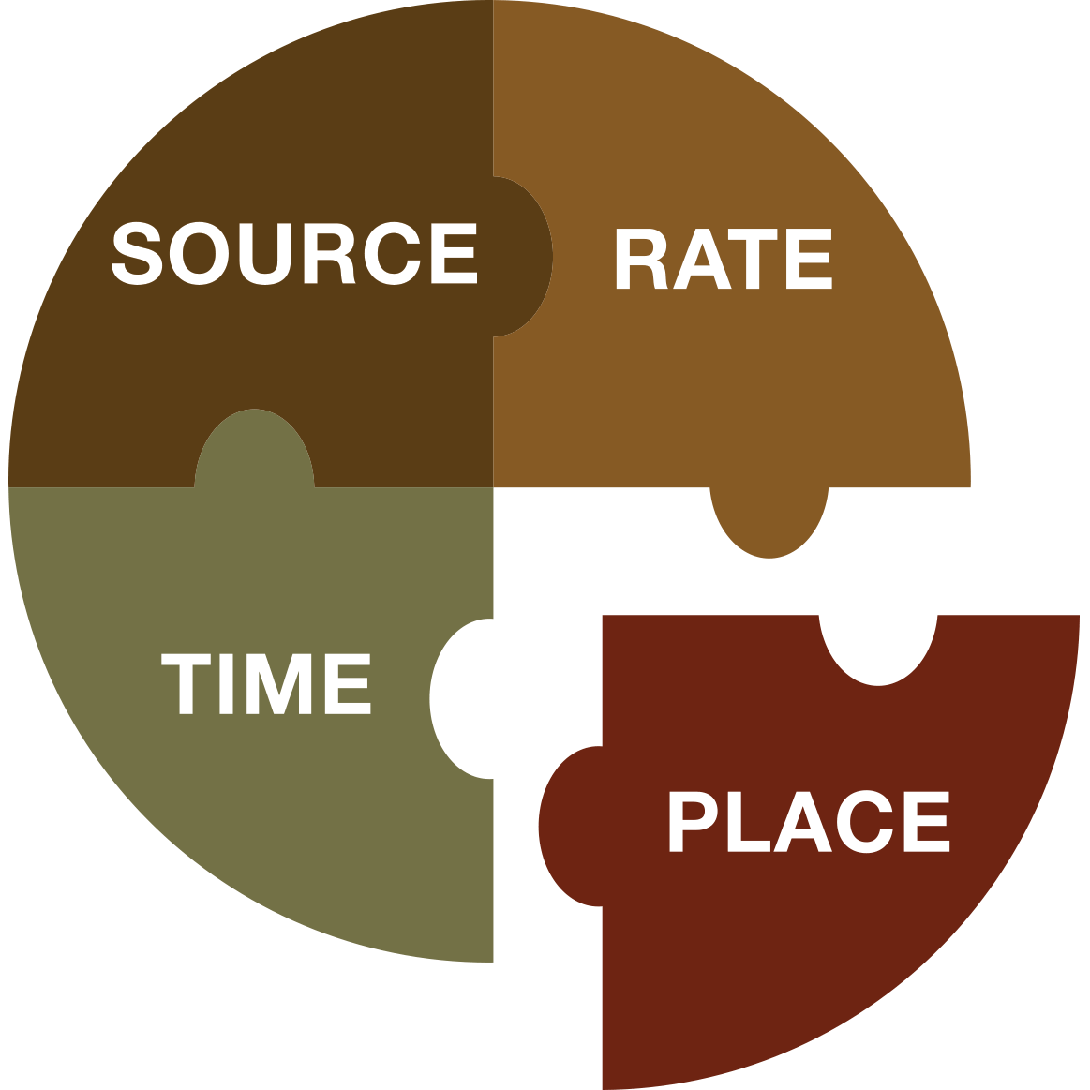
Right Place
Recognize Crop Rooting Patterns
Manage Spatial Variability
Notes:
Making sure that nutrients are in the right place means we need to think about nutrient placement on the scale of the individual plant and on the larger management unit or landscape basis.
At the smaller scale of individual plants, different crops have different rooting patterns. Corn and wheat for example have a fibrous rooting system with a largely horizontal orientation. Soybeans have a tap root system, with a primarily vertical orientation. So in a sense, corn and wheat have a greater ability to explore the soil near the surface for nutrients and soybeans have a greater ability to explore the depths.
When making placement decisions, particularly for fertilizer, we need to consider whether the placement chosen matches the rooting orientation of the crop. This is the first principle under right place - to consider rooting patterns when making placement decisions.
The other way in which placement needs to be considered is with respect to the spatial variability of the landscape. We all know that crop yield varies across a field and this variability in production potential depends on a number of soil and micro-climatic factors. Right place means we should consider this spatial variability at the landscape level when developing our BMPs.
To start, considering variability can be as simple as looking at each field as a separate cropping system and assessing the nutrient needs based on the characteristics of that field. Of course, the idea of managing spatial variability eventually leads to some form of variable rate fertilizer application which might be the best of the best management practices when it comes to managing spatial variability.
That wraps up our quick look at some of the 4R principles that form a framework for developing BMPs.

Slide 11
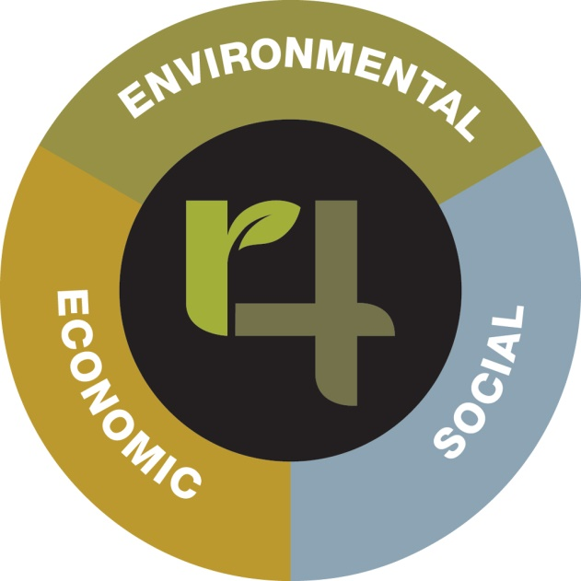
Sustainability Goals
Economic
Improve farm profitability by improving return on fertilizer dollars
Make the most of dollars spent on fertilizer
Contribute to improve regional economic development
Social
Improve access to sources of information to assist in farm management decision making
Improve productivity of farm labour by appropriate use of emerging technology that increase efficiencies of field operations and reduce costs per unit of crop harvested
Environmental
Prevent nutrient loss from cropping system
Improve recycling of crop nutrient from crop residues and livestock manures
Towards Implementing 4R Nutrient Stewardship Practices on YOUR Farm
Notes:
So what are appropriate goals for a 4R Plan? Some examples are shown.
Economic Goals could be things such as:
To improve farm profitability by improving return on fertilizer dollars
Make the most of dollars spent on fertilizer
Contribute to improved regional economic development
Social Goals could be things such as:
Improve access to sources of information to assist in farm management decision making
Improve productivity of farm labour by appropriate use of emerging technologies that increase efficiencies of field operations and reduce costs per unit of crop harvested
Environmental Goals could by things such as:
Prevent nutrient loss from cropping system
Improve recycling of crop nutrients from crop residues and livestock manures
The point is that goals, while they are the big picture part of 4R, need to be relevant to your farming operation and to the need of you and your family. They also need to be relevant to other stakeholders in the local and global community. So who are these other stakeholders? They are your neighbors, the people you do business with, governments at all levels, the companies that use farm products to make other products and at the other end of the food chain the people who sit down at the supper table.
Finally, goals need to be something that better nutrient management of the cropping system can influence.
To start with it’s a good idea to keep your goal list relatively short. It’s important to make real progress on one or two important goals in each of the three areas rather than set a bunch of goals that are hard to meet or hard to measure.

Slide 12
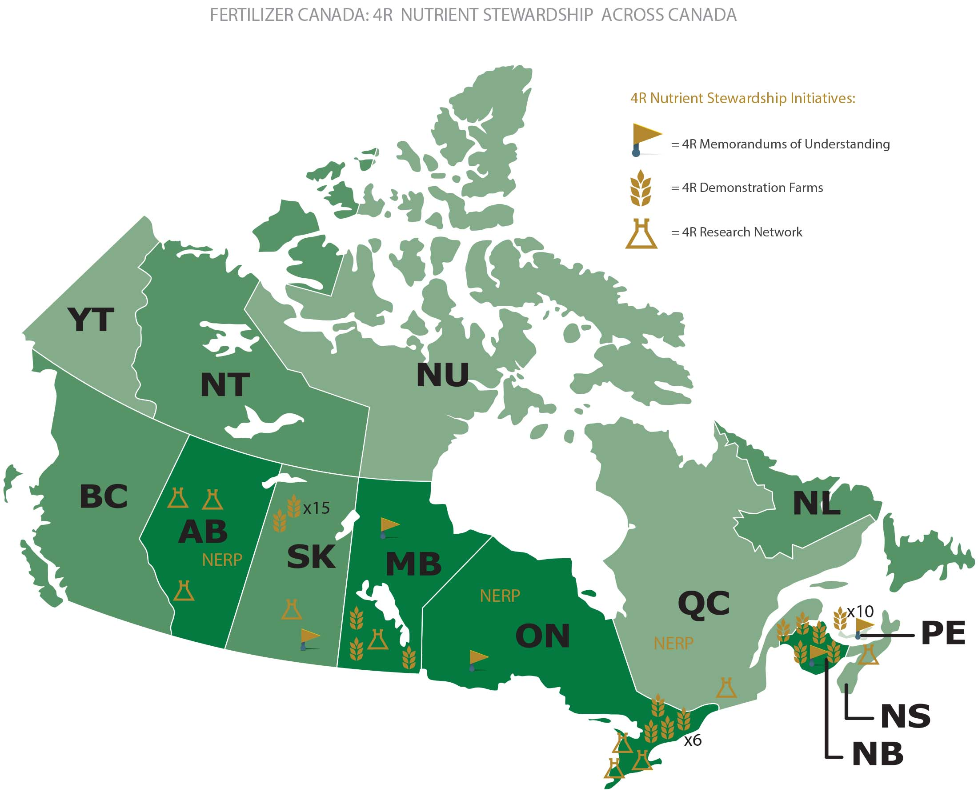
4Rs Across Canada
Notes:
Fertilizer Canada is engaged with provincial governments, farm groups, environmental groups and industry to link the province’s objectives for environmental performance with 4R Nutrient Stewardship. These projects include information development and distribution, 4R training materials and programs, field extension events and field trials.
These partnerships include:
National project funded by Agriculture and Agri-Food Canada to reduce GHG emissions
MOUs: Alberta, Saskatchewan, Manitoba, Ontario, PEI, NB (negotiating with QC)
4R Research Network – 9 researchers across the country
42 4R Demonstration Farms across the country

Slide 13
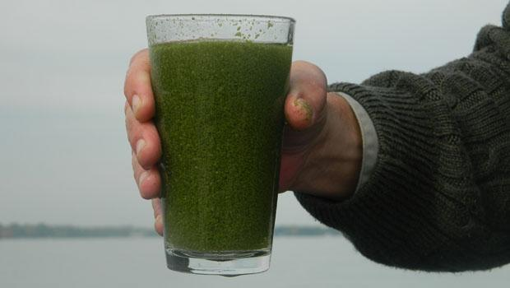
Notes:
The Ontario agriculture industry is committed to working towards the long term improvement of the Great Lakes water quality and the growing algal blooms in Lake Erie supporting the need to protect and restore the ecological health of the Great Lakes and is committed to being a part of the solution to ensuring the Great Lakes remain “drinkable, swimmable and fishable.” The industry recognizes the importance of environmental stewardship and its role in ensuring the proper use of fertilizer. Ontario has been a leader in encouraging farmers to use nutrient management planning in crop production.

Slide 14
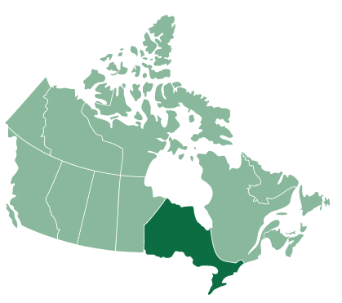
4R Nutrient Stewardship in Ontario
Notes:
Thank you Cassandra. Please welcome Anne Loeffler from the Grand River Conservation Authority, representing Conservation Ontario who will introduce the background and structure of the Ontario 4R Certification Program.
Thank you – Good afternoon everyone. Ontario represents a large portion of Canada’s most viable and productive farmland. Ontario has been a leader in nutrient management planning for crop production. The province has embraced 4R Nutrient Stewardship as a valuable tool for meeting the province’s agricultural and environmental goals. 4R Nutrient Stewardship is a recognized part of the Ontario Government’s strategy to reduce nutrient losses from Ontario farmland. Specifically, the 4R Nutrient Stewardship is referenced in the draft Canada-Ontario Action Plan for partnering on achieving P loading reductions in Lake Erie
4R Nutrient Stewardship offers Ontario Ag-retailers a a strategic opportunity to provide leadership to Ontario’s farm community as they move toward meeting provincial objectives to improve the water quality of the Great Lakes and contributing watersheds, while increasing agricultural productivity. Findings suggest that 4R Nutrient Stewardship can offer benefits when compared to traditional practices. The adoption of 4R nutrient stewardship will continue to ensure the effective protection and conservation Ontario’s agricultural soils, water quality, and ecosystem health as they relate to nutrients. Because every farm is different, the implementation of 4R Nutrient Stewardship practices are fully adaptable to the diversity of Ontario agriculture production.

Slide 15
4R Nutrient Stewardship in Ontario
4R Memorandum of Cooperation
Ontario 4R Certification Program
Ontario CCA Board: 4R Specialty Certification to CCAs
Grower Surveying
Demonstration Farms
Notes:
The Government of Ontario, Fertilizer Canada, and the Ontario Agri Business Association formalized a commitment on agricultural sustainability and environmental action. With a combined industry investment of $300,000 over three years, the funding partners signed a Memorandum of Cooperation helping Ontario farmers maximize crop yields with minimal environmental impact.
This is a multi-stakeholder approach demonstrating the collective commitment to sustainable agriculture and environmental stewardship. Additional participation includes:
Ontario Ministry of Agriculture, Food and Rural Affairs (OMAFRA)
Ontario Agri Business Association (OABA)
Fertilizer Canada
Ontario Certified Crop Advisor Board
Christian Farmers Federation of Ontario
Grain Farmers of Ontario
Conservation Ontario
Ministry of the Environment and Climate Change (MOECC)
International Plant Nutrition Institute (IPNI)
Nature Conservancy (Ohio)
Ontario Federation of Agriculture
Ontario agri-retailers
As one of the major initiatives under this agreement, we have proactively collaborated to develop a voluntary retailer certification program that will accelerate the on-farm adoption of 4R Nutrient Stewardship as a best practice for responsible nutrient application and management. The 4R Ontario Steering Committee and technical working group, made up of these organizations, have developed the 4R Ontario Certification program and purposed standards.

Slide 16
Development of Standards
Developed by the 4R Science & Tech Working Group
Based on the 4R Ohio Certification Program
Addresses regional priorities for water quality
Includes the most current research available
Notes:
The proposed standards, being presented later in this webinar, were developed by the 4R Ontario Steering Committee in close collaboration with the 4R Nutrient Technical Working Group
Based on the 4R Ohio Certification Program; the validity, suitability and accountability of the Ohio 4R Certification model for implementation in the Ontario marketplace was tested and validated during a pilot program in 2016
In addition to general principles of 4R Nutrient Stewardship, the standards have incorporated specific criteria for the purpose of addressing regional priorities for water quality
The 4R Ontario Steering Committee members will continuously work with the research community to ensure the standards stay up to date and provide the most current research available.

Slide 17
Goals of the 4R Certification Program in Ontario
Optimize crop uptake of nutrients and minimize nutrient losses
Create long-term positive impacts on water bodies associated with agricultural production areas
Encourage sharing of the most up-to-date information
Help the agricultural sector adapt to new research and technology
Notes:
The goals of the 4R Certification Program pertains to the Ontario MOU Agreement and aims to address concerns surrounding the Great Lakes water quality by creating long-term improvement on water bodies associated with agricultural production areas. The goals of the program are as follows;
optimize crop uptake of nutrients and minimize nutrient losses;
create long-term positive impacts on water bodies associated with agricultural production areas, including the reduction of eutrophication and incidence of harmful algal blooms, and helping to meet water quality standards;
encourage sharing of the most up-to-date information about responsible nutrient stewardship with Nutrient Service Providers and growers; and other interested groups
help the agricultural sector adapt to new research and technology in the area of nutrient stewardship

Slide 18
Benefits to the Public and Conservation Partners
The 4R Certification program aims to improve and protect the waters of Lake Erie in the Great Lakes Basin of Ontario
Provides end-use customers with proof of environmental sustainability
This science and fact-based approach meets government and environmental organization demands and exceeds them
Ensuring the Great Lakes remain “drinkable, swimmable and fishable”
Notes:
With these goals in mind, there are a number of benefits for the public and conservation partners.
First, the 4R Certification program aims to improve and protect the waters of Lake Erie in the Great Lakes Basin of Ontario by providing nutrient service providers with science-based, consistent metrics for nutrient application and management to optimize nutrient availability and reduce nutrient loss
With an anticipated demand for sustainable food production, this program provides end-use customers with proof of environmental sustainability
With government and conservation partner sitting on the 4R ON Steering Committee, the program and purposed standards reflect government and environmental organization demands and exceeds them
The Ontario agriculture industry supports the need to protect and restore the ecological health of the Great Lakes and is committed to being a part of the solution to ensuring the Great Lakes remain “drinkable, swimmable and fishable.”

Slide 19
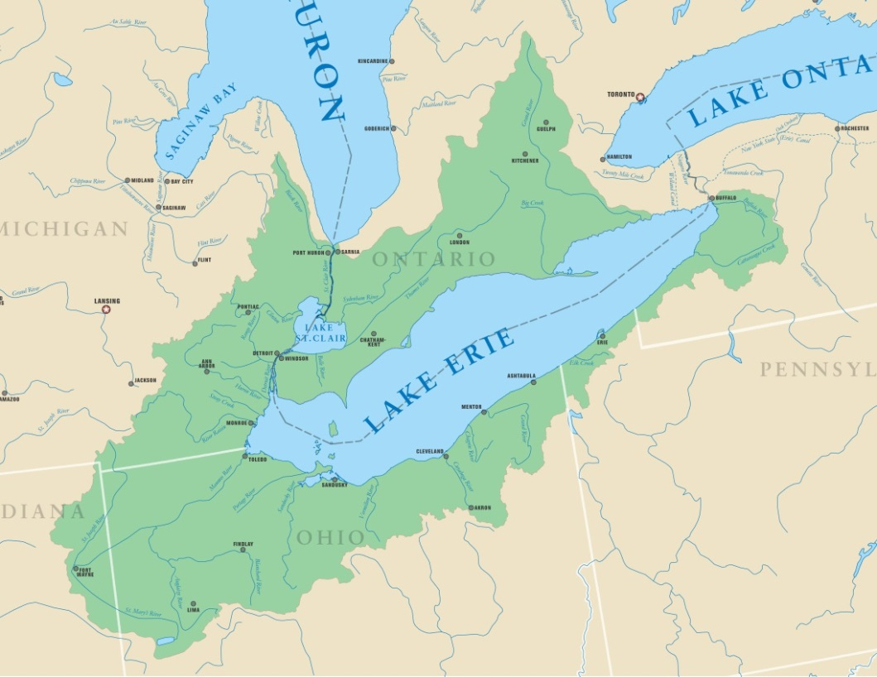
Scope
In Ontario and the Great Lakes Basin
Standards form a set of auditable 4R Nutrient Stewardship criteria
Ontario 4R Certification Program is a voluntary program
Nutrient Services Providers include:
agricultural retailers
agricultural service providers
certified professionals
Notes:
The Program is designed to recognize Nutrient Service Providers who have adopted the principles and practices of 4R Nutrient Stewardship.
The term Nutrient Service Provider includes those engaged in the sale of nutrients to farm customers, those engaged in making nutrient recommendations to farm customers and those engaged in the application of nutrients on farmland.
These standards translate 4R Nutrient Stewardship into a set of auditable criteria that demonstrate due diligence and accountability.
The 4R Nutrient Stewardship Certification Program is voluntary, and will be of direct interest to all Nutrient Service Providers across the province of Ontario, with an initial and priority focus on the west basin of Lake Erie

Slide 20
Structure
Third-party audited
37 auditable criteria
Training: (T) [6]
Recommendations: (R) [12]
Application: (A) [10]
Documentation: (D) [9]
Each auditable evaluation criterion will be reported as:
Comply
Not Comply
or Not Applicable
Notes:
The 4R Certification Standards will be audited via a in-person audit process
The audit is completed by a third-party. The 4R Ontario Steering Committee has selected AWSA (Agri chemical warehouse standards association) as the third party auditor for the program.
The standards (which total 37 auditable criteria) are divided into the following main sections:
6 Training and Education criteria (referred to as T is for training )
12 Recommendations criteria (referred to as R for recommendation)
10 Application criteria (referred to as A for application)
And 9 Documentation criteria (referred to as D for documentation)
Each standard will be re-evaluated on a two-year cycle by the third party auditor, via an in-person audit, to maintain certification.
Unless otherwise specified, 100 per cent of grower customers of the Nutrient Service Provider must meet the requirements specified by the auditable evaluation criteria during every audit year in order to achieve conformance with the standards.
The degree of conformance to the standards will be assessed by the auditor, who will evaluate each auditable evaluation standard. It is important to note that the ag retailer will only be audited on what the ag retailer can control. Audit results will be reported, as: Comply, Not Comply, or Not Applicable.

Slide 21
Implementation
Scheduled to be published April 1, 2018 and implemented in Fall 2018
Re-evaluated on a two-year cycle to keep certification
45-day consultation period ends February 28, 2018
Please provide written comments to:
McKenzie Smith Audit Coordinator, Fertilizer Canada Email: msmith@fertilizercanada.ca T: 613-786-3044 | M: 613-793-8387
Notes:
The 4R Certification program will be on a two year audit cycle and is scheduled to be published April 1, 2018 and implemented in Fall 2018.
Currently in a consultation period, the proposed standards are open for public comment until February 28, 2017. Any comments are to be provided in writing and submitted to:
McKenzie Smith
Audit Coordinator
Fertilizer Canada
350 Sparks St. Suite 907, Ottawa, Ontario, K1R 7S8
Email: msmith@fertilizercanada.ca
T: 613-786-3044 | M: 613-793-8387

Slide 22
Proposed 4R Certification Standards
Notes:
Thank you Anne! Ron Campbell from the Ontario Agri Business Association will now go through the 37 4R Certification Standards and the related evaluation criteria for each standards.

Slide 23
Standards – Training Requirements
T1 | Nutrient Service Providers, sales, and application staff have undergone an initial training and staff are able to demonstrate knowledge about 4R Nutrient Stewardship and the 4R Certification Program. | Meeting agendas, education log, or materials indicating 4R concepts and topics (Right Rate, Time, Place and Source) were covered, roster of those in attendance. Can be an interview with various staff. Educational information and sample presentations available at eLearning.fertilizercanada.ca & 4r.fertilizercanada.ca.
T2 | Certified professionals must have current certification in good standing. | Print-off of current credentials and/or certification which include: Certified Crop Adviser (CCA), CCA 4R Specialty or Certified Nutrient Management Consultant.
T3 | Any staff member making nutrient stewardship recommendations attend training, at least once every 2 years on the practices and principles of 4R Nutrient Stewardship, soil sampling and testing techniques, and/or nutrient water interaction. This is demonstrated through a minimum of 5 hours of documented training per year. | If the staff person is a CCA or Certified Nutrient Management Consultant, then proof of active status is sufficient. If not a CCA, but still a certified professional, print-off of classes taken is needed. If not explicit, include agendas of meetings attended.

Slide 24
Standards – Training Requirements Continued
T4 | Nutrient Service Provider's sales and application staff attend a training at least once every 2 years on 4R Nutrient Stewardship. This is demonstrated through a minimum of 2 hours of relevant training approved by the Ontario 4R Retailer Certification program administrator. | Program Administrator must review training offered, it may be through the agri-business itself or through a third-party. Agenda and attendance is required.
T5 | Nutrient Service Provider has conveyed informational materials on 4R Nutrient Stewardship to all grower customers. | Signature by grower, OR proof of attendance at a company sponsored 4R Nutrient Stewardship educational event, OR proof of distribution of materials via mailing list.
T6 | Nutrient Service Provider has sponsored or directly provided a training session on 4R Nutrient Stewardship that is available for all grower customers. | Agenda of the company-sponsored educational event shows training on 4R Nutrient Stewardship approved by the Program Administrator

Slide 25
Standards – Recommendation Requirements
R1 | Soil (analysis) tests are conducted by an OMAFRA accredited lab which include, at minimum: organic matter, Phosphorus (Olsen), Potassium, and pH. | Review of soil testing records on file, can be hard copy or electronic. All 4 items must be indicated on the records.
R2 | Soil tests are conducted at least once every 4 years. | Review of records on file, can be hard copy or electronic. Most recent soil test result may not be older than 4 years old.
R3 | Nutrient recommendations utilize the soil test history of the field, including results from the most recent soil test. | Review of records on file, can be hard copy or electronic. Current soil test results must be equal to or less than 4 years old. If it is a new field, crop insurance township averages, drainage, and soil type may be used.
R4 | Soil tests are taken at an appropriate depth from relatively uniform areas no larger than 25 acres. | Review of records on file, can be hard copy or electronic. Maps indicating acres represented in sample must be provided. All areas sampled must be smaller than 25 acres.

Slide 26
Standards – Recommendation Requirements Continued
R5 | If manure is applied, its content of total and available nutrients is based on either OMAFRA's database average for the specific manure type, or using sampling and analysis following recognized guidelines. | Samples collected using procedures set out in Nutrient Management Act protocols. Analysis must be conducted by OMAFRA approved laboratory. Manure nutrient analysis records (hard copy or electronic) will be reviewed if manure is applied on fields where recommendations are made or fertilizer applied.
R6 | Nutrient recommendations and/or application adhere to minimum setbacks from all known sensitive areas, such as tile inlets, well heads, gullies, and water bodies specified in applicable national, provincial, or local laws. | Records of application recommendations and actual applied maps or spreading tickets. Information on (4R Ontario website) will relate to national and provincial regulations. Any local laws will not be updated regularly on the site.
R7 | For all nutrient recommendations and/or application, the inclusion of a minimum setback distance (e.g., 35-100 ft.) near known sensitive areas, such as tile inlets, well heads, gullies, and water bodies is documented and discussed with the grower customer. | Setbacks discussed in meetings with grower customer, in subsequent years signatures of grower customers will be on file, or included on customer's application/recommendation cover sheet or maps.

Slide 27
Standards – Recommendation Requirements Continued
R8 | All sources of nutrients are accounted for in the 4R Nutrient Stewardship Plan, including but not limited to commercial fertilizers, manure/litter, biosolids, cover crops, and the previous crop. | Nutrient recommendations indicate all sources of nutrients in the recommendation records. Credits are given to all sources of fertilizer applied and there is a reduction in commercial fertilizer recommended.
R9 | Crop yield goals are discussed with the grower and are based on previous crop yield history. | Review of records on file, can be hard copy or electronic. Proof of level of crop management may be previous yield history, township averages, or local adaptive management research. Discussion about the process and some documentation or records of process.
R10 | Recommended nutrient application rates are at or below limits specified by nutrient application recommendations recognized by a government or academic institution that reflects growing conditions consistent with those of the customer. Recommendations may also allow for adaptive management based on documented on-farm data showing reasonable expectation of improved crop yield without increased risk of harm to water quality. | Records will be compared to credible government or academic sponsored nutrient recommendations first. If above these rates, data from adaptive management research must be presented justifying the different recommendation. Field averages will be used to evaluate this criteria. The Nutrient Management Act is considered a government recognized recommendation source.

Slide 28
Standards – Recommendation Requirements Continued
R11 | If urea or UAN is broadcast and not incorporated within 24 hours, it is recommended to be applied with an enhanced efficiency N sources. | Review of records on file, can be hard copy or electronic. Fertilizer recommendations and applied scale ticket or as-applied map.
R12 | Discussion on nitrogen management include options of split application, nitrification inhibitors and slow release technologies. | producer sign off.

Slide 29
Standards – Application Requirements
A1 | Application records shall not exceed recommendations for custom applied acres. Within an acceptable margin of error for calibrated equipment. | Review of records on file, can be hard copy or electronic. Nutrient recommendations and applied scale ticket or as-applied map.
A2 | Phosphorus injection, subsurface banding, or broadcasting with immediate incorporation are the recommended placement methods unless the risk of phosphorus loss to surface water has been demonstrated to be low according to a provincially approved phosphorus index risk assessment procedure. | Recommendation records indicate the recommended placement(s). Statement on phosphorus placement given/mailed to grower customers or grower customer signature indicating understanding.
A3 | Crop nutrient applications are neither made nor recommended to be made on frozen or snow covered ground. | Recommendation records indicate the preferred timing. Application records indicate there is no frozen ground or snow present. Frozen ground is defined: when soil conditions are such that tillage or nutrient incorporation and/or injection after application are not possible at the time of nutrient application, and will not be possible within the next 48 hours as a result of frozen conditions. Snow-covered ground is defined: when soil cannot be seen because of snow cover.

Slide 30
Standards – Application Requirements Continued
A4 | Total application of Phosphorus not to exceed the quantity needed for the next two years of planned crops. | Records will be compared to a recognized recommendation source. Field averages will be used to evaluate this criteria. Records of individual soil test will be compared to the credible recommendation source or equivalent tool. Crop nutrients regulated under the Nutrient Management Act must follow Technical Standard of the NMA.
A5 | Nutrients are applied according to a written nutrient recommendation that has been prepared within the prior three years. | Records of application will be compared to the recommendations on file. Only applicable to the full service customers.
A6 | All nutrient application equipment must be calibrated, at least annually. | Calibration (i.e., maintenance) records indicating equipment service date and any maintenance/service required.
A7 | Broadcast applications of crop nutrients without immediate incorporation are neither made nor recommended unless a documented local weather forecast (verifiable private or government generated) indicates less than a 50% chance of a rainfall event involving more than 25mm (one inch) of rain beginning in the next 12 hours. | The current weather forecast for the nearest town available to the fields is printed as a record within 12 hours of application. If the chance of precipitation exceeds 50%, the forecast total amount must be less than 25 mm (one inch). A consistent source of weather forecasts is used.

Slide 31
Standards – Application Requirements Continued
A8 | Where in-field variability in crop nutrient need or environmental risk is identified and variable rate application is warranted, site specific nutrient application is used. | Review of records on file, can be hard copy or electronic. Maps must be provided. Consideration is targeted towards fields that are 25 acres or larger.
A9 | Records of nutrient application include at minimum: method of application; time of application; field map showing locations of application; nutrient source & rate weather (temperature and precipitation) conditions at the time of application; and weather forecast for the day of application | Review of records on file, can be hard copy or electronic.
A10 | No application of fall nitrogen other than co-applied with P sources or to meet fall planting N requirements. | No application or recommendation for fall application of N other than for what is included in P sources or is used for winter wheat or cover crop.

Slide 32
Standards – Documentation Requirements
D1 | Nutrient Service Providers will record a list of grower customers and number of acres in the following categories: full service, recommendation only, application only, and an estimate of all other acres. | Review of records on file, can be hard copy or electronic. The NSP will record and submit a list of grower customers and acres per each in the following categories: full service, recommendation only, application only, and an estimate of all other acres.
D2 | Nutrient Service Provider maintains records related to all nutrient and application recommendations by Nutrient Service Provider. | Review of records on file, can be hard copy or electronic. Fertilizer recommendations and applied scale ticket or as-applied map.
D3 | Records related to grower customers are kept confidential by the Nutrient Service Provider and are made available for review during an audit. | Confidentiality statement with NSP and auditor signatures. Records are kept confidential by NSP as demonstrated with computer codes, file cabinets, or "safe" rooms or confidentiality agreement with the grower customer.
D4 | Nutrient Service Provider keeps onsite list and/or copies (either electronic or hard-copy) of relevant national, provincial, or municipal laws related to nutrient recommendations and application. | Review of records on file, can be hard copy or electronic.

Slide 33
Standards – Documentation Requirements Continued
D5 | Records of individual fields that are accesible to the retailer and made available to the grower/customer include, at minimum: field boundary, soil type current soil test results, nutrient recommendations crop yield goals used for making recommendations, and rates applied to each field | Review of records on file, can be hard copy or electronic.
D6 | Nutrient recommendations have been reviewed and acknowledged in writing by the grower/customer. | Signatures of grower customers on file.
D7 | Nutrient recommendations for each grower have been approved and signed by a Certified Professional. | Signatures of Certified Professional for each grower customer is on file, certifying that they approve the nutrient recommendation.
D8 | 4R Nutrient Plans must include information about yield goals, known sensitive areas (e.g., surface water, inlets, wells, etc.), soil type delineation, setbacks, and soil test results. | Review of records on file, can be hard copy or electronic. There may be multiple field maps to ensure all the information is outlined.
D9 | Field records related to monitoring of 4R implementation must include the watersheds and sub-watersheds where the farms are located. | Identify by watershed name or supply GIS data layer and/or hard copy map.

Slide 34
Post-Webinar Poll
Now rate your awareness of the 4R Nutrient Stewardship Program. Rate awareness on a scale of 1 to 5 (1 being unaware and 5 being very aware)
How important do you now consider the 4Rs to reducing negative environmental impacts due to improper fertilizer use? Rate importance on a scale or 1 to 5 (1 being unimportant and 5 being very important)
Notes:
Thank you Ron! At this time, we will prompt a short post webinar poll. You should be prompted with questions 1-4 one at a time, where you can select your answer of 1 to 5 accordingly. We will give 2 minutes for everyone to answer each question, after all 4 questions have been completed we will continue with the conclusion of the webinar and have a Q&A session.
Please let us know if you experience any technical difficulties during the poll. Thank you!

Slide 35
The RIGHT TIME for NUTRIENT STEWARDSHIP is RIGHT NOW.
Q&A
Notes:
Thank you for your participation in today’s webinar and for completing the pre and post webinar polls. We will now open the floor to the audience for questions and comments regarding 4R Nutrient Stewardship., the Ontario 4R Certifications program, the 4R Certification standards or other concerns.

Slide 36
Thank you!
Scheduled to be published April 1, 2018
Implemented in Fall 2018
Consultation period ends February 28, 2018
Please provide written comments to:
McKenzie Smith
Audit Coordinator
Fertilizer Canada
Email: msmith@fertilizercanada.ca
T: 613-786-3044 | M: 613-793-8387
Notes:
Thank you again for joining today’s webinar. Please contact McKenzie Smith at Fertilizer Canada with any written comments, questions or for a recording of today’s webinar.

