Slide 1
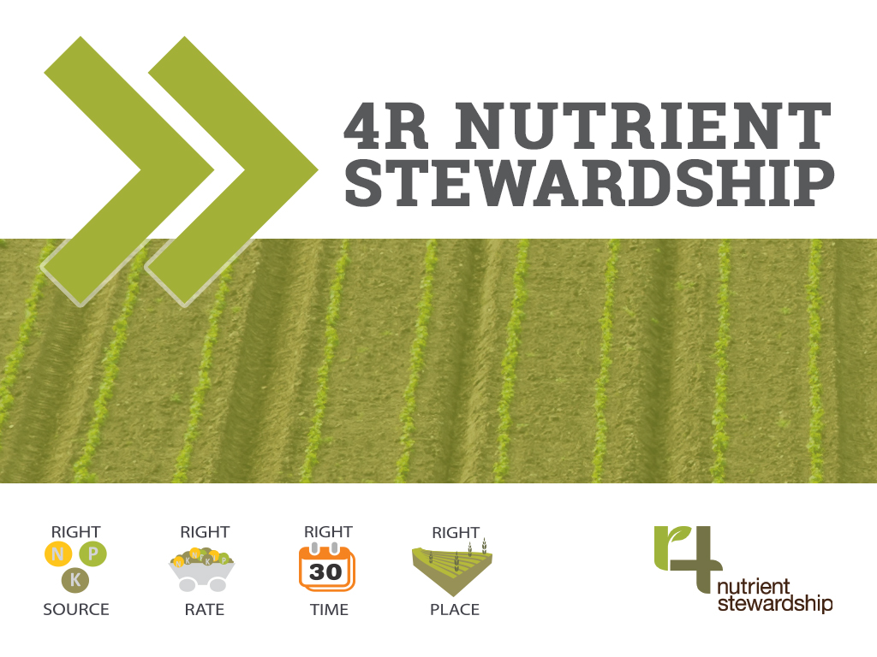
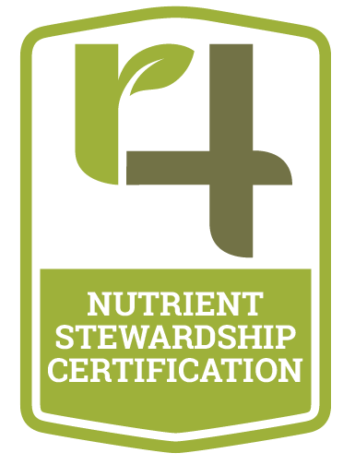
4R Ontario Certification Program
Sales & Application Staff Training

Slide 2
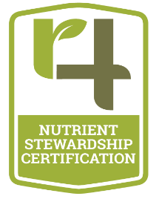
Notes:
4R Nutrient Stewardship is an innovative approach for fertilizer best management practices. This approach considers economic, social and environmental dimensions of nutrient stewardship and is essential to sustainability of agricultural systems.
The concept is simple – apply the right source of nutrient, at the right rate, at the right time and in the right place – but the implementation is knowledge-intensive and site-specific.
The agricultural industry, government, and conservation authorities in Ontario are committed to sustainable food production. 4R Nutrient Stewardship provides a science-based framework for implementing, validating, and communicating those efforts.
My presentation today will serve as an introduction to the 4Rs and help you to understand the economic, social and environmental benefits of putting these beneficial practices to work on your farm.
The Right Source means ensuring a balanced supply of essential plant nutrients including granular fertilizers, liquid fertilizers and/or manures.
The Right Rate is applying just enough fertilizer to meet the needs of the plant while accounting for the nutrients already in the soil.
The Right Time means applying fertilizer when the plant will get the most benefit and avoiding times when fertilizer can be lost to the environment.
The Right Place is where the plants can easily use it and where it is less likely to be lost to the water or air.

Slide 3
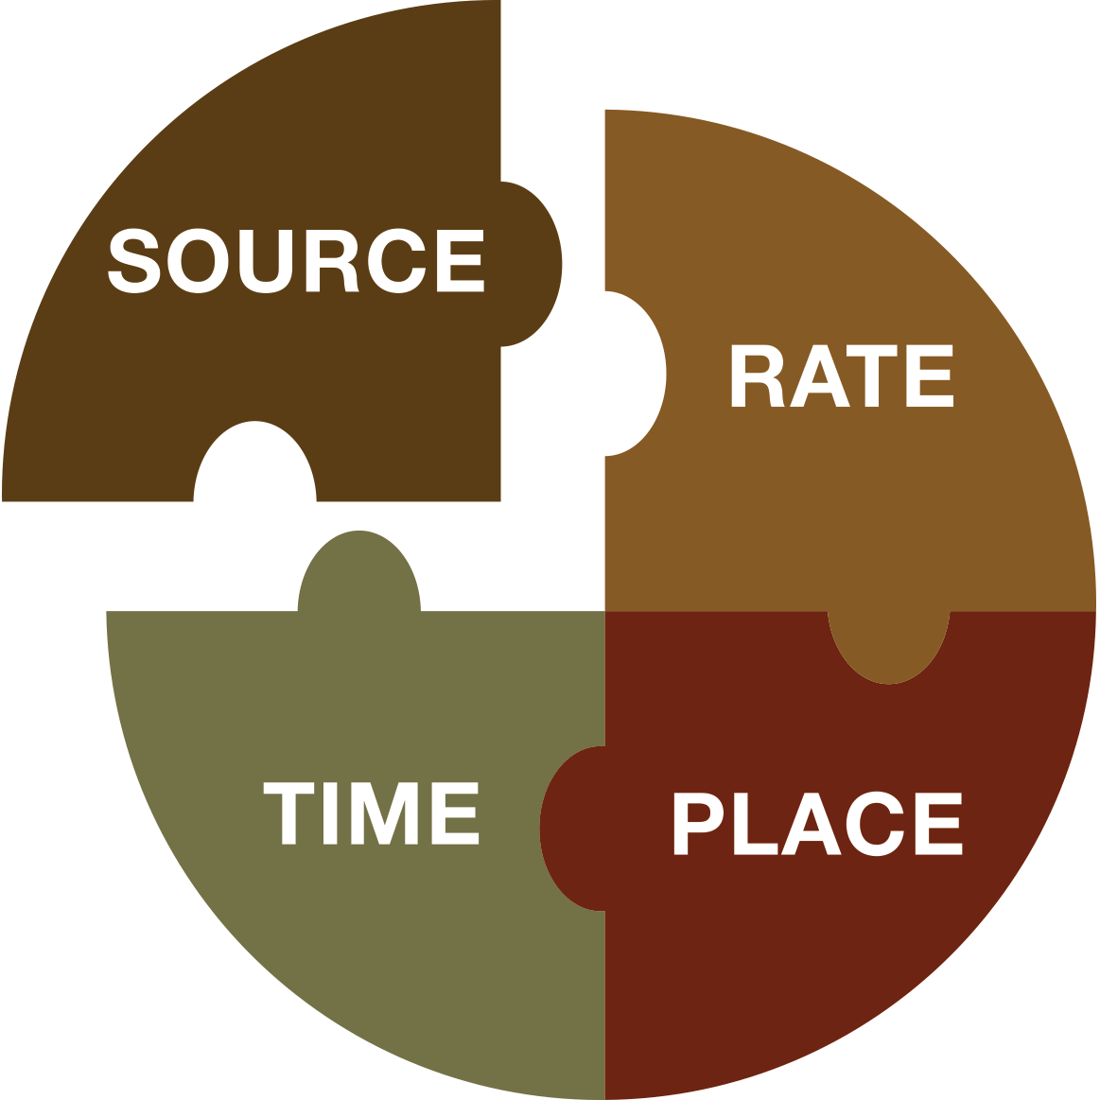
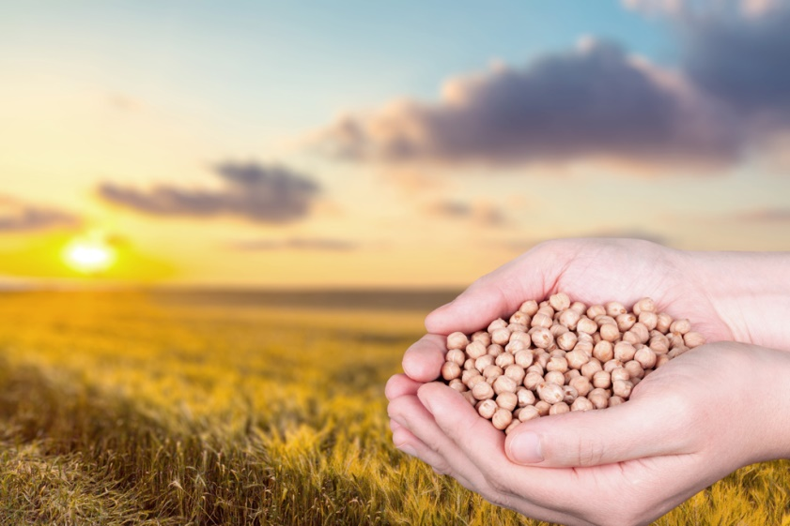
Right Source
Ensure Balanced Supply
Suit Soil Properties
Notes:
Let’s explore these 4R principles a little more. Starting with Right source.
The first key principle of right source is the idea of a balanced supply of nutrients. Since the nutrient in shortest supply limits growth, if you add a nutrient to soil that's already there in sufficient quantity, the crop will not respond to it, or at least not in a positive way. The other side of the coin is if you have two nutrients that are in short supply and you only add one of them, the crop will not respond, or at least not very much, until the second nutrient is added.
So when it comes to crop nutrients, don't add what's already there, and when you add things that aren't there, balance them.
The second important principle when making source decisions is to make sure that the source of nutrients is a good match for the soil. This means you have to take into account both soil properties like pH and soil conditions like moisture. For example, avoid applying urea to high pH soils due to higher risk of volatilization losses.

Slide 4
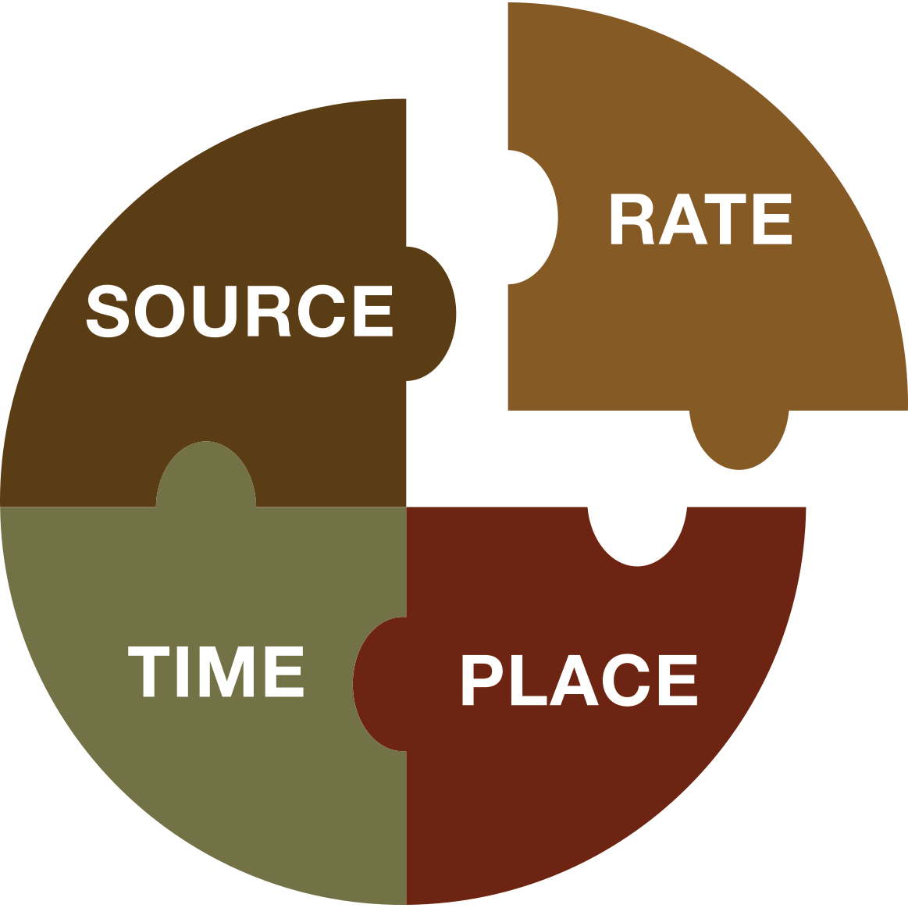
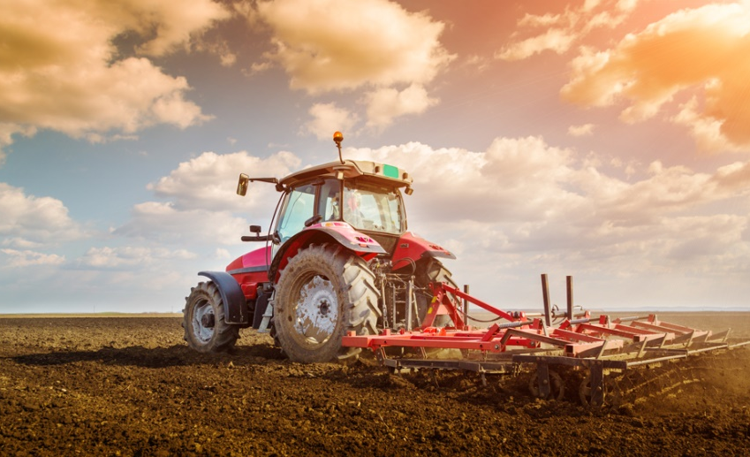
Right Rate
Assesses All Resources
Assesses Plant Demand
Notes:
The two most important scientific principles underlying right rate decisions are soil supply and plant demand.
The idea behind the supply side principal is that we need to assess all sources that are contributing nutrients to the crop when determining nutrient addition rates. While this is conceptually a pretty simple idea, it's often difficult to put into practice as a multitude of factors interact to control nutrient supply. Assessing nutrient supply is not an exact science but that said we do have some tools, for example soil testing, that give us good approximations of nutrient supply in the soil and when it comes to nutrients added as fertilizer or manure, we can directly measure the quantities added to the cropping system.
Demand is influenced by variables in the cropping system including: moisture, temperature, and soil type which all help determine crop growth and how much of each nutrient they will need. Demand also varies based on the crop type (wheat is different than corn) and even based on the variety of the chosen crop.
A useful way to think about crop demand is to think of it in terms of yield potential. For example, silt loam soils typically have a greater yield potential than heavy clay soils.. Since higher yields mean higher nutrient demands, we will need a greater supply of nutrients on the silt loam farms compared to the heavy clay.
Remember that it's important to assess both the nutrient supply and the crop demand when making rate decisions.

Slide 5
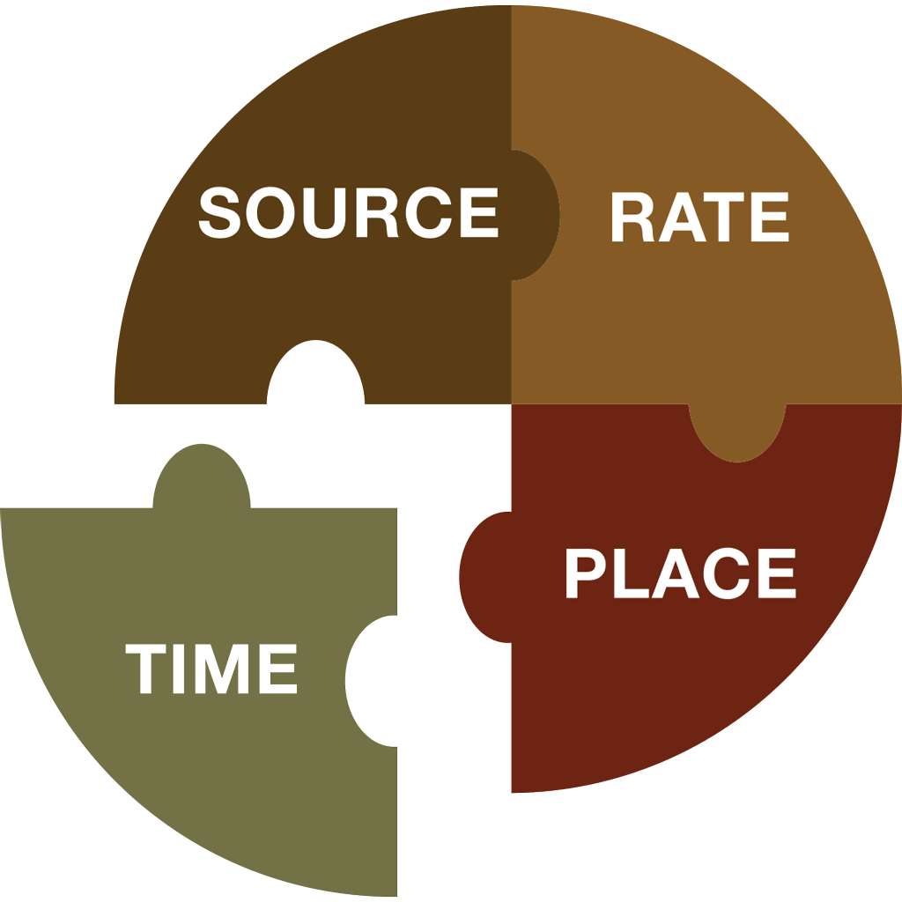
Right Time
Assesses Dynamics of Crop Uptake and Soil Supply
Determine Time of Loss Risk
Notes:
The Right time for nutrient additions is closely linked to the supply and demand idea we just covered in the right rate discussion.
If you think about the way a crop grows - let’s take an annual crop such as corn for our example - early in the season the crop is small and nutrient demand is fairly low. But in most parts of Canada, soils are still cold and the soil supply of nutrients like phosphorus can be too low to meet even that small demand. Once the crop is established, the growth rate accelerates and nutrient demand increases through the vegetative and early reproductive stages. Then, as the crop matures, the growth rate and nutrient uptake slows and then stops. As the season progresses, soil supply also tends to increase for nutrients like nitrogen that are supplied in part through mineralization of soil organic matter. So we want to make sure the nutrients are there when the crop needs them whether it’s early in the spring or mid-season and we want to take into account that the soil supply of these nutrients changes as the season progresses.
The second principle for right time is to consider the risk of nutrient loss when deciding the timing of your application. When nutrients are added to soil, they don’t just sit there until the crop takes them up. They can:
react with the soil chemically to form precipitates
be adsorbed onto surfaces
move below the rooting zone with water = leaching
Be lost to runoff
soil microbes can take them up
be transformed into gaseous forms and be lost to the atmosphere
All these processes can remove nutrients from the available nutrient pool. It’s important we consider these losses when we make our timing decisions both to ensure adequate supply for the crop and to minimize the environmental impact from losses.

Slide 6
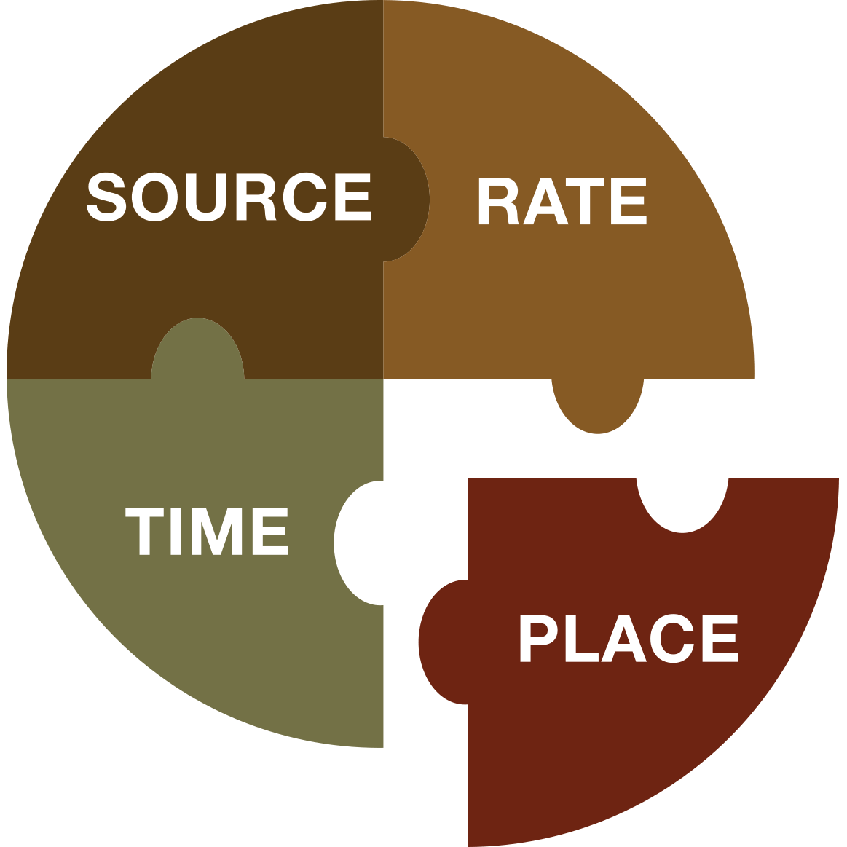
Right Place
Recognize Crop Rooting Patterns
Manage Spatial Variability
Notes:
Making sure that nutrients are in the right place means we need to think about nutrient placement on the scale of the individual plant and on the larger management unit or landscape basis.
At the smaller scale of individual plants, different crops have different rooting patterns. Corn and wheat for example have a fibrous rooting system with a largely horizontal orientation. Soybeans have a tap root system, with a primarily vertical orientation. So in a sense, corn and wheat have a greater ability to explore the soil near the surface for nutrients and soybeans have a greater ability to explore the depths.
When making placement decisions, particularly for fertilizer, we need to consider whether the placement chosen matches the rooting orientation of the crop. This is the first principle under right place - to consider rooting patterns when making placement decisions.
The other way in which placement needs to be considered is with respect to the spatial variability of the landscape. We all know that crop yield varies across a field and this variability in production potential depends on a number of soil and micro-climatic factors. Right place means we should consider this spatial variability at the landscape level when developing our BMPs.
To start, considering variability can be as simple as looking at each field as a separate cropping system and assessing the nutrient needs based on the characteristics of that field. Of course, the idea of managing spatial variability eventually leads to some form of variable rate fertilizer application which might be the best of the best management practices when it comes to managing spatial variability.
That wraps up our quick look at some of the 4R principles that form a framework for developing BMPs.

Slide 7
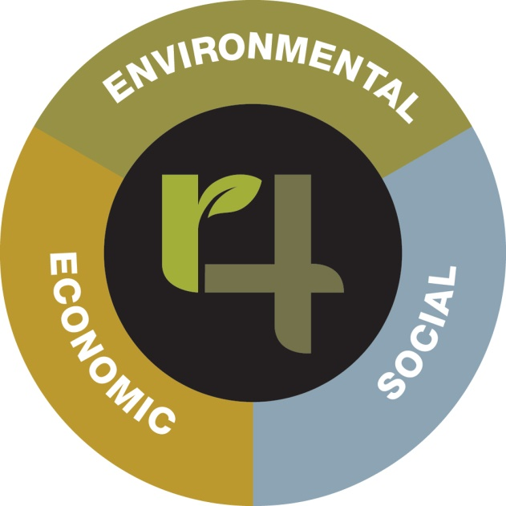
Sustainability Goals
Economic
Improve farm profitability by improving return on fertilizer dollars
Make the most of dollars spent on fertilizer
Contribute to improve regional economic development
Social
Improve access to sources of information to assist in farm management decision making
Improve productivity of farm labour by appropriate use of emerging technology that increase efficiencies of field operations and reduce costs per unit of crop harvested
Environmental
Prevent nutrient loss from cropping system
Improve recycling of crop nutrient from crop residues and livestock manures
Towards Implementing 4R Nutrient Stewardship Practices on YOUR Farm
Notes:
So what are appropriate goals for a 4R Plan? Some examples are shown.
Economic Goals could be things such as:
To improve farm profitability by improving return on fertilizer dollars
Make the most of dollars spent on fertilizer
Contribute to improved regional economic development
Social Goals could be things such as:
Improve access to sources of information to assist in farm management decision making
Improve productivity of farm labour by appropriate use of emerging technologies that increase efficiencies of field operations and reduce costs per unit of crop harvested
Environmental Goals could by things such as:
Prevent nutrient loss from cropping system
Improve recycling of crop nutrients from crop residues and livestock manures
The point is that goals, while they are the big picture part of 4R, need to be relevant to your farming operation and to the need of you and your family. They also need to be relevant to other stakeholders in the local and global community. So who are these other stakeholders? They are your neighbors, the people you do business with, governments at all levels, the companies that use farm products to make other products and at the other end of the food chain the people who sit down at the supper table.
Finally, goals need to be something that better nutrient management of the cropping system can influence.
To start with it’s a good idea to keep your goal list relatively short. It’s important to make real progress on one or two important goals in each of the three areas rather than set a bunch of goals that are hard to meet or hard to measure.

Slide 8
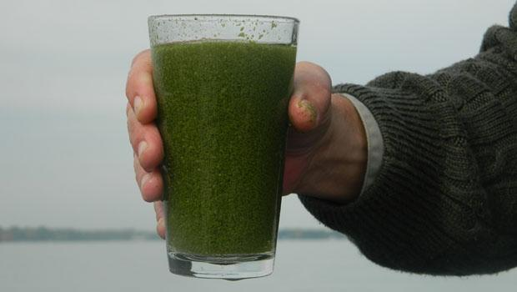
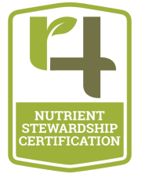
Notes:
Many of you have probably seen this picture before. I’m told this is a glass of water from lake Erie. I’ve heard some colleagues joke that it looks like a new kind of health smoothie – but unfortunately, this is a glass of water taken from the lake that is contaminated with algal blooms.
So, this not a new or small problem, and although the agricultural sector is not solely responsible for the growing algal blooms- it is a contributing factor. Therefore, The Ontario agriculture industry is committed to working towards the long term improvement of the Great Lakes water quality and the growing algal blooms in Lake Erie. By supporting the need to protect and restore the ecological health of the Great Lakes, we are committed to being a part of the solution to ensuring the Great Lakes remain “drinkable, swimmable and fishable.” The industry recognizes the importance of environmental stewardship and its role in ensuring the proper use of fertilizer. Ontario has been a leader in encouraging farmers to use nutrient management planning in crop production.

Slide 9
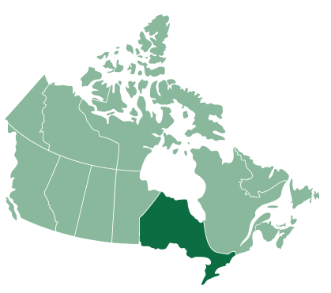
4R Nutrient Stewardship in Ontario
Notes:
Ontario represents a large portion of Canada’s most viable and productive farmland. Ontario has been a leader in nutrient management planning for crop production. The province has embraced 4R Nutrient Stewardship as a valuable tool for meeting the province’s agricultural and environmental goals. 4R Nutrient Stewardship is a recognized part of the Ontario Government’s strategy to reduce nutrient losses from Ontario farmland. Specifically, the 4R Nutrient Stewardship is referenced in the draft Canada-Ontario Action Plan for partnering on achieving P loading reductions in Lake Erie
4R Nutrient Stewardship offers Ontario ag-retailers a strategic opportunity to provide leadership to Ontario’s farm community as they move toward meeting provincial objectives to improve the water quality of the Great Lakes and contributing watersheds, while increasing agricultural productivity. Findings suggest that 4R stewardship can offer significant benefits as compared to traditional practices. The adoption of 4R nutrient stewardship will continue to ensure the effective protection and conservation Ontario’s agricultural soils, water quality, and ecosystem health as they relate to nutrients. Because every farm is different, the implementation of 4R Nutrient Stewardship practices is fully adaptable to the diversity of Ontario agriculture.
As one of the major initiatives under this MOU agreement, we have proactively collaborated to develop a voluntary retailer certification program that will accelerate the on-farm adoption of 4R Nutrient Stewardship as a best practice for responsible nutrient application and management. The 4R Ontario Steering

Slide 10
Goals of the 4R Certification Program in Ontario
Optimize crop uptake of nutrients and minimize nutrient losses
Create long-term positive impacts on water bodies associated with agricultural production areas
Encourage sharing of the most up-to-date information
Help the agricultural sector adapt to new research and technology
Notes:
The goals of the 4R Certification Program pertains to the Ontario MOU Agreement and aims to address concerns surrounding the Great Lakes water quality by creating long-term improvement on water bodies associated with agricultural production areas. The goals of the program are as follows;
optimize crop uptake of nutrients and minimize nutrient losses;
create long-term positive impacts on water bodies associated with agricultural production areas, including the reduction of eutrophication and incidence of harmful algal blooms, and helping to meet water quality standards;
encourage sharing of the most up-to-date information about responsible nutrient stewardship with Nutrient Service Providers and growers; and other interested groups
help the agricultural sector adapt to new research and technology in the area of nutrient stewardship

Slide 11
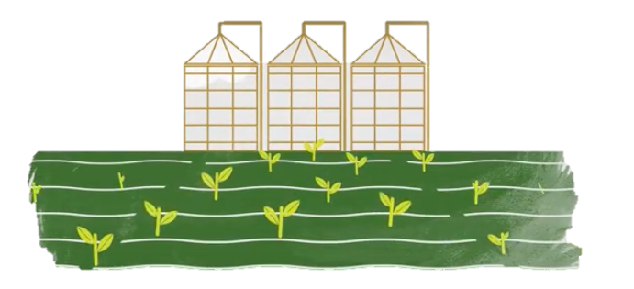
Benefits to the Agri-retailers and CCAs
By helping growers complete a 4R plan to get their acres counted, a retailer is getting the first and best opportunity to fully understand their fertility requirements
4R is based on current, region-specific nutrient best management practices
Becoming 4R Certified allows Ontario retail locations to use the 4R sustainability certification and communicate to farmers and external stakeholders that they are becoming part of the solution
Staff earn CCA credits for training
It’s the right thing to do at the right time
Notes:
When a farmer comes into a location to get assistance in completing and implementing their 4R plan, it’s an amazing sales opportunity. Working with the farmer on completing the plan is a chance for more than just completing a sale, but an opportunity to fully understand and see the whole scope of their fertility requirements, and can work with the grower to implement strategies that will make the best use of nutrients on the farm. It is important to recognize that 4R is based on region-specific best management practices, and that the 4R Ontario Steering Committee will continuously work with the technical committee to identify and implement improvements.
Ag retail staff can also earn CCA credits for training and your agronomic team will naturally be inclined to support a plan like this one that is fundamentally based in the latest scientific best practices.
4R is the right thing to do. We know the industry is headed this way, and getting ahead of it now let’s us be leaders and make a positive contribution to the environment.
Finally, 4R Ontario is also going to give our 4R certified retail partners the opportunity to display and co-brand 4R marketing materials so you can communicate to farmers that you’re supportive of getting their acres in to count and help us show how Ontario farmers are leading the way in nutrient stewardship.

Slide 12
The RIGHT TIME for NUTRIENT STEWARDSHIP is RIGHT NOW.
Q&A

