Slide 1
^{FERTILIZER USE}
^{Western Canada}
^{CDN 2023}

Slide 2

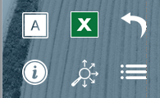
Navigation
Canola
Spring Wheat
General Fertilizer Practices
Fertilizer Timing
Fertilizer Timing
Sources of Fertilizer Advice
Fertilizer Source
Fertilizer Source
Frequency of Soil Testing Nitrogen
Fertilizer Placement
Fertilizer Placement
Reasons for Not Soil Testing for N Every Year
Nitrogen Rates
Nitrogen Rates
Frequency of Soil Testing P, K and S
Phosphorus Rates
Phosphorus Rates
Frequency of Soil Testing - Micronutrients
Potassium Rates
Potassium Rates
Frequency of Soil Testing - Electrical Conductivity
Sulphur Rates
Sulphur Rates
Frequency of Soil Testing - Organic Matter
Fertilizer Program
Fertilizer Program
Frequency of Soil Testing - pH
Use of Variable Rates by Fertilizer Type
Use of Variable Rates by Fertilizer Type
Familiarity with 4R Concept
Consistency with 4R Practices
Consistency with 4R Practices
Growers Who Believe They Comply With 4R
Reasons for Not Meeting Consistency Criteria
Reasons for Not Meeting Consistency Criteria
Growers Who Work With a 4R Agronomist/Mgmt Specialty CCA
Nitrogen Fixing Crop in Previous Year
Nitrogen Fixing Crop in Previous Year
Growers Who Have A 4R Plan In Place
Rates Set By Field
Rates Set By Field
Benefits Of Having A 4R Plan In Place
Approaches Used To Decide Rate
Approaches Used To Decide Fertilizer Rate
Reasons For Not Putting A 4R Plan In Place
Main Person Who Determined Rate
Main Person Who Determined Rate
Reasons Some Farmers Do Not Adopt 4R Practices
Rate Decisions on 4R Consistency Compliance
Rate Decisions on 4R Consistency Compliance
Fee to Prepare 4R Plan
Professional Designation
Professional Designation
Sources of Fertilizer Information
Importance of Professional Designation
Importance of Professional Designation
Programs Used to Measure Environmental Footprint
Deviation from Recommended Rate
Deviation from Recommended Rate
Reasons for Increasing Rate
Reasons for Increasing Rate
Demographics
Reasons for Decreasing Rate
Reasons for Decreasing Rate
Geographic Distribution
Use of Nitrogen Stabilizers
Use of Nitrogen Stabilizers
Farm Size and Crop Acre Categories
Use of EEFs by Timing
Use of EEFs by Timing
Demographics
Target Yield vs. Actual Yield
Target Yield vs. Actual Yield
Study Methodology & Sample
Nitrogen Use Efficiency
Nitrogen Use Efficiency
Factors Considered When Setting Target Yield
Factors Considered When Setting Target Yield
Key Findings
Use of Micro/Secondary Nutrients
Use of Micro/Secondary Nutrients
Canola Summary
Custom Application by Timing
Custom Application by Timing
Spring Wheat Summary
Tillage Practices
Tillage Practices
4R Nutrient Stewardship
Seeding Details
Seeding Details
Use of Biostimulants
Use of Biostimulants
Use of Nitrogen Fixing Biostimulants
Use of Nitrogen Fixing Biostimulants
In SLIDESHOW VIEW, click on any title or button on the above slide to navigate to the section.
Use the icons in the side-bar of each slide for convenient navigation and quick access to more information:
DETAILED DATA
Escape from Slideshow View to NORMAL VIEW; then click to open a worksheet with detailed data.
ATTRIBUTES
Click to see the full attribute statement behind abbreviations used in charts.
BACK TO LIST
Click to return to the list of several similar charts.
INFORMATION
Click for a pop-up that explains the slide. Click again to hide.
SECTION NAVIGATION
Click to return to the navigation slide for the section you are in.
NAVIGATION
Click to return to this study navigation slide.

Slide 3
Canola in Western Canada - Summary
NITROGEN
Primary Nitrogen fertilizers were applied on 113% of canola acres (multiple applications on some acres). 
Urea represents 52% of total Nitrogen volume, edging higher in 2023; use of anhydrous ammonia declined in 2023. 
75% of Nitrogen volumes were applied at planting; no significant changes in application timing for nitrogen. 
At planting, 36% of Nitrogen volume was side banded and 30% mid-row banded. 
Average rate = 114 lbs./ac; up in 2023.  Rates both before and at planting edged higher in 2023. 
Primary Phosphorus fertilizers were applied on 100% of canola acres. 
MAP represents 70% of total Phosphorus volume (an increase); MicroEssentials accounted for another 14%; use of DAP increased. 
91% of Phosphorus volumes were applied at planting; fairly consistent over time. 
34% of P₂O₅ volumes were seed placed, 39% side-banded and 17% mid-row banded. 
Average rate = 35 lbs./ac.  About 9% of canola acres were not treated with P₂O₅. 
Potassium fertilizers were applied on 38% of canola acres. 
Dry potash represents 81% of total volume; a decrease compared to 2022. 
85% of K₂O volumes were applied at planting; consistent with volumes applied in 2022. 
42% of K₂O volumes were side-banded, 18% seed placed, and 22% mid-row banded. 
Average rate = 8 lbs./ac, similar to 2022.  63% of canola acres were not treated with any K₂O. 
Primary Sulphur fertilizers were applied on 70% of canola acres. 
Ammonium sulphate was stable at 33% of total Sulphur volume; Use of MicroEssentials edged higher in 2023. 
67% of S volumes were applied at planting; a decrease in 2023, applications in the spring before planting continue to trend lower. 
16% of Sulphur volumes were seed placed, 25% side-banded and 17% mid-row banded. 
Average rate = 19 lbs./ac; similar to rates in 2022.  Just 18% of canola acres were not treated with any Sulphur. 
Source:
Timing:
Placement:
Rate:
PHOSPHORUS
Canola Summary 
Source:
Timing:
Placement:
Rate:
POTASSIUM
Source:
Timing:
Placement:
Rate:
SULPHUR
Source:
Timing:
Placement:
Rate:

Slide 4
Spring Wheat in Western Canada - Summary
NITROGEN
Primary Nitrogen fertilizers were applied on 113% of spring wheat acres (multiple applications on some acres). 
Urea represents 55% of total Nitrogen volume, similar to 2022; use of anhydrous ammonia appears to be trending lower. 
74% of Nitrogen volumes were applied at planting (a decline); applications in the fall and before planting both increased in 2023. 
At planting, 35% of Nitrogen volume was mid-row banded and 30% side banded. 
Average rate = 99 lbs./ac; an increase compared to 2022.  In the spring before planting the average Nitrogen rate was 100 lbs./ac. 
Primary Phosphorus fertilizers were applied on 91% of spring wheat acres. 
MAP represents 78% of total Phosphorus volume an increase in 2023; use of liquid ammonium polyphosphate also increased. 
90% of Phosphorus volumes were applied at planting; similar to volumes applied in 2022. 
50% of P₂O₅ volumes were seed placed, 28% side-banded and 14% mid-row banded. 
Average rate = 30 lbs./ac; stable in 2023.  About 13% of spring wheat acres were not treated with P₂O₅. 
Potassium fertilizers were applied on 38% of spring wheat acres. 
Dry potash represents 87% of total volume; similar to volumes in 2022. 
91% of K₂O volumes were applied at planting; similar volumes applied at all other timings. 
26% of K₂O volumes were side-banded, 27% mid-row banded, and 34% seed placed. 
Average rate = 6.5 lbs./ac; slightly lower in 2023.  61% of spring wheat acres were not treated with any K₂O. 
Primary Sulphur fertilizers were applied on 29% of spring wheat acres. 
Ammonium sulphate represents 26% of total volume; MicroEssentials, ammonium thiosulphate and Super S all increased in 2023. 
86% of Sulphur volumes were applied at planting, edging slightly lower compared to 2022. 
23% of Sulphur volumes were side banded, 44% seed placed and 20% mid-row banded. 
Average rate = 5.3 lbs./ac; a slight decrease compared to 2022.  60% of spring wheat acres were not treated with any Sulphur. 
Source:
Timing:
Placement:
Rate:
PHOSPHORUS
Spring Wheat Summary 
Source:
Timing:
Placement:
Rate:
POTASSIUM
Source:
Timing:
Placement:
Rate:
SULPHUR
Source:
Timing:
Placement:
Rate:

Slide 5
4R Nutrient Stewardship - Summary
NITROGEN
The number of farmers with a 4R plan in places continues to grow; those who say their practices meet 4R continues to trend higher.
No significant changes to 4R knowledge in Western Canada in 2023. 
4R concept familiarity is higher among larger farmers and young growers; uniform across geography. 
More large farms, young farmers and farmers in Manitoba believe that their fertilizer practices comply with 4R stewardship. 
The number of farmers who said their practices meet 4R requirements continues to trend higher. 
The number of farmers who work with a Designated Agronomist also continues to trend higher. 
More large farms work with a 4R Designated Agronomist. 
The % of farmers with a 4R Plan increased in 2023 and the % without a 4R plan decreased. 
A higher percentage of large farms have a 4R Plan in place; slightly fewer older growers have a plan in place. 
Those with a 4R Plan say there are multiple benefits led by knowing you are using best environmental stewardship practices. 
Those without a 4R Plan say there are many reasons; Lack of proven benefits and lack of incentive are the top 2 factors. 
Those who do not think they comply with 4R say that lack of equipment and cost are the main reasons. 
Ag retailers and Certified Crop Advisors are the main sources of information about 4R. 
4R NUTRIENT STEWARDSHIP
PHOSPHORUS
4R Summary 
POTASSIUM
SULPHUR

Slide 6
Canola
Canola
Fertilizer Timing
Fertilizer Source
Fertilizer Placement
Nitrogen Rates
Phosphorus Rates
Potassium Rates
Sulphur Rates
Fertilizer Program
Answering Key Questions:
What are the most common application timings for each nutrient and fertilizer type?
What nutrients and fertilizer types are being used?
What are the most common placements for each nutrient and fertilizer type?
What rates are being applied?
To what extent do farmers vary their fertilizer program from field to field?
To what extent are farmers incorporating nitrogen fixing crops into their rotation?
How do farmers decide what fertilizer rate to apply?
How extensively are nitrogen stabilized products being used?
How do actual yields compare to target yields?
How many growers are applying micro or secondary nutrients?
How do fertilizer practices compare on owned versus rented land?
How did weather conditions impact fertilizer practices?
What tillage practices were used?
To what extent were biostimulants used?
Use of Variable Rates by Fertilizer Type
Consistency with 4R Practices
Reasons for Not Meeting Consistency Criteria
Nitrogen Fixing Crop in Previous Year
Rates Set By Field
Approaches Used To Decide Rate
Main Person Who Determined Rate
Rate Decisions on 4R Consistency Compliance
Professional Designation
Importance of Professional Designation
Deviation from Recommended Rate
Reasons for Increasing Rate
Reasons for Decreasing Rate
Use of Nitrogen Stabilizers
Use of EEFs by Timing
Target Yield vs. Actual Yield
Nitrogen Use Efficiency
Factors Considered When Setting Target Yield
Use of Micro/Secondary Nutrients
Custom Application by Timing
Tillage Practices
Seeding Details
Use of Biostimulants
Use of Nitrogen Fixing Biostimulants
In SLIDESHOW VIEW, click on any title or button on the above slide to navigate to the section.
Use the icons in the side-bar of each slide for convenient navigation and quick access to more information:
DETAILED DATA
Escape from Slideshow View to NORMAL VIEW; then click to open a worksheet with detailed data.
ATTRIBUTES
Click to see the full attribute statement behind abbreviations used in charts.
BACK TO LIST
Click to return to the list of several similar charts.
INFORMATION
Click for a pop-up that explains the slide. Click again to hide.
SECTION NAVIGATION
Click to return to the navigation slide for the section you are in.
NAVIGATION
Click to return to this study navigation slide.

Slide 7

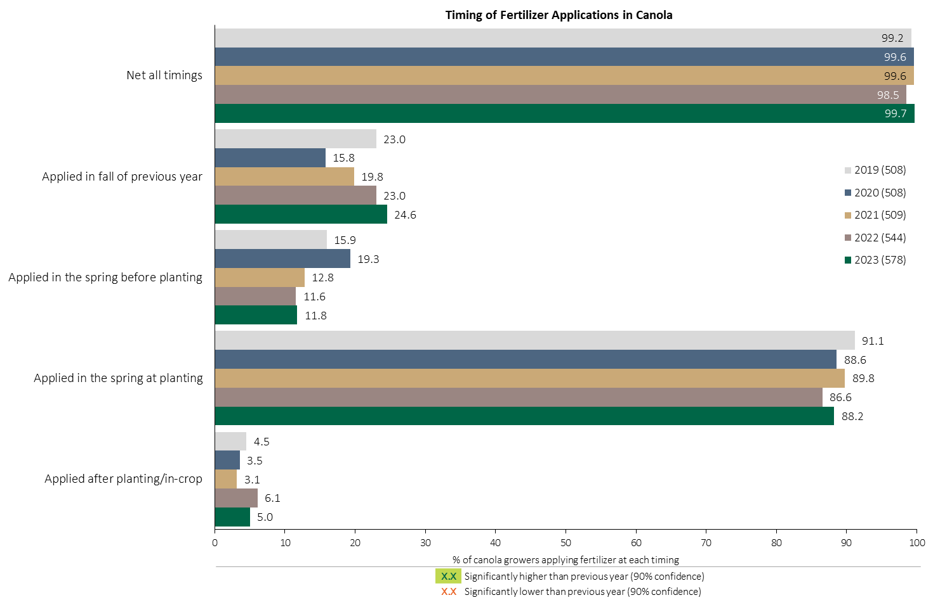

Fertilizer Applications in Canola - % Growers
Canola
Applications in the fall of the previous year continue to trend higher.
About 88% of canola growers apply fertilizer at planting.
Respondents were asked: “For your 2023 canola crop, did you apply fertilizer at each timing? – and given the options of a) Applied in fall of previous year, b) in the spring before planting, c) in the spring at planting and d) after planting/in-crop.
The chart illustrates the % of respondents who applied fertilizer at each timing.

Slide 8
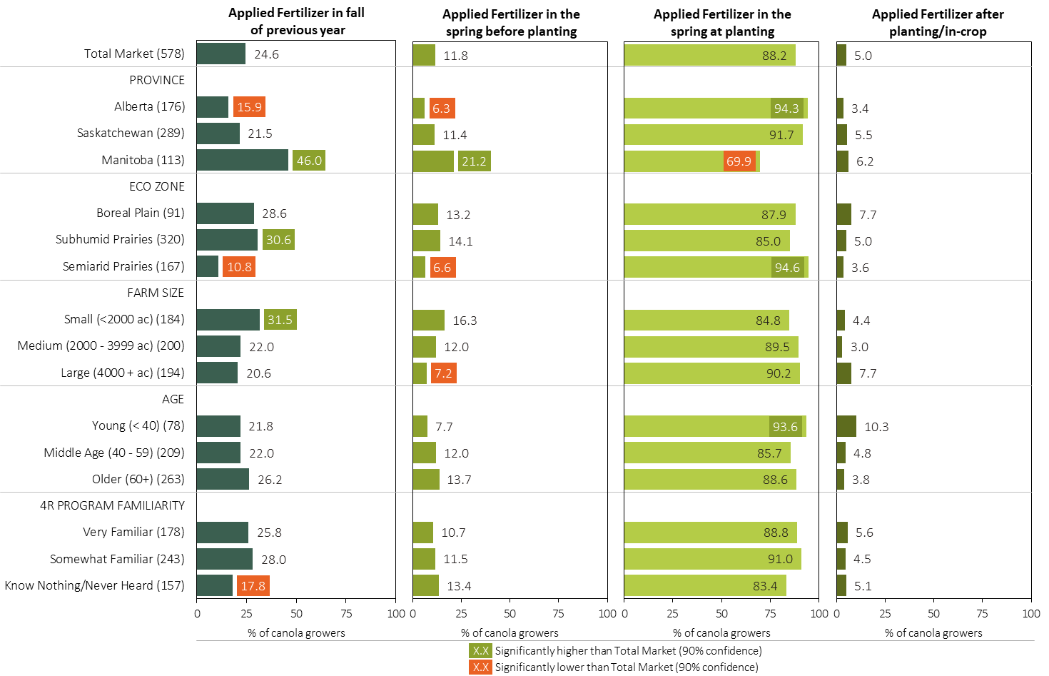
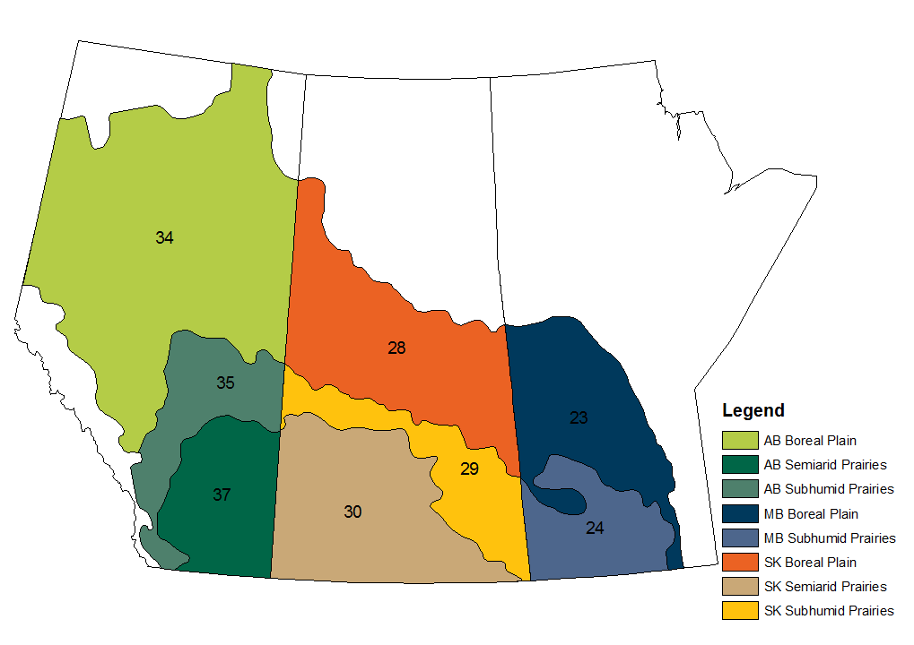
Fertilizer Applications in Canola - % Growers by Timing in 2023
Canola
Manitoba growers were more likely to apply fertilizer in the fall/spring before planting
MAP
Respondents were asked: “For your 2023 canola crop, did you apply fertilizer at each timing? – and given the options of a) Applied in fall of previous year, b) in the spring before planting, c) in the spring at planting and d) after planting/in-crop.
Separately by province, eco zone, farm size, age and 4R program familiarity, the charts illustrate the % of canola growers who applied fertilizer at each timing.

Slide 9
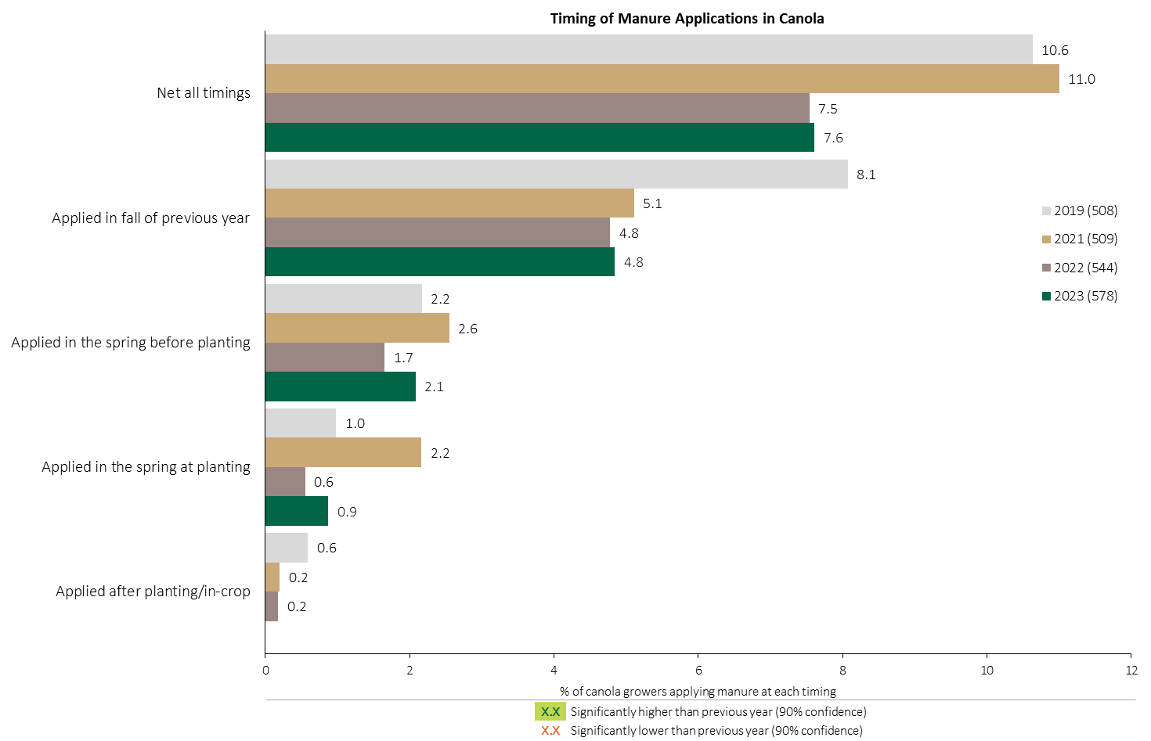
Manure Applications in Canola - % Growers
Consistent with 2022, about 8% of canola growers applied manure.
Canola
Respondents were asked: “For your 2023 canola crop, did you apply manure at each timing? – and given the options of a) Applied in fall of previous year, b) in the spring before planting, c) in the spring at planting and d) after planting/in-crop.
The chart illustrates the % of respondents who applied manure at each timing.

Slide 10
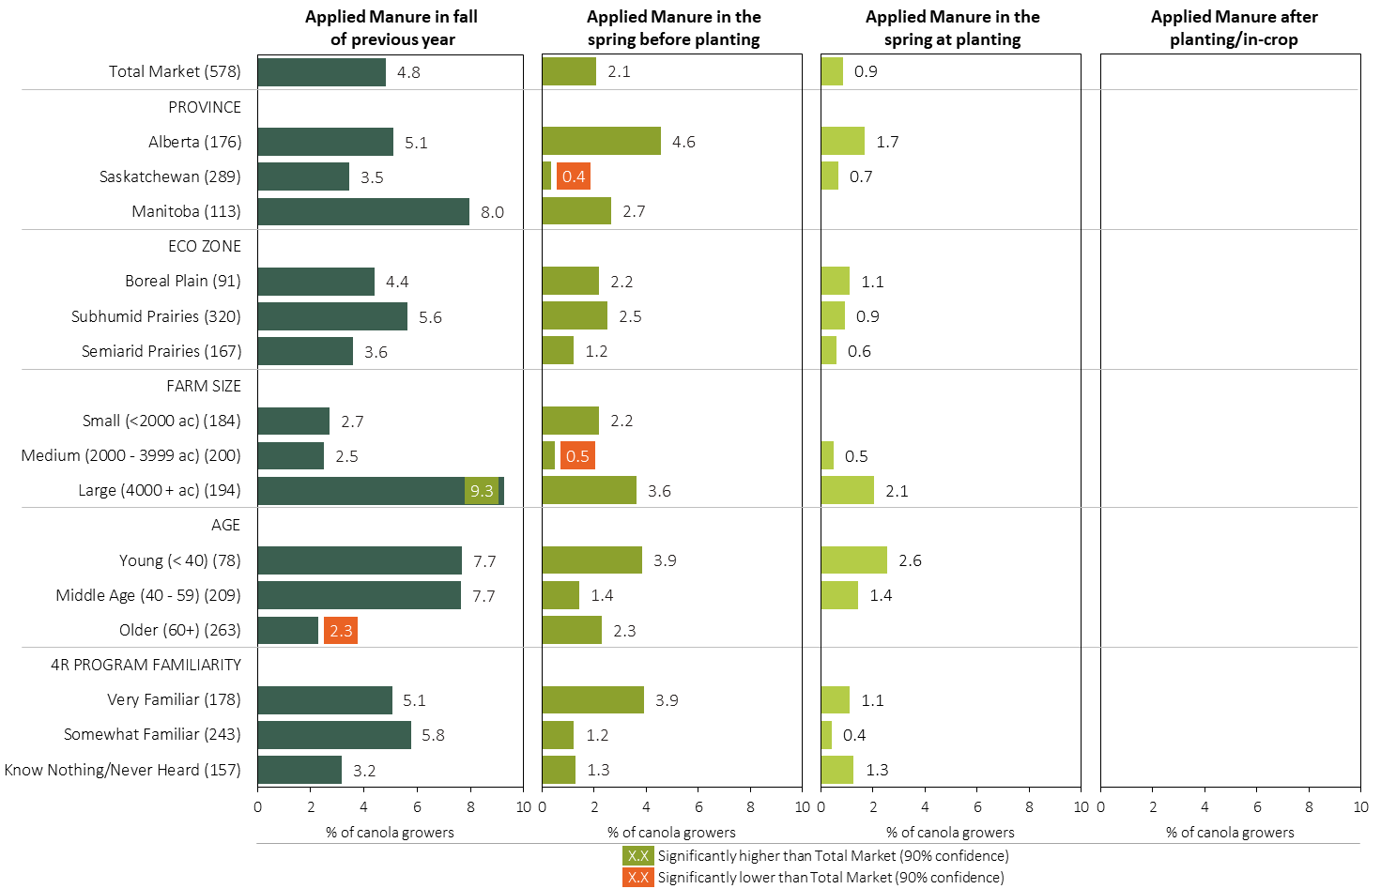
Manure Applications in Canola - % Growers by Timing in 2023
Canola
MAP
Respondents were asked: “For your 2023 canola crop, did you apply manure at each timing? – and given the options of a) Applied in fall of previous year, b) in the spring before planting, c) in the spring at planting and d) after planting/in-crop.
Separately by province, eco zone, farm size, age and 4R program familiarity, the charts illustrate the % of canola growers who applied manure at each timing.

Slide 11
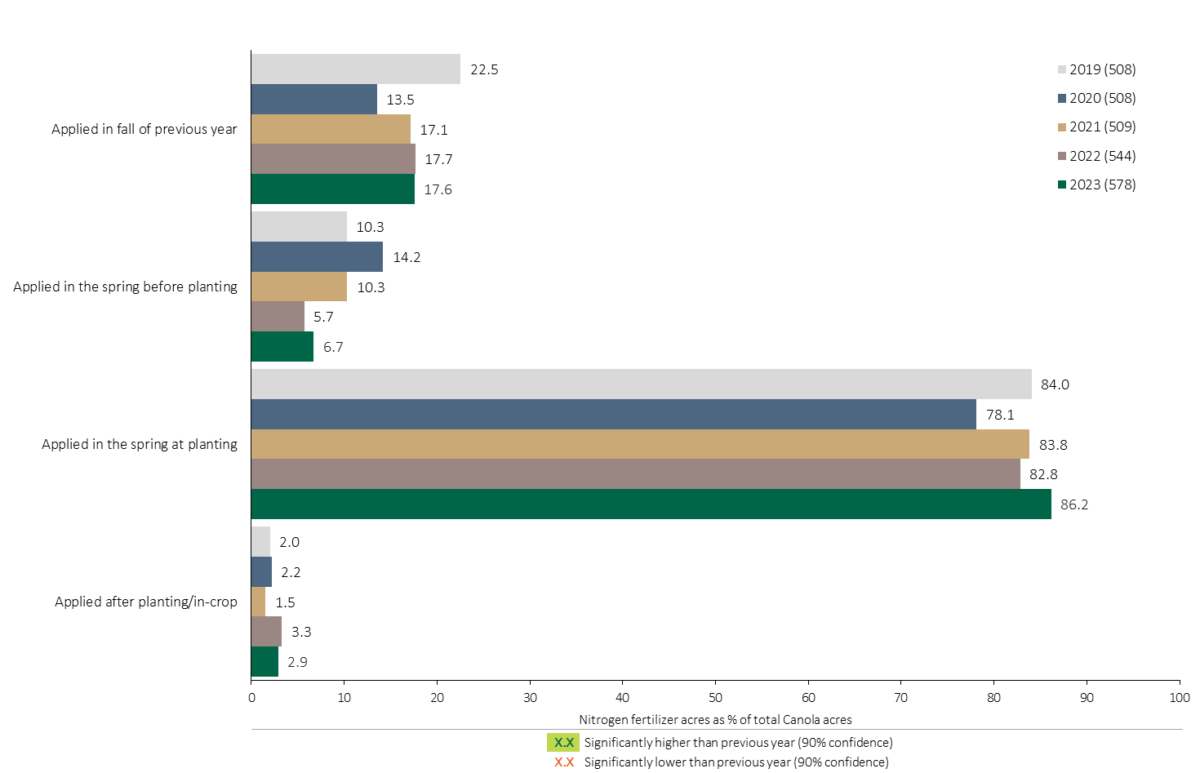

Nitrogen Timing in Canola - % Crop Acres
Canola
86% of canola acres were treated with a Nitrogen fertilizer at planting in 2023.
Note: Nitrogen only includes those fertilizer types where nitrogen is the primary component.
For each application timing, respondents were asked: “Of your [xxx] acres of canola, how many acres of each fertilizer type did you apply?”
The chart illustrates the % of total canola acres that were treated with a primary Nitrogen fertilizer at each timing in each year. A list of Primary Nitrogen fertilizers can be accessed by clicking on the “A” button. Significant changes from 2022 to 2023 are highlighted.

Slide 12
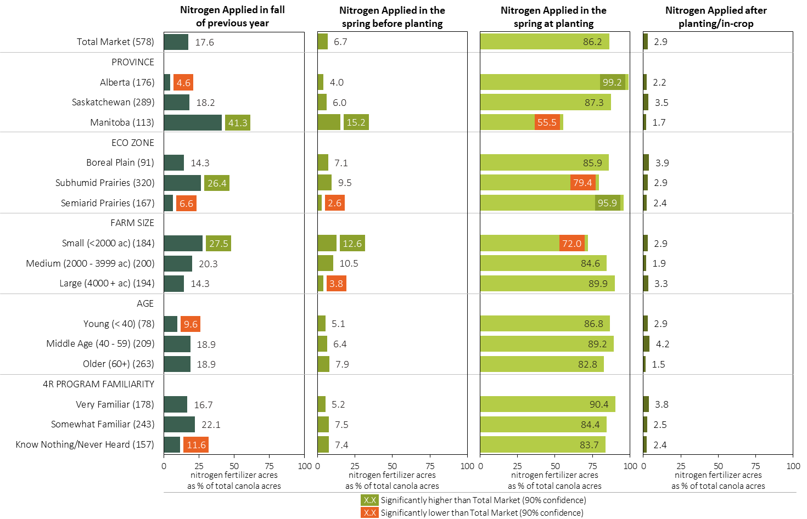
Nitrogen Timing in Canola in 2023 (% of Crop Acres)
Canola
MAP
Note: Nitrogen only includes those fertilizer types where nitrogen is the primary component.
For each application timing, respondents were asked: “Of your [xxx] acres of canola, how many acres of each fertilizer type did you apply?”
Separately for each timing, the charts illustrate the % of total canola acres that was treated with a primary nitrogen fertilizer by province, eco zone, farm size, age and 4R program familiarity.
Nitrogen only includes those fertilizer types where nitrogen is the primary component. A list can be accessed by clicking on the “A” button.

Slide 13
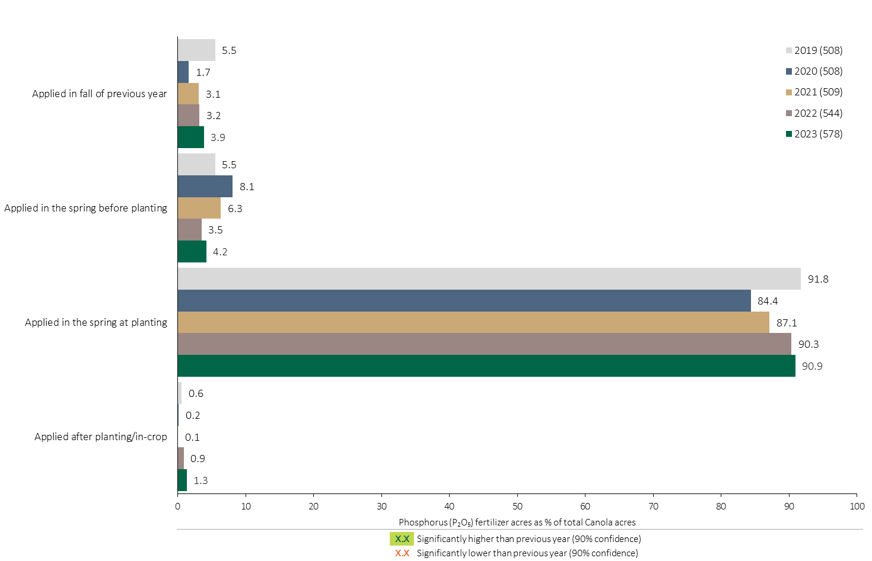
Phosphorus (P₂O₅) Timing in Canola - % Crop Acres
Canola
91% of total canola acres were treated with Phosphorous at planting.
Note: Phosphorus only includes those fertilizer types where phosphorus is the primary component.
For each application timing, respondents were asked: “Of your [xxx] acres of canola, how many acres of each fertilizer type did you apply?”
The chart illustrates the % of total canola acres that were treated with a primary Phosphorus fertilizer at each timing in each year. A list of Primary Phosphorus fertilizers can be accessed by clicking on the “A” button. Significant changes from 2022 to 2023 are highlighted.

Slide 14
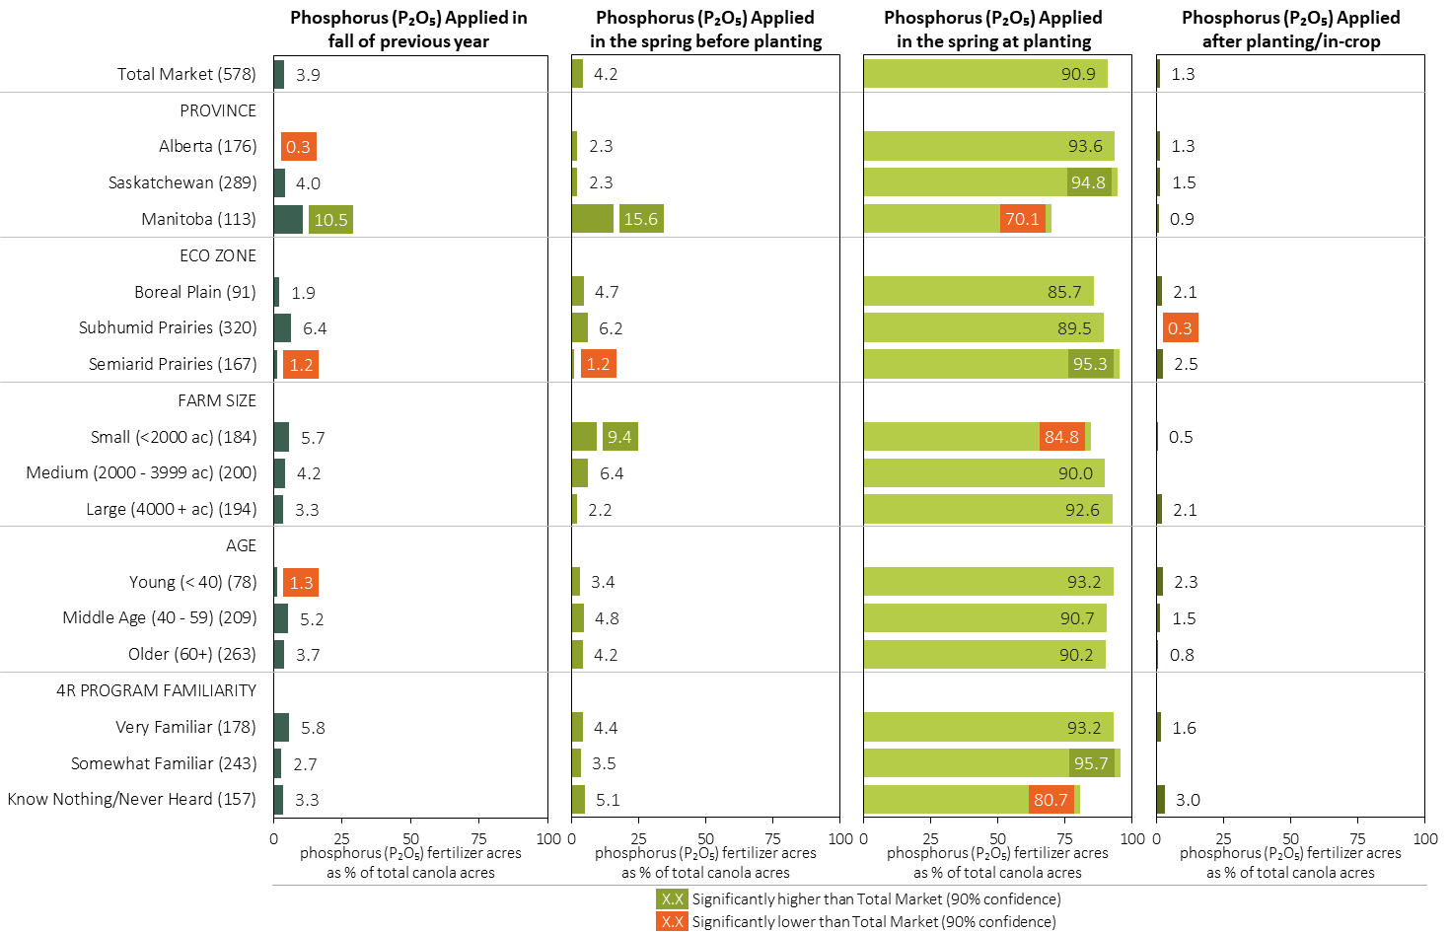
Phosphorus (P₂O₅) Timing in Canola in 2023 (% of Crop Acres)
Canola
MAP
Note: Phosphorus only includes those fertilizer types where phosphorus is the primary component.
For each application timing, respondents were asked: “Of your [xxx] acres of canola, how many acres of each fertilizer type did you apply?”
Separately for each timing, the charts illustrate the % of total canola acres that was treated with a primary phosphorus fertilizer by province, eco zone, farm size, age and 4R program familiarity.
Phosphorus only includes those fertilizer types where phosphorus is the primary component. A list can be accessed by clicking on the “A” button.

Slide 15
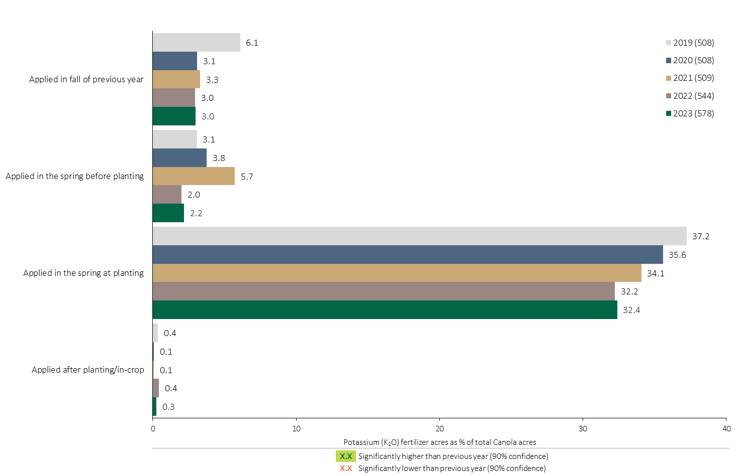
Potassium (K₂O) Timing in Canola - % Crop Acres
Canola
The % of canola acres treated with a Potassium fertilizer at planting stabilized in 2023.
Note: Potassium only includes those fertilizer types where potassium is the primary component.
For each application timing, respondents were asked: “Of your [xxx] acres of canola, how many acres of each fertilizer type did you apply?”
The chart illustrates the % of total canola acres that were treated with a primary Potassium fertilizer at each timing in each year. A list of Primary Potassium fertilizers can be accessed by clicking on the “A” button. Significant changes from 2022 to 2023 are highlighted.

Slide 16
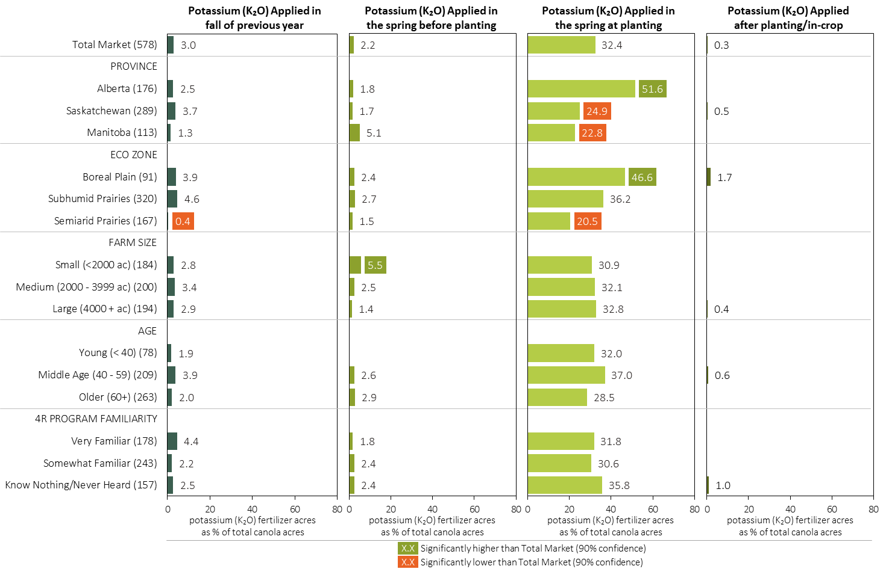
Potassium (K₂O) Timing in Canola in 2023 (% of Crop Acres)
Canola
MAP
Note: Potassium only includes those fertilizer types where potassium is the primary component.
For each application timing, respondents were asked: “Of your [xxx] acres of canola, how many acres of each fertilizer type did you apply?”
Separately for each timing, the charts illustrate the % of total canola acres that was treated with a primary potassium fertilizer by province, eco zone, farm size, age and 4R program familiarity.
Potassium only includes those fertilizer types where potassium is the primary component. A list can be accessed by clicking on the “A” button.

Slide 17
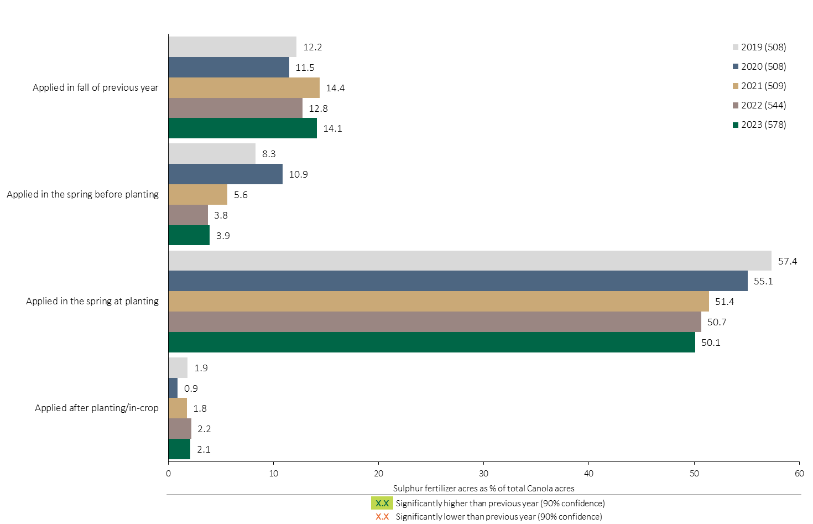
Sulphur Timing in Canola - % Crop Acres
Canola
The % of canola acres treated with a Sulphur fertilizer at planting continues to trend lower.
Note: Sulphur only includes those fertilizer types where sulphur is the primary component.
For each application timing, respondents were asked: “Of your [xxx] acres of canola, how many acres of each fertilizer type did you apply?”
The chart illustrates the % of total canola acres that were treated with a primary Sulphur fertilizer at each timing in each year. A list of Primary Sulphur fertilizers can be accessed by clicking on the “A” button. Significant changes from 2022 to 2023 are highlighted.

Slide 18
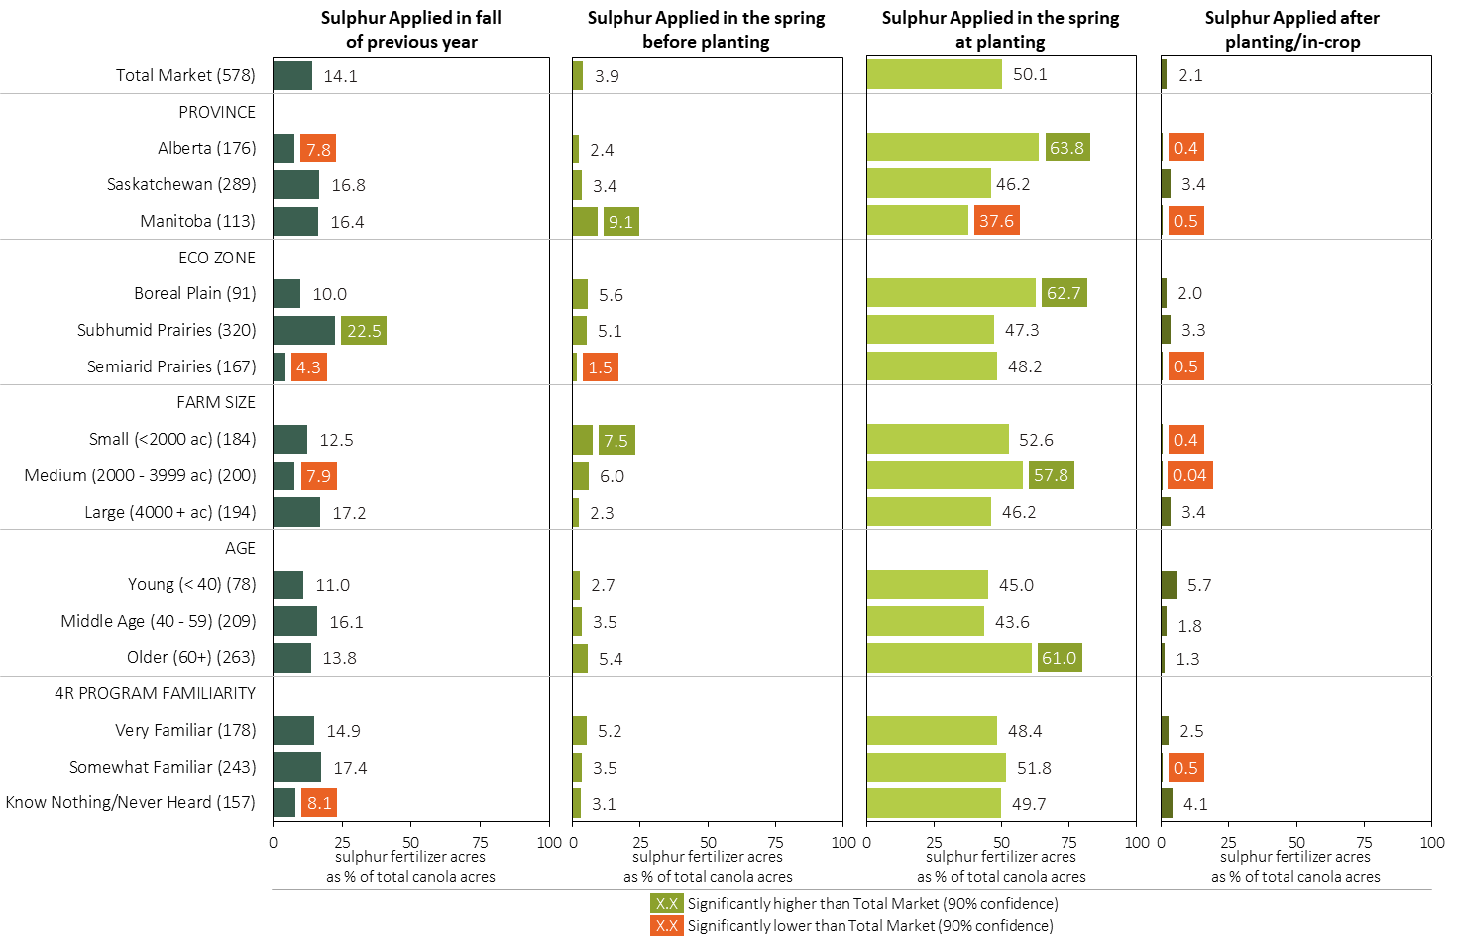
Sulphur Timing in Canola in 2023 (% of Crop Acres)
Canola
MAP
Note: Sulphur only includes those fertilizer types where sulphur is the primary component.
For each application timing, respondents were asked: “Of your [xxx] acres of canola, how many acres of each fertilizer type did you apply?”
Separately for each timing, the charts illustrate the % of total canola acres that was treated with a primary sulphur fertilizer by province, eco zone, farm size, age and 4R program familiarity.
Sulphur only includes those fertilizer types where sulphur is the primary component. A list can be accessed by clicking on the “A” button.

Slide 19
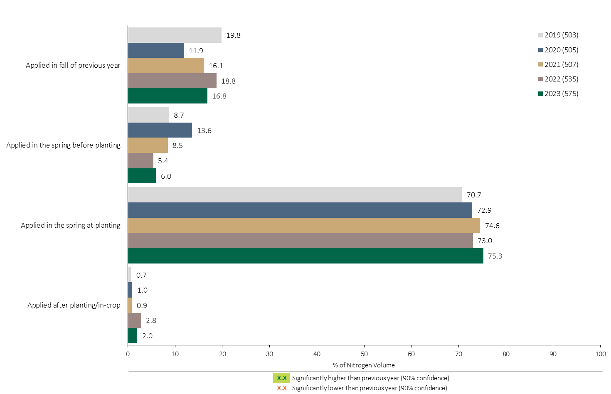
Nitrogen Timing in Canola - % of Volume
Canola
Canola Summary 
75% of total Nitrogen volume in canola was applied at planting.
Note: Nitrogen volume was calculated from all sources of nitrogen contained in all fertilizer types
For each fertilizer type used in either a custom blend or applied as an unblended product, respondents were asked: a) how many acres they applied, and b) the application rate in pounds of actual nutrient/ac. Volumes of each nutrient were calculated by multiplying acres treated times the application rate.
The graph illustrates the % of total Nitrogen volume applied in canola that was applied at each timing in each year.
Total pounds of actual Nitrogen applied was calculated based on all sources of Nitrogen from all fertilizer types.

Slide 20
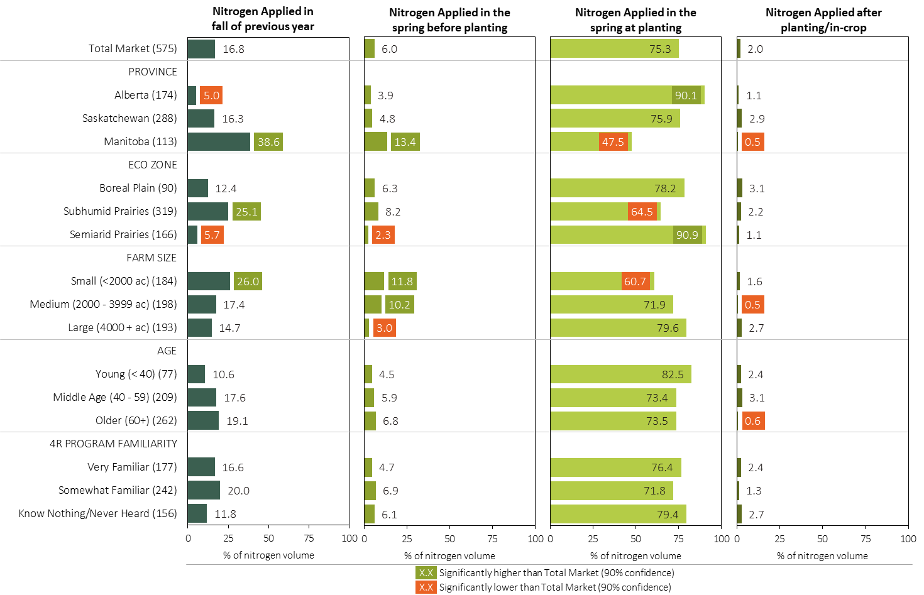
Nitrogen Timing in Canola in 2023 (% of Volume)
Canola
MAP
Note: Nitrogen volume was calculated from all sources of nitrogen contained in all fertilizer types
For each fertilizer type used in either a custom blend or applied as an unblended product, respondents were asked: a) how many acres they applied, and b) the application rate in pounds of actual nutrient/ac. Volumes of each nutrient were calculated by multiplying acres treated times the application rate.
Separately for each timing, the charts illustrate the % of total nitrogen volume that was applied by province, eco zone, farm size, age and 4R program familiarity.
Total pounds of actual nitrogen applied was calculated based on all sources of nitrogen from all fertilizer types.

Slide 21
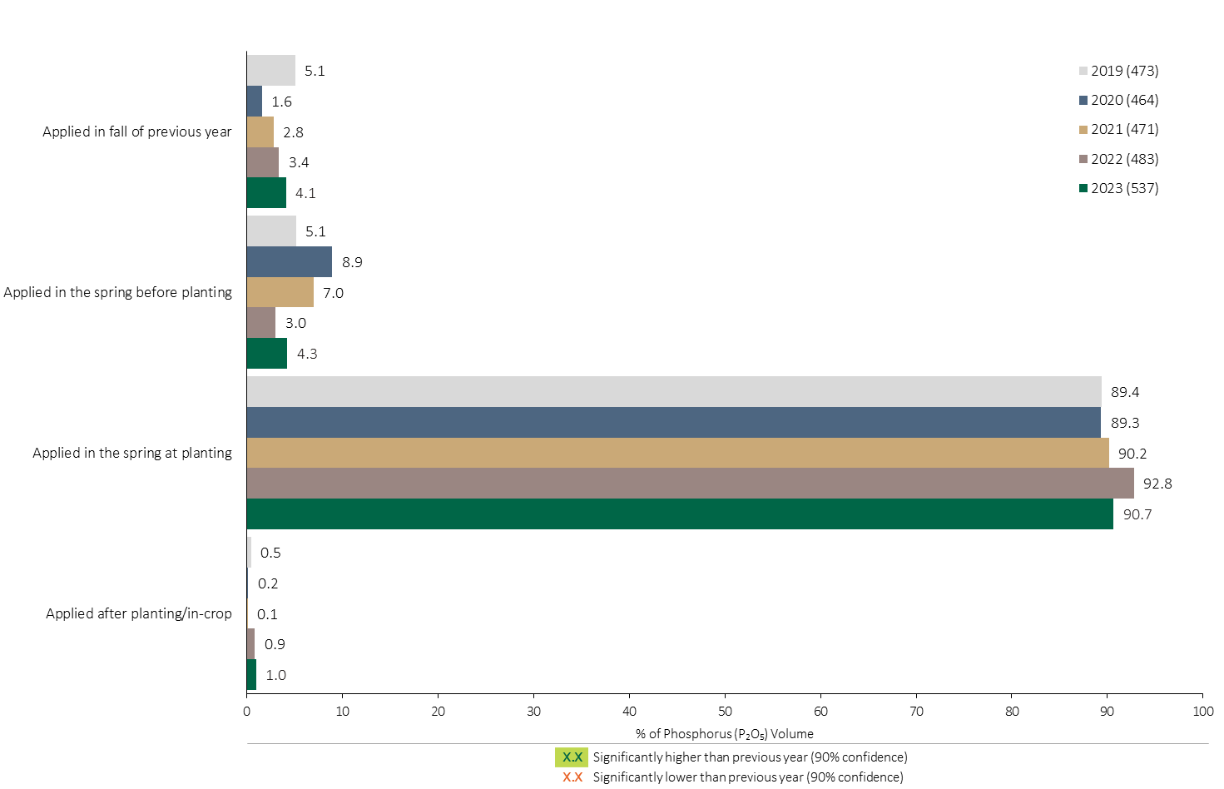
Phosphorus (P₂O₅) Timing in Canola - % of Volume
Canola
Canola Summary 
91% of total Phosphorus (P₂O₅) applied in canola was applied at planting.
Note: Phosphorus (P₂O₅) volume was calculated from all sources of phosphorus contained in all fertilizer types
For each fertilizer type used in either a custom blend or applied as an unblended product, respondents were asked: a) how many acres they applied, and b) the application rate in pounds of actual nutrient/ac. Volumes of each nutrient were calculated by multiplying acres treated times the application rate.
The graph illustrates the % of total Phosphorus (P₂O₅) volume applied in canola that was applied at each timing in each year.
Total pounds of actual Phosphorus (P₂O₅) applied was calculated based on all sources of Phosphorus (P₂O₅) from all fertilizer types.

Slide 22
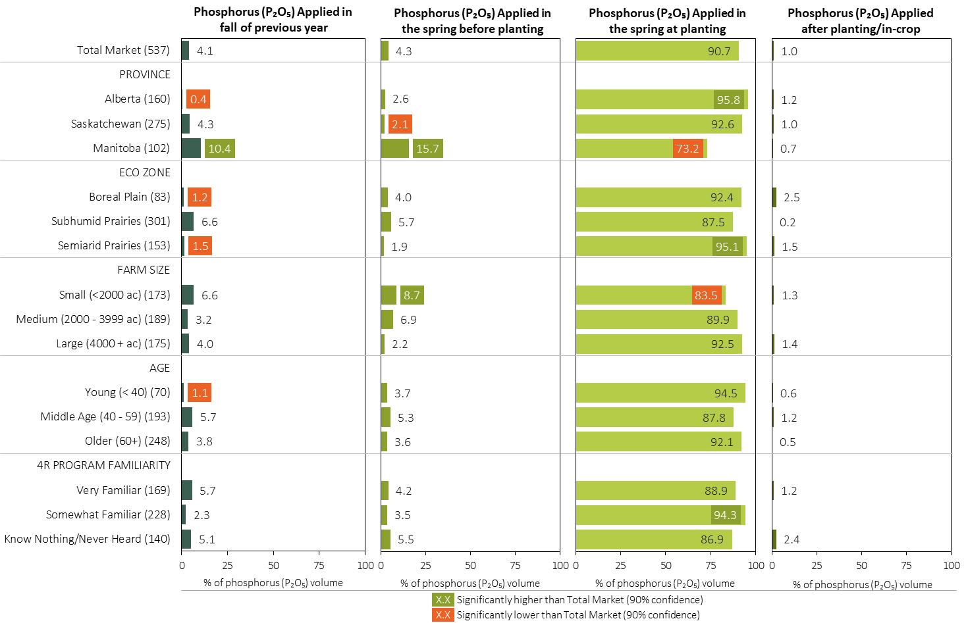
Phosphorus (P₂O₅) Timing in Canola in 2023 (% of Volume)
Canola
MAP
Note: Phosphorus (P₂O₅) volume was calculated from all sources of phosphorus contained in all fertilizer types
For each fertilizer type used in either a custom blend or applied as an unblended product, respondents were asked: a) how many acres they applied, and b) the application rate in pounds of actual nutrient/ac. Volumes of each nutrient were calculated by multiplying acres treated times the application rate.
Separately for each timing, the charts illustrate the % of total Phosphorus (P₂O₅) volume that was applied by province, eco zone, farm size, age and 4R program familiarity.
Total pounds of actual Phosphorus (P₂O₅) applied was calculated based on all sources of Phosphorus (P₂O₅) from all fertilizer types.

Slide 23
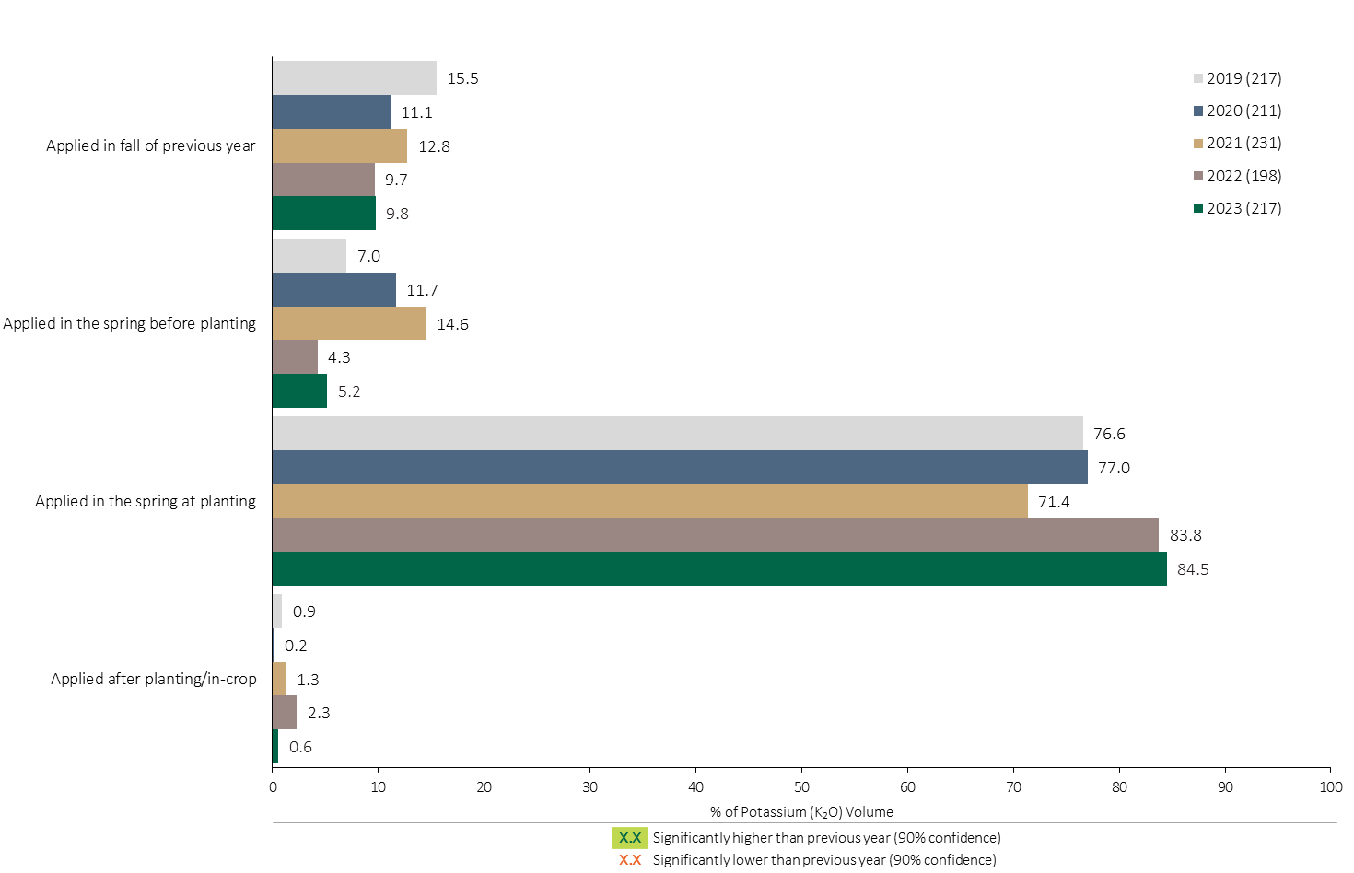
Potassium (K₂O) Timing in Canola - % of Volume
Canola
Canola Summary 
85% of total Potassium applied in canola was applied at planting.
Note: Potassium (K₂O) volume was calculated from all sources of potassium contained in all fertilizer types
For each fertilizer type used in either a custom blend or applied as an unblended product, respondents were asked: a) how many acres they applied, and b) the application rate in pounds of actual nutrient/ac. Volumes of each nutrient were calculated by multiplying acres treated times the application rate.
The graph illustrates the % of total Potassium (K₂O) volume applied in canola that was applied at each timing in each year.
Total pounds of actual Potassium (K₂O) applied was calculated based on all sources of Potassium (K₂O) from all fertilizer types.

Slide 24
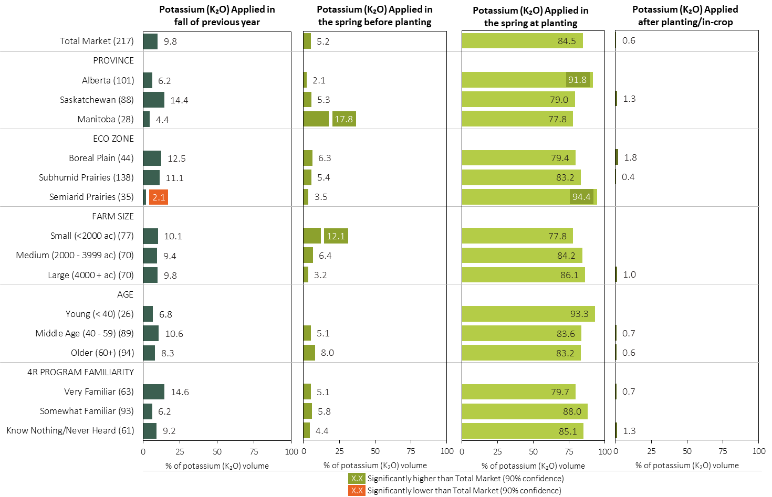
Potassium (K₂O) Timing in Canola in 2023 (% of Volume)
Canola
MAP
Note: Potassium (K₂O) volume was calculated from all sources of potassium contained in all fertilizer types
For each fertilizer type used in either a custom blend or applied as an unblended product, respondents were asked: a) how many acres they applied, and b) the application rate in pounds of actual nutrient/ac. Volumes of each nutrient were calculated by multiplying acres treated times the application rate.
Separately for each timing, the charts illustrate the % of total Potassium (K₂O) volume that was applied by province, eco zone, farm size, age and 4R program familiarity.
Total pounds of actual potassium (K₂O) applied was calculated based on all sources of potassium (K₂O) from all fertilizer types.

Slide 25
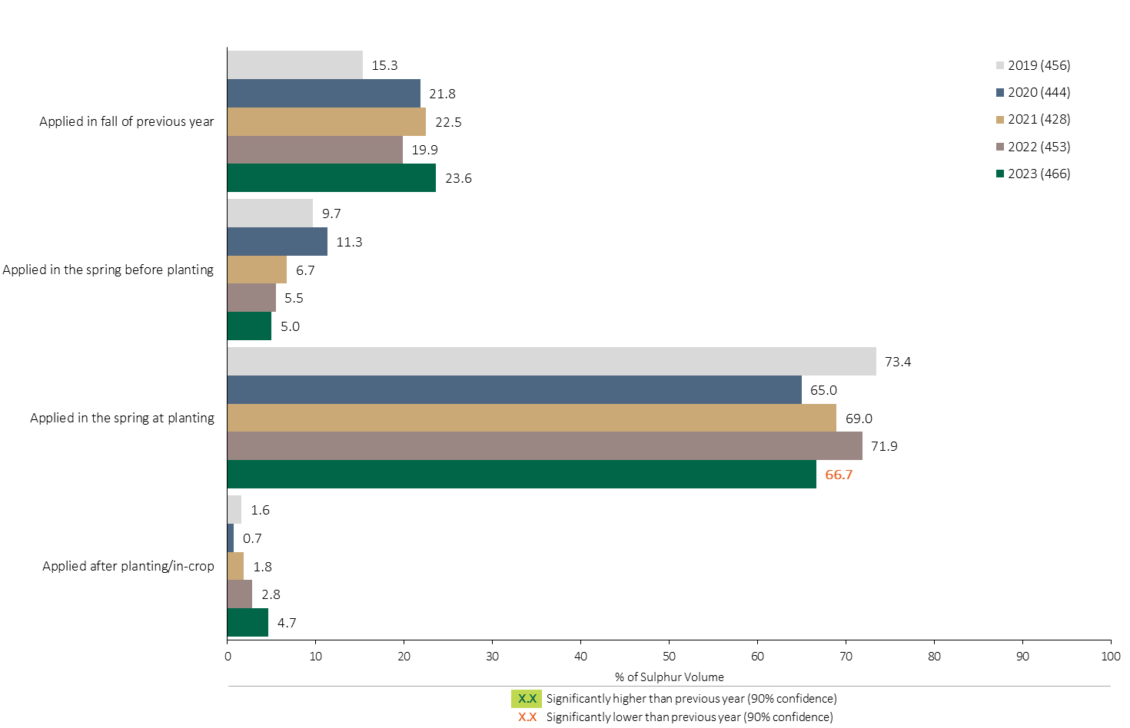
Sulphur Timing in Canola - % of Volume
Canola
Canola Summary 
67% of the Sulphur volume in canola was applied at planting in 2023; a decline from 2022.
Note: Sulphur volume was calculated from all sources of sulphur contained in all fertilizer types
For each fertilizer type used in either a custom blend or applied as an unblended product, respondents were asked: a) how many acres they applied, and b) the application rate in pounds of actual nutrient/ac. Volumes of each nutrient were calculated by multiplying acres treated times the application rate.
The graph illustrates the % of total Sulphur volume applied in canola that was applied at each timing in each year.
Total pounds of actual Sulphur applied was calculated based on all sources of Sulphur from all fertilizer types.

Slide 26
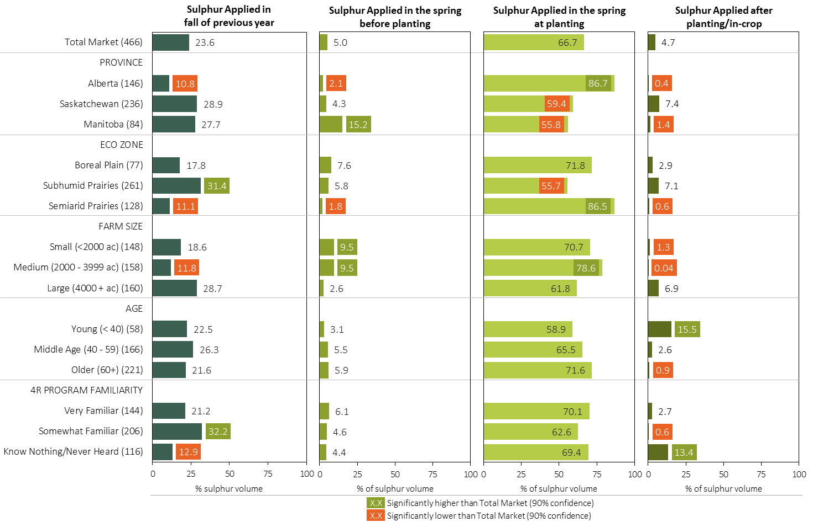
Sulphur Timing in Canola in 2023 (% of Volume)
Canola
MAP
Note: Sulphur volume was calculated from all sources of sulphur contained in all fertilizer types
For each fertilizer type used in either a custom blend or applied as an unblended product, respondents were asked: a) how many acres they applied, and b) the application rate in pounds of actual nutrient/ac. Volumes of each nutrient were calculated by multiplying acres treated times the application rate.
Separately for each timing, the charts illustrate the % of total sulphur volume that was applied by province, eco zone, farm size, age and 4R program familiarity.
Total pounds of actual sulphur applied was calculated based on all sources of sulphur from all fertilizer types.

Slide 27
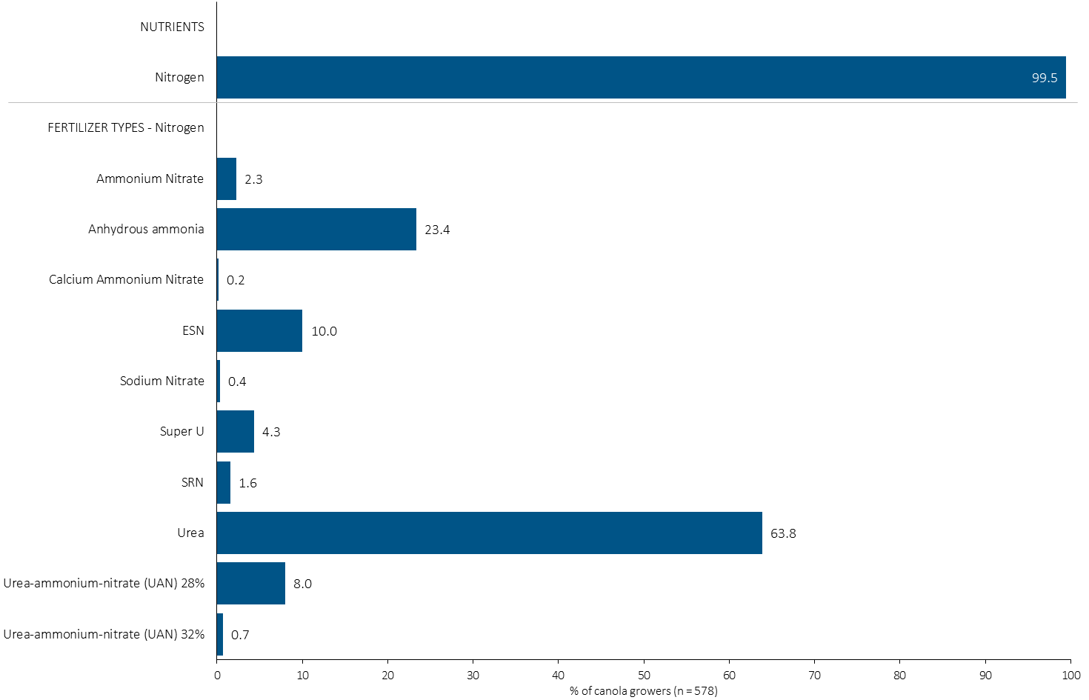
% of Canola Growers Using Each Nitrogen Source in 2023
Canola
23% of canola growers used anhydrous ammonia in 2023.
Note: Nutrients were defined based on any fertilizer type that contains the nutrient.
Respondents were asked: “For your 2023 canola crop, did you apply fertilizer or manure at each timing? – and given the options of a) Applied in fall of previous year, b) in the spring before planting, c) in the spring at planting and d) after planting/in-crop. For your 2023 canola crop, which fertilizer types did you apply at each timing?
The chart illustrates the % of canola growers who indicated that they used this nutrient and each fertilizer type in canola in 2023.
Nutrients were defined based on any fertilizer type that contains the nutrient.

Slide 28
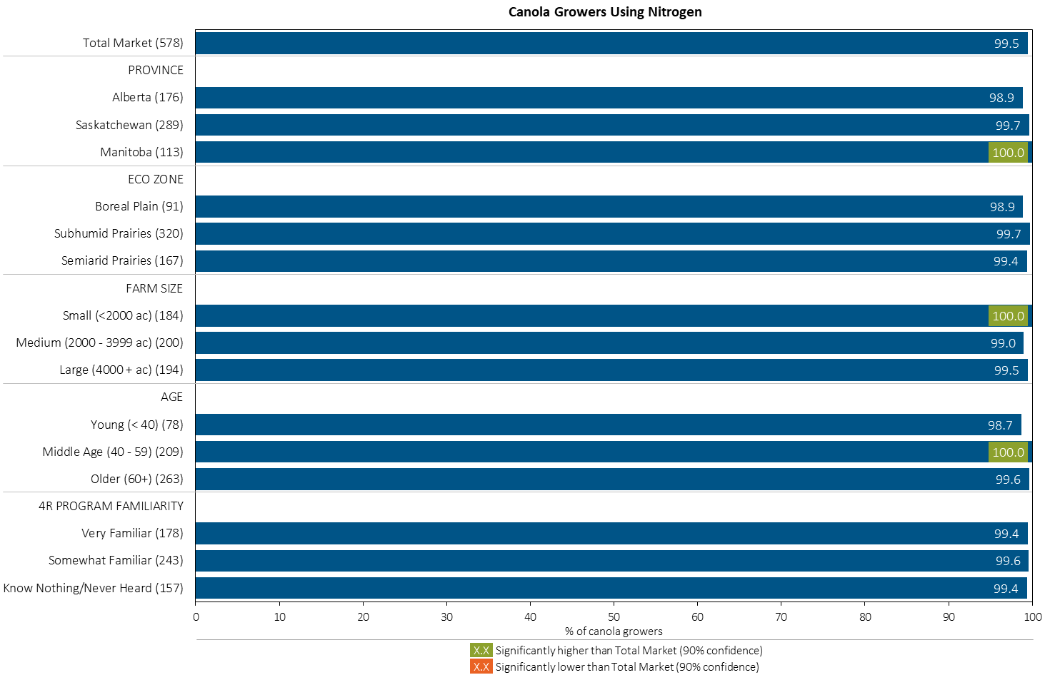
% of Canola Growers Using Nitrogen in 2023
Canola
MAP
Note: Nutrients were defined based on any fertilizer type that contains the nutrient.
Respondents were asked: “For your 2023 canola crop, did you apply fertilizer or manure at each timing? – and given the options of a) Applied in fall of previous year, b) in the spring before planting, c) in the spring at planting and d) after planting/in-crop. For your 2023 canola crop, which fertilizer types did you apply at each timing?
The chart illustrates the % of canola growers who indicated that they used this nutrient in canola in 2023 by province, eco zone, farm size, age and 4R familiarity.
Nutrients were defined based on any fertilizer type that contains the nutrient.

Slide 29
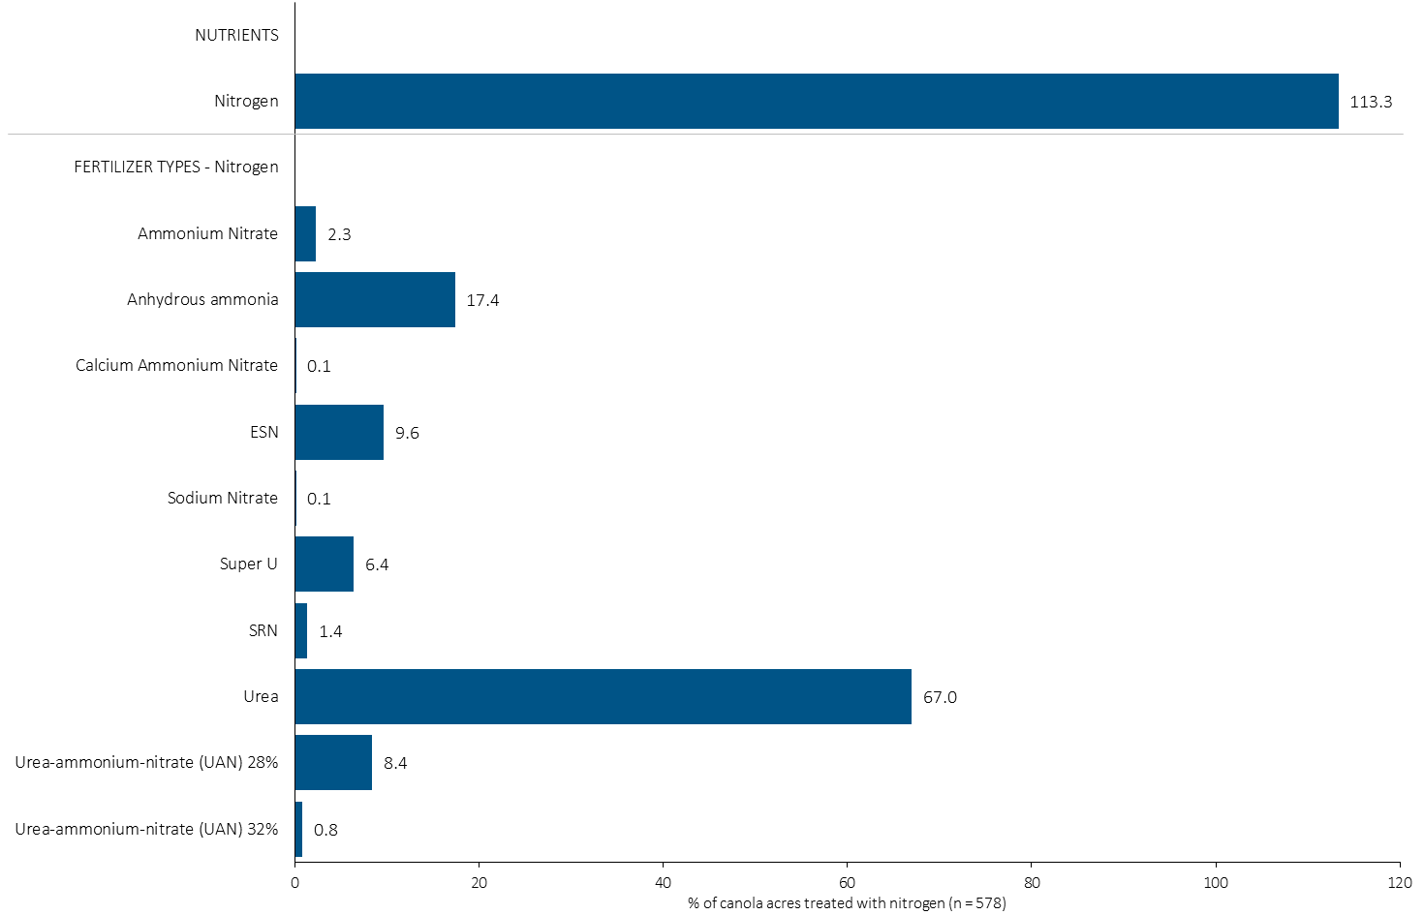
Acres Treated With Each Nitrogen Source in Canola in 2023
Canola
Multiple Nitrogen fertilizers were applied on some canola acres.
Canola Summary 
67% of canola acres received an application of Urea in 2023.
Note: Nutrients were defined based on the primary component of each fertilizer type
For each application timing, respondents were asked: “Of your [xxx] acres of canola, how many acres of each fertilizer type did you apply?”
The chart illustrates the % of total canola acres that were treated with this nutrient and each fertilizer type in 2023.
Nutrients were defined based on the primary component (see adjacent fertilizer types by clicking on the “A” button).

Slide 30
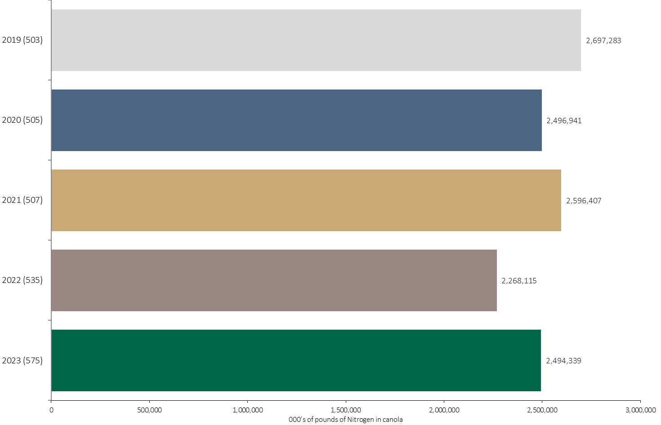
Nitrogen Volume in Canola
Canola
An estimated 2.5 billion pounds of N was used in canola in 2023.
Note: Nitrogen volume was calculated from all sources of nitrogen contained in all fertilizer types
For each fertilizer type used in either a custom blend or applied as an unblended product, respondents were asked: a) how many acres they applied, and b) the application rate in pounds of actual nutrient/ac. Volumes of each nutrient were calculated by multiplying acres treated times the application rate.
The chart illustrates the total nitrogen volume (000’s of pounds) that was used in each year. The nitrogen volume was calculated from all sources of nitrogen contained in all fertilizer types.

Slide 31
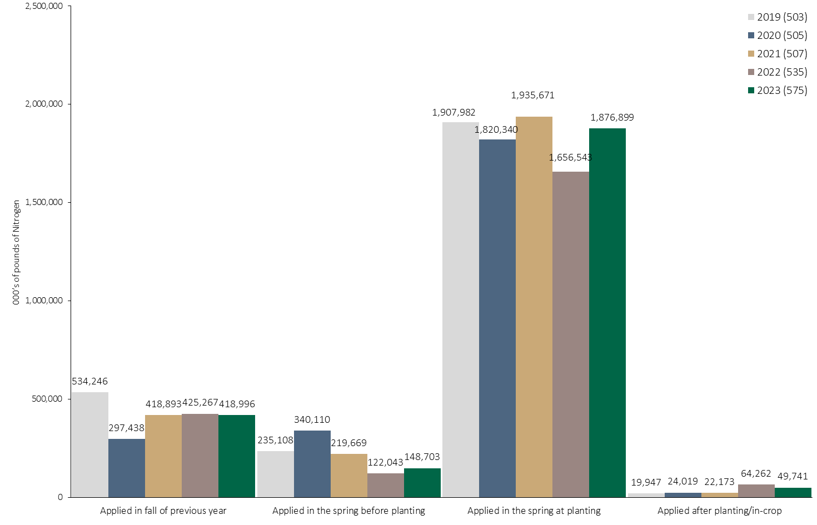
Nitrogen Volume in Canola by Timing
Canola
Note: Nitrogen volume was calculated from all sources of nitrogen contained in all fertilizer types
For each fertilizer type used in either a custom blend or applied as an unblended product, respondents were asked: a) how many acres they applied, and b) the application rate in pounds of actual nutrient/ac. Volumes of each nutrient were calculated by multiplying acres treated times the application rate.
The chart illustrates the total nitrogen volume (000’s of pounds) that was used in each year by application timing. The nitrogen volume was calculated from all sources of nitrogen contained in all fertilizer types.

Slide 32
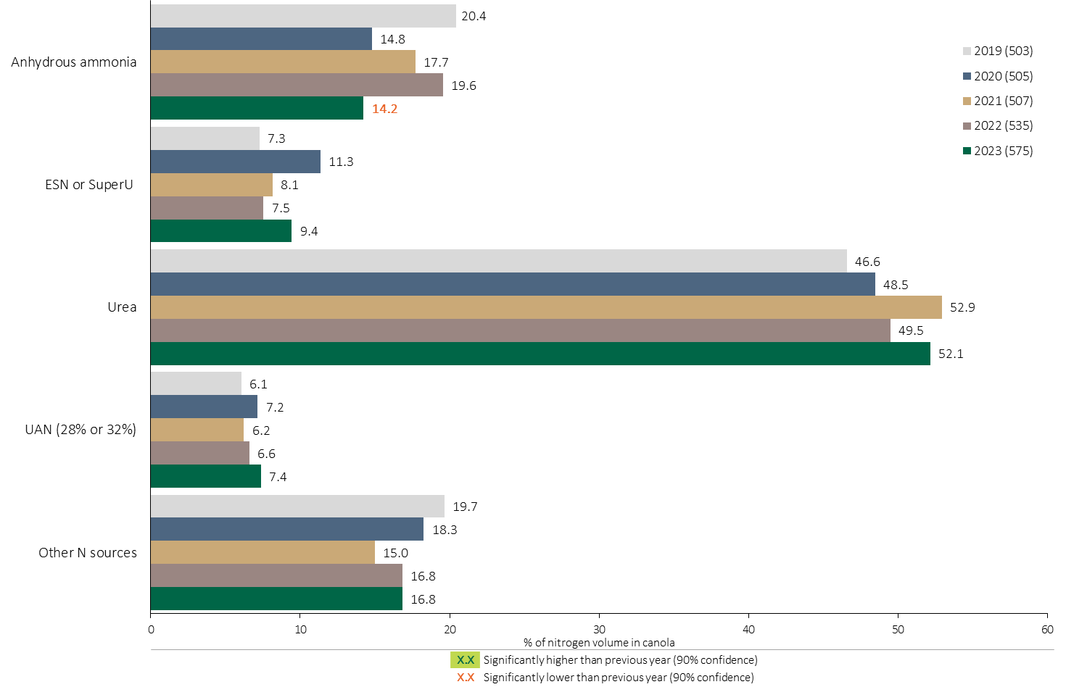
Nitrogen Fertilizer Source in Canola - All Timings
Canola
Use of Anhydrous ammonia declined in 2023 compared to 2022.
Canola Summary 
Use of Urea edged higher.
Note: Nitrogen volume was calculated from all sources of nitrogen contained in all fertilizer types
For each fertilizer type used in either a custom blend or applied as an unblended product, respondents were asked: a) how many acres they applied, and b) the application rate in pounds of actual nutrient/ac. Volumes of each nutrient were calculated by multiplying acres treated times the application rate.
The chart illustrates the % of total nitrogen volume applied at all timings that was provided by each fertilizer type. The nitrogen volume was calculated from all sources of nitrogen contained in all fertilizer types.

Slide 33
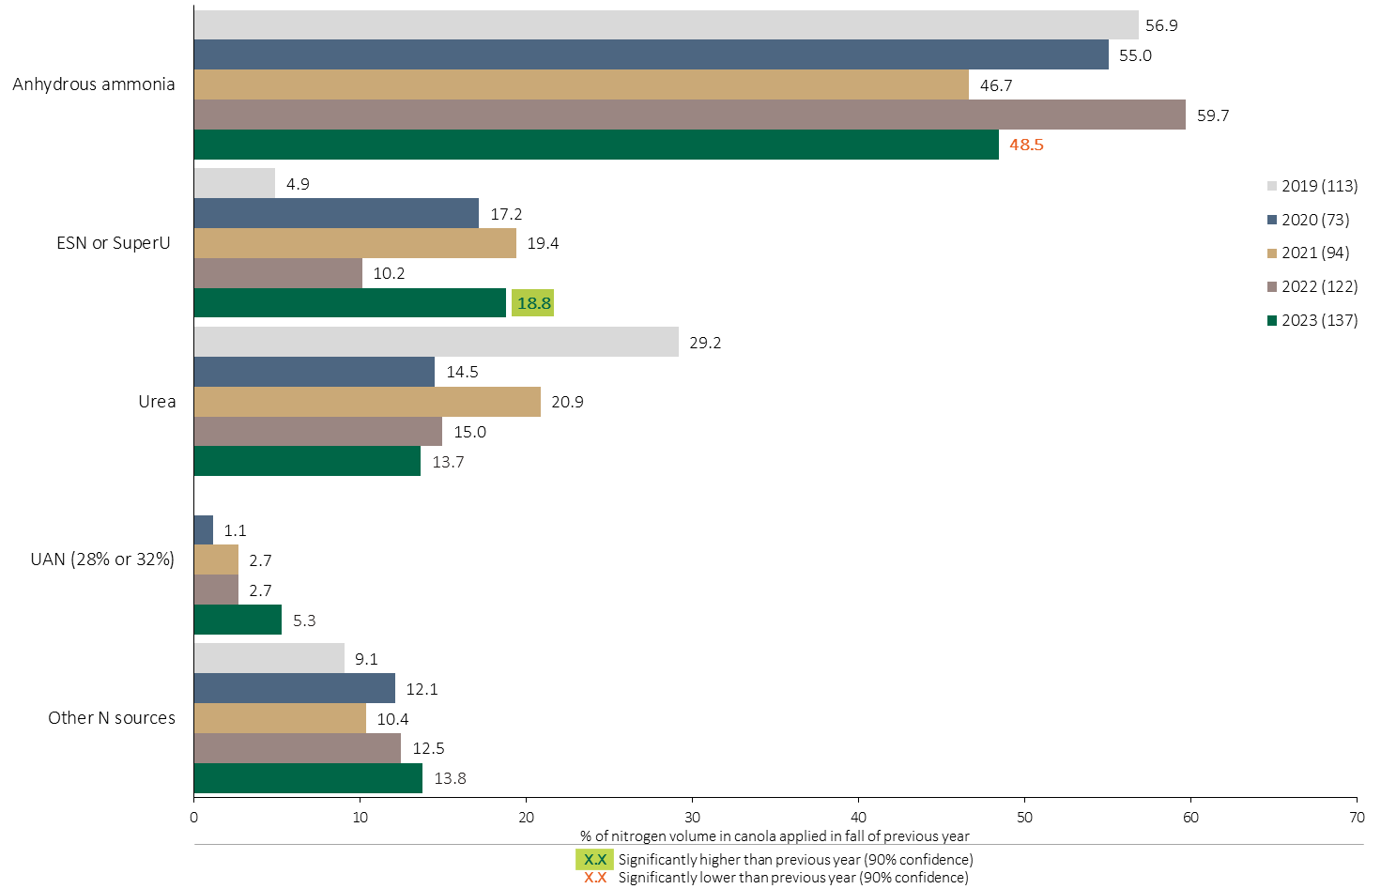
Nitrogen Fertilizer Source in Canola - Fall Timing
Canola
Use of Anhydrous ammonia in the fall declined in 2023 compared to 2022.
Use of ESN/SuperU at the fall timing increased in 2023.
Note: Nitrogen volume was calculated from all sources of nitrogen contained in all fertilizer types
For each fertilizer type used in either a custom blend or applied as an unblended product, respondents were asked: a) how many acres they applied, and b) the application rate in pounds of actual nutrient/ac. Volumes of each nutrient were calculated by multiplying acres treated times the application rate.
The chart illustrates the % of total nitrogen volume applied in the fall of the previous year that was provided by each fertilizer type. The nitrogen volume was calculated from all sources of nitrogen contained in all fertilizer types.

Slide 34
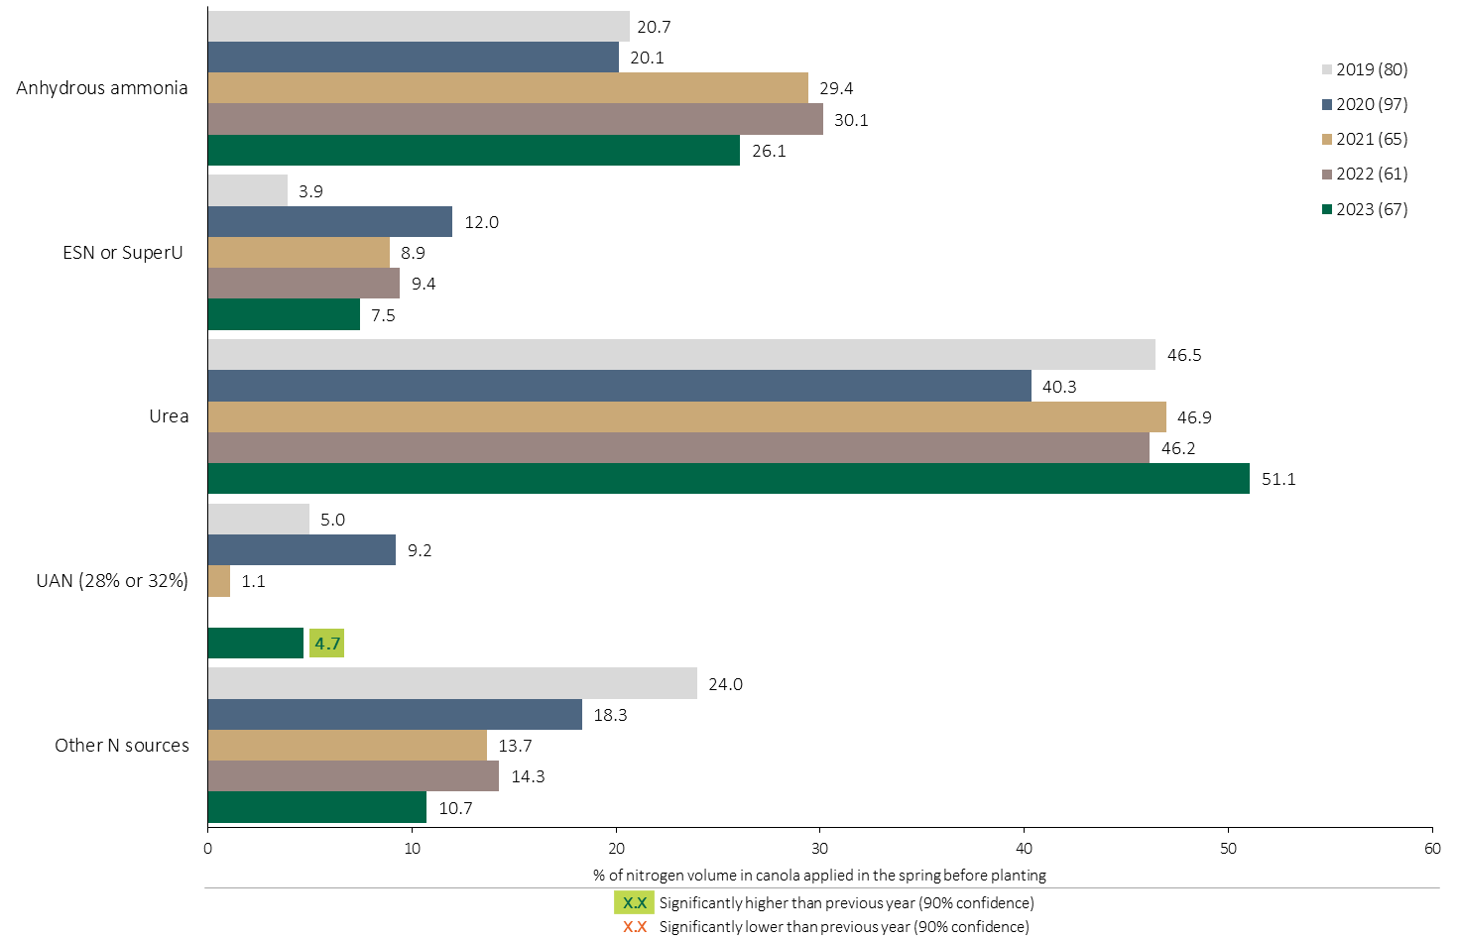
Nitrogen Fertilizer Source in Canola - Spring Before Planting
Canola
Note: Nitrogen volume was calculated from all sources of nitrogen contained in all fertilizer types
For each fertilizer type used in either a custom blend or applied as an unblended product, respondents were asked: a) how many acres they applied, and b) the application rate in pounds of actual nutrient/ac. Volumes of each nutrient were calculated by multiplying acres treated times the application rate.
The chart illustrates the % of total nitrogen volume applied in the spring before planting that was provided by each fertilizer type. The nitrogen volume was calculated from all sources of nitrogen contained in all fertilizer types.

Slide 35
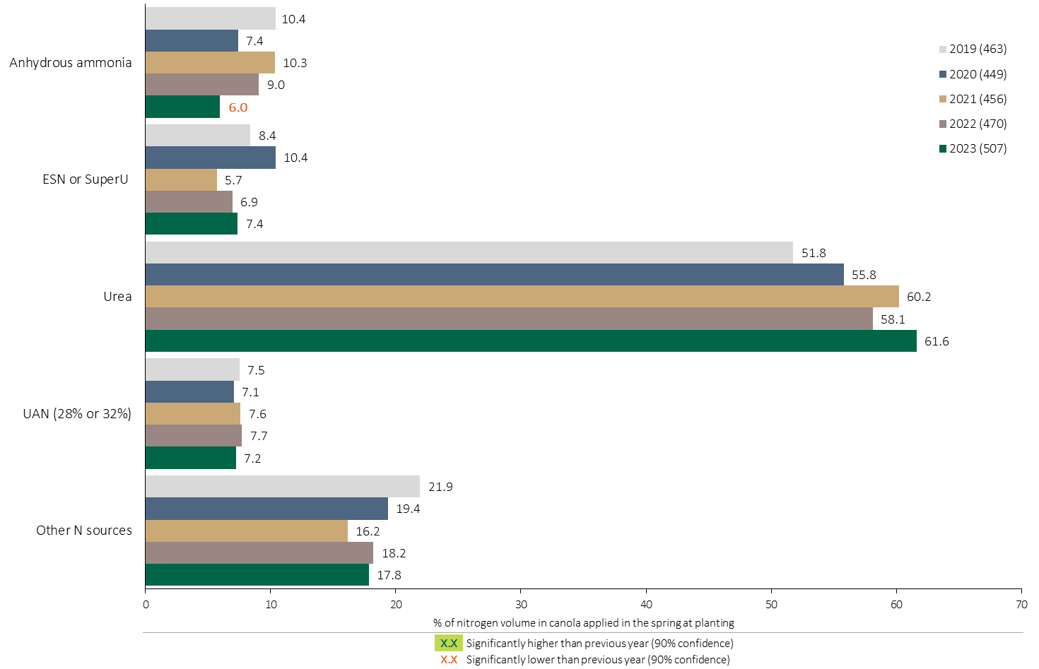
Nitrogen Fertilizer Source in Canola - At Planting
Canola
Urea was the primary source of Nitrogen applied at planting in 2023.
Note: Nitrogen volume was calculated from all sources of nitrogen contained in all fertilizer types
For each fertilizer type used in either a custom blend or applied as an unblended product, respondents were asked: a) how many acres they applied, and b) the application rate in pounds of actual nutrient/ac. Volumes of each nutrient were calculated by multiplying acres treated times the application rate.
The chart illustrates the % of total nitrogen volume applied in the spring at planting that was provided by each fertilizer type. The nitrogen volume was calculated from all sources of nitrogen contained in all fertilizer types.

Slide 36
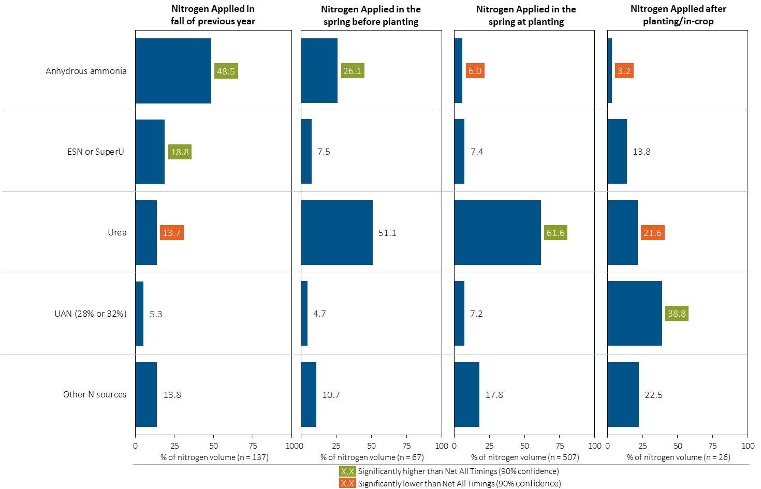
Nitrogen Fertilizer Source in Canola by Timing
Canola
Note: Nitrogen volume was calculated from all sources of nitrogen contained in all fertilizer types
For each fertilizer type used in either a custom blend or applied as an unblended product, respondents were asked: a) how many acres they applied, and b) the application rate in pounds of actual nutrient/ac. Volumes of each nutrient were calculated by multiplying acres treated times the application rate.
Separately for each application timing, the graphs illustrate the % of total nitrogen volume applied in canola that came from each fertilizer source.
Total pounds of actual nitrogen applied was calculated based on all sources of nitrogen from all fertilizer types.

Slide 37
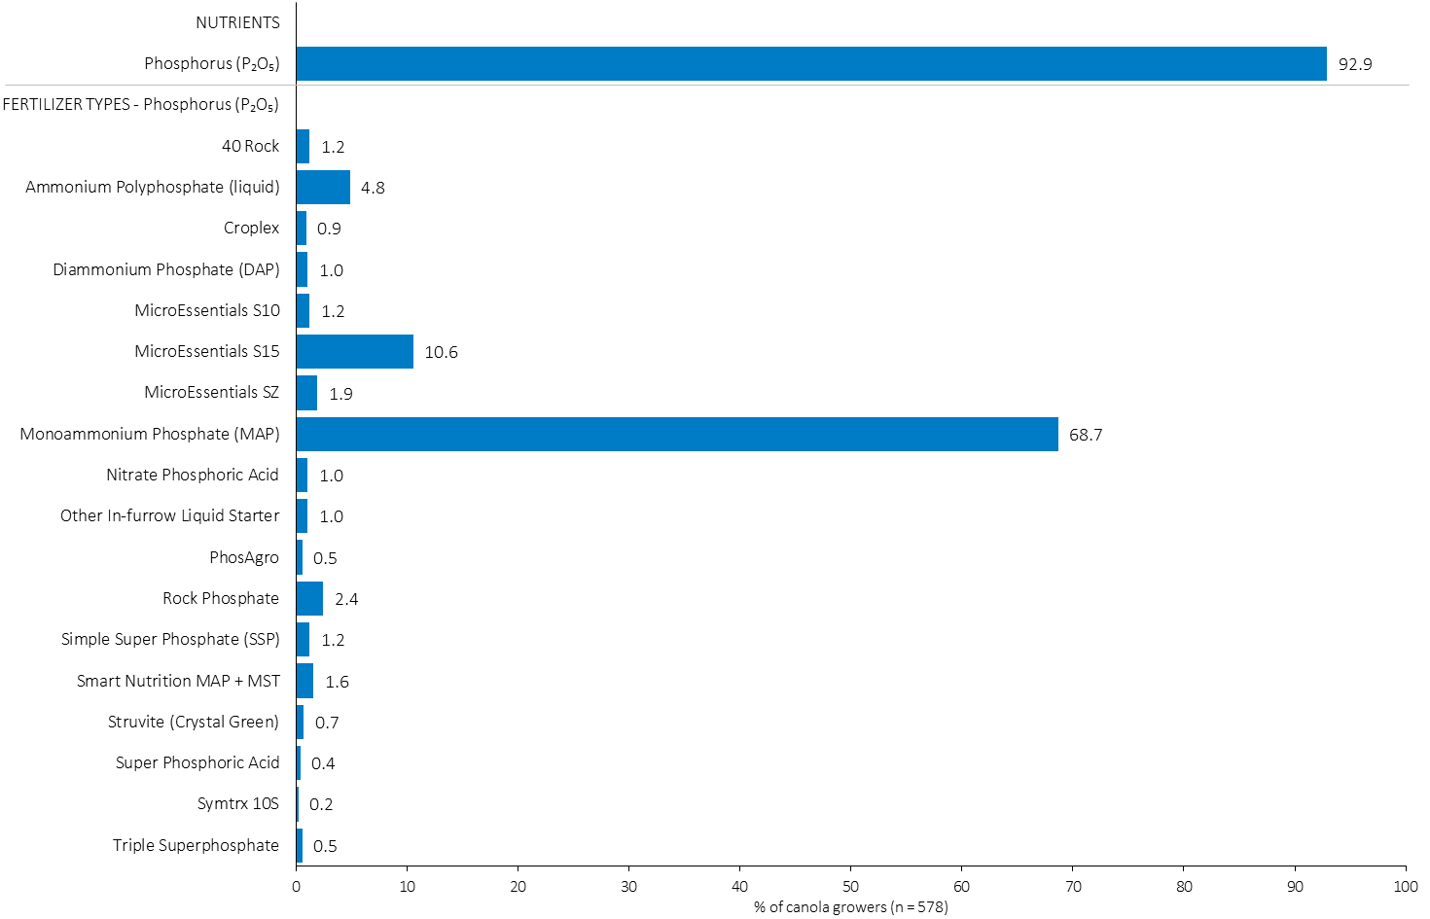
% of Canola Growers Using Each Phosphorus (P₂O₅) Source in 2023
Canola
69% of canola growers used MAP in 2023.
Note: Nutrients were defined based on any fertilizer type that contains the nutrient.
Respondents were asked: “For your 2023 canola crop, did you apply fertilizer or manure at each timing? – and given the options of a) Applied in fall of previous year, b) in the spring before planting, c) in the spring at planting and d) after planting/in-crop. For your 2023 canola crop, which fertilizer types did you apply at each timing?
The chart illustrates the % of canola growers who indicated that they used this nutrient and each fertilizer type in canola in 2023.
Nutrients were defined based on any fertilizer type that contains the nutrient.

Slide 38
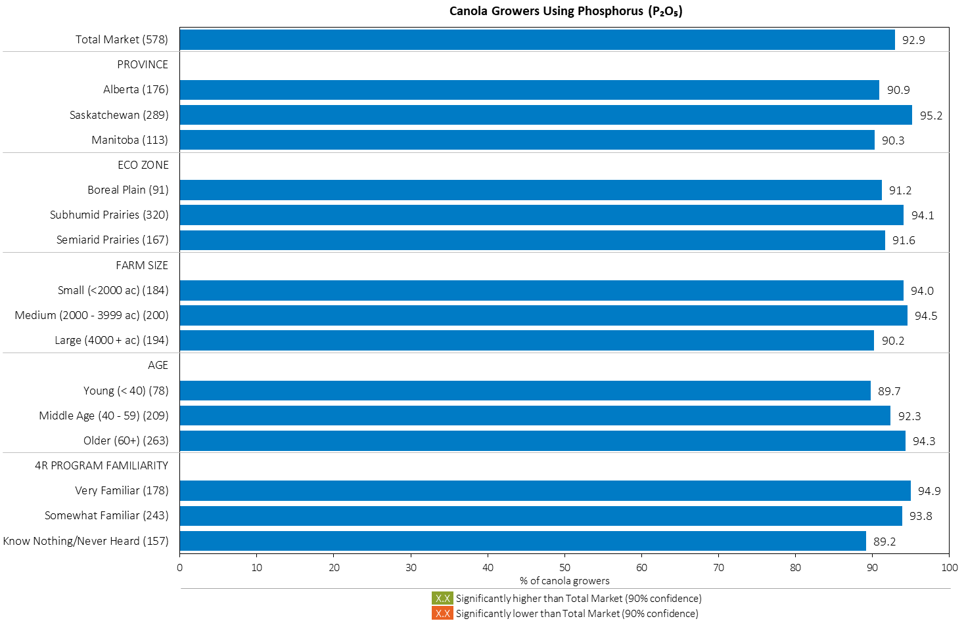
% of Canola Growers Using Phosphorus (P₂O₅) in 2023
Canola
MAP
Note: Nutrients were defined based on any fertilizer type that contains the nutrient.
Respondents were asked: “For your 2023 canola crop, did you apply fertilizer or manure at each timing? – and given the options of a) Applied in fall of previous year, b) in the spring before planting, c) in the spring at planting and d) after planting/in-crop. For your 2023 canola crop, which fertilizer types did you apply at each timing?
The chart illustrates the % of canola growers who indicated that they used this nutrient in canola in 2023 by province, eco zone, farm size, age and 4R familiarity.
Nutrients were defined based on any fertilizer type that contains the nutrient.

Slide 39
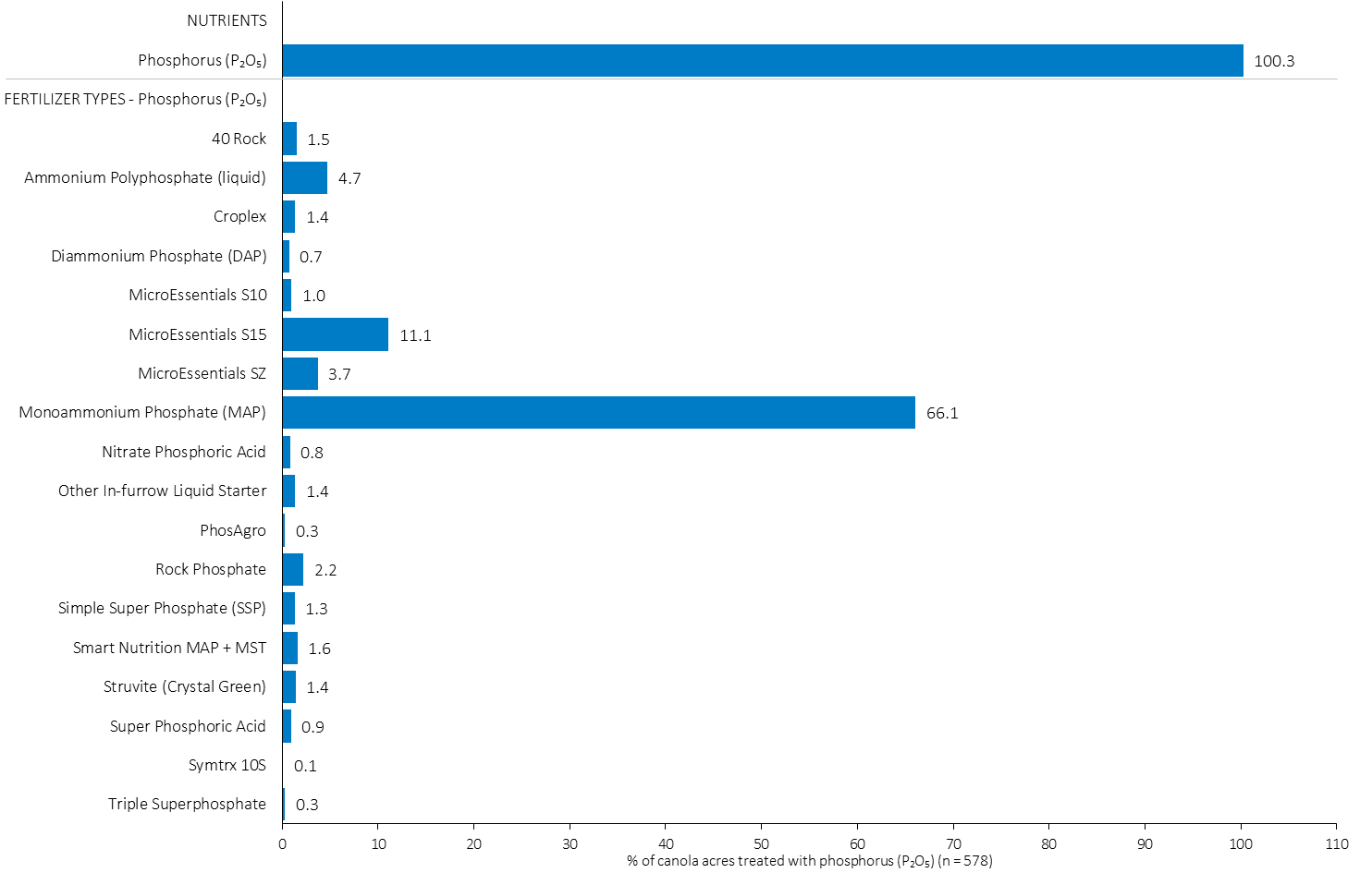
Acres Treated With Each Phosphorus (P₂O₅) Source in Canola in 2023
Canola
Canola Summary 
66% of canola acres received an application of MAP in 2023.
Note: Nutrients were defined based on the primary component of each fertilizer type
For each application timing, respondents were asked: “Of your [xxx] acres of canola, how many acres of each fertilizer type did you apply?”
The chart illustrates the % of total canola acres that were treated with this nutrient and each fertilizer type in 2023.
Nutrients were defined based on the primary component (see adjacent fertilizer types by clicking on the “A” button).

Slide 40
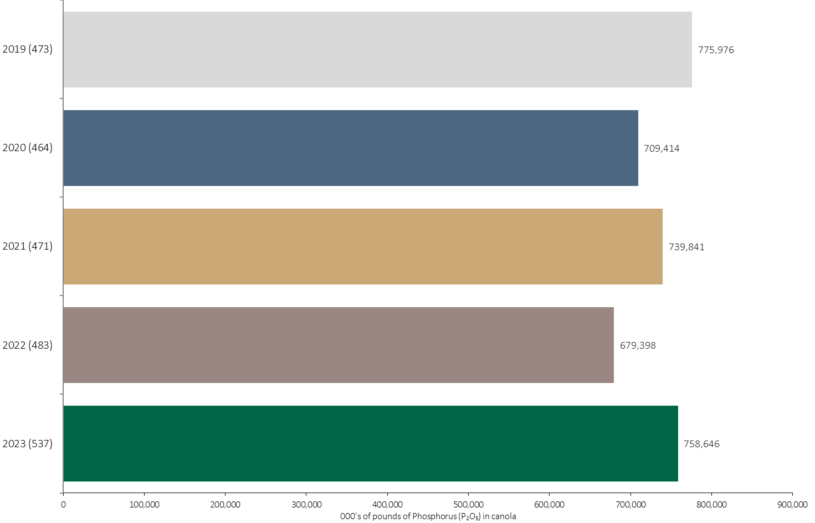
Phosphorus (P₂O₅) Volume in Canola
Canola
An estimated 758 million pounds of P₂O₅ was used in canola in 2023.
Note: Phosphorus (P₂O₅) volume was calculated from all sources of phosphorus contained in all fertilizer types
For each fertilizer type used in either a custom blend or applied as an unblended product, respondents were asked: a) how many acres they applied, and b) the application rate in pounds of actual nutrient/ac. Volumes of each nutrient were calculated by multiplying acres treated times the application rate.
The chart illustrates the total phosphorus (P₂O₅) volume (000’s of pounds) that was used in each year. The phosphorus (P₂O₅) volume was calculated from all sources of phosphorus (P₂O₅) contained in all fertilizer types.

Slide 41
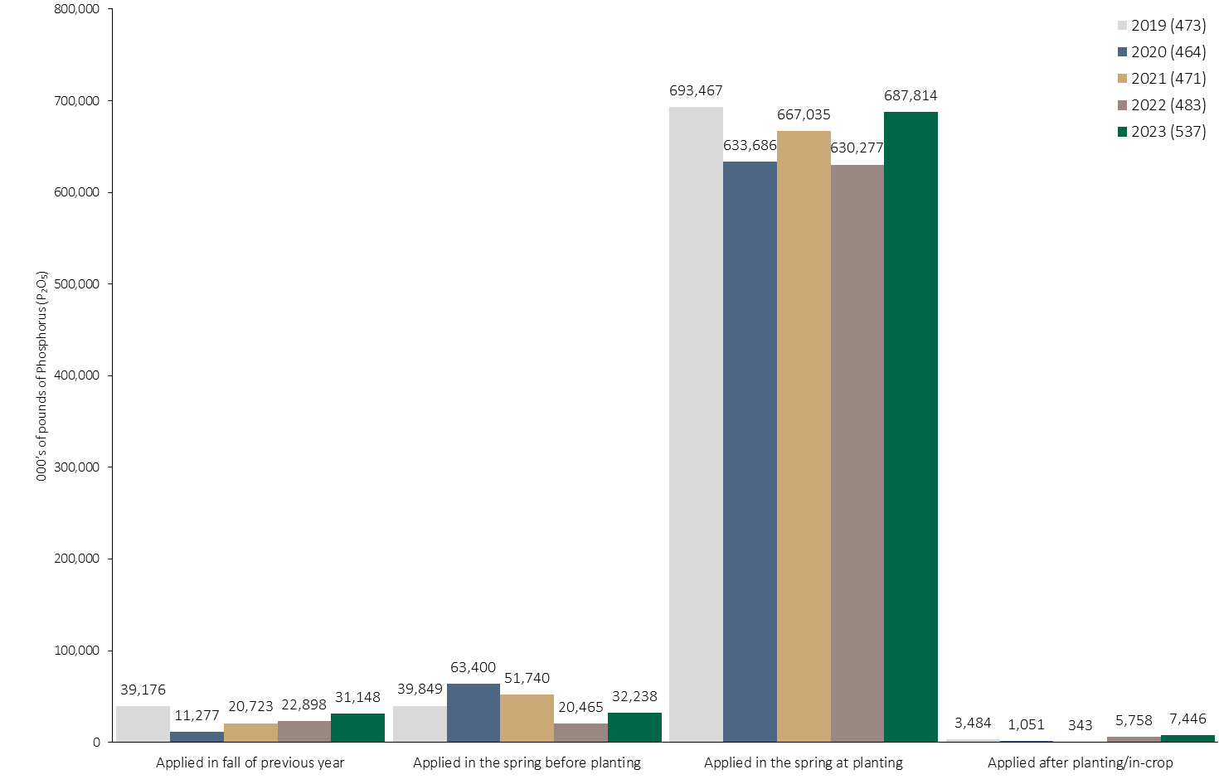
Phosphorus (P₂O₅) Volume in Canola by Timing
Canola
Note: Phosphorus (P₂O₅) volume was calculated from all sources of phosphorus contained in all fertilizer types
For each fertilizer type used in either a custom blend or applied as an unblended product, respondents were asked: a) how many acres they applied, and b) the application rate in pounds of actual nutrient/ac. Volumes of each nutrient were calculated by multiplying acres treated times the application rate.
The chart illustrates the total phosphorus (P₂O₅) volume (000’s of pounds) that was used in each year by application timing. The phosphorus (P₂O₅) volume was calculated from all sources of phosphorus (P₂O₅) contained in all fertilizer types.

Slide 42
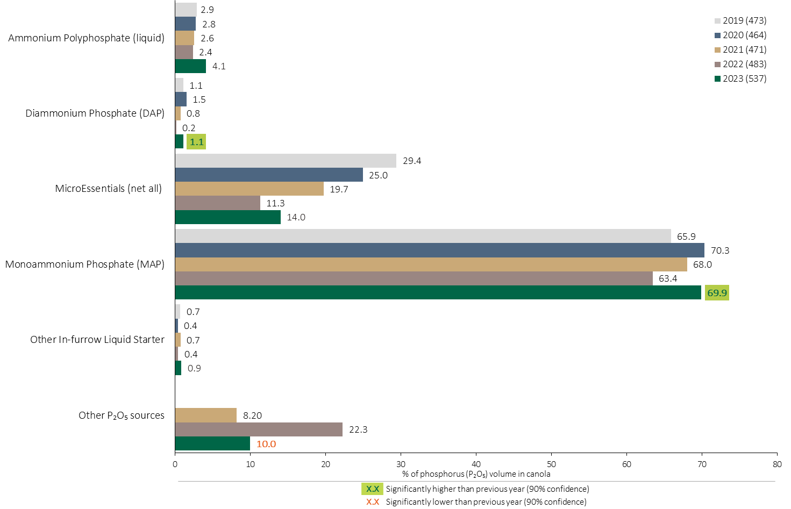
Phosphorus (P₂O₅) Fertilizer Source in Canola - All Timings
Canola
Use of DAP increased in 2023.
Canola Summary 
Use of MAP increased as a % of total Phosphorus (P₂O₅) volume in 2023.
Fewer other Phosphorus fertilizer types were used in 2023.
Note: Phosphorus (P₂O₅) volume was calculated from all sources of phosphorus contained in all fertilizer types
For each fertilizer type used in either a custom blend or applied as an unblended product, respondents were asked: a) how many acres they applied, and b) the application rate in pounds of actual nutrient/ac. Volumes of each nutrient were calculated by multiplying acres treated times the application rate.
The chart illustrates the % of total phosphorus (P₂O₅) volume applied at all timings that was provided by each fertilizer type. The phosphorus (P₂O₅) volume was calculated from all sources of phosphorus (P₂O₅) contained in all fertilizer types.

Slide 43
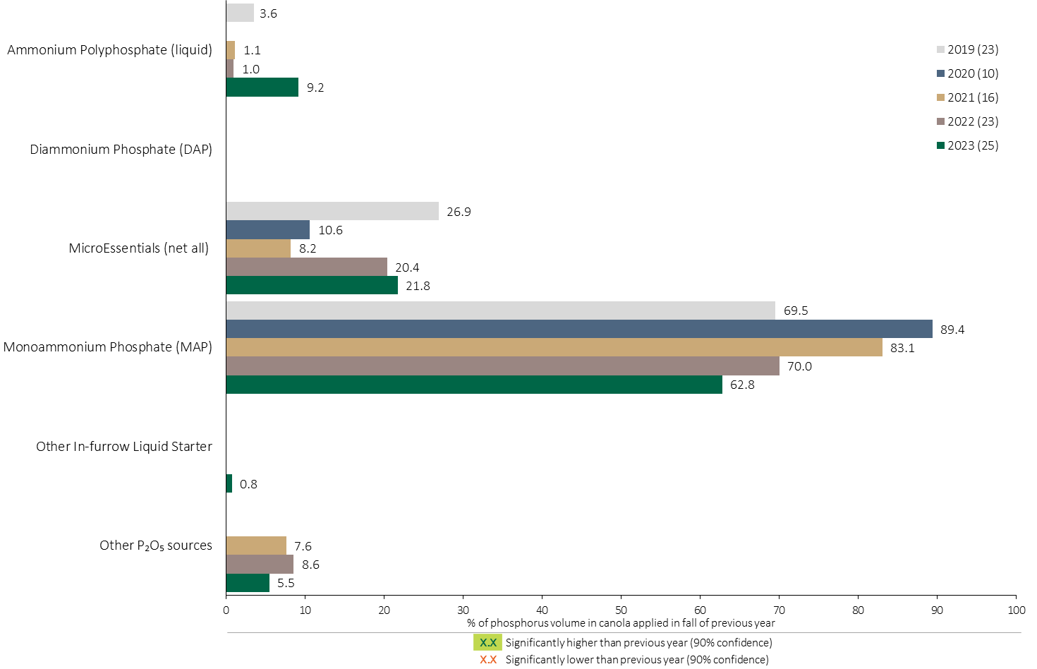
Phosphorus (P₂O₅) Fertilizer Source in Canola - Fall Timing
Canola
Use of MAP in the fall continues to trend lower.
Note: Phosphorus (P₂O₅) volume was calculated from all sources of phosphorus contained in all fertilizer types
For each fertilizer type used in either a custom blend or applied as an unblended product, respondents were asked: a) how many acres they applied, and b) the application rate in pounds of actual nutrient/ac. Volumes of each nutrient were calculated by multiplying acres treated times the application rate.
The chart illustrates the % of total phosphorus (P₂O₅) volume applied at the fall timing that was provided by each fertilizer type. The phosphorus (P₂O₅) volume was calculated from all sources of phosphorus (P₂O₅) contained in all fertilizer types.

Slide 44
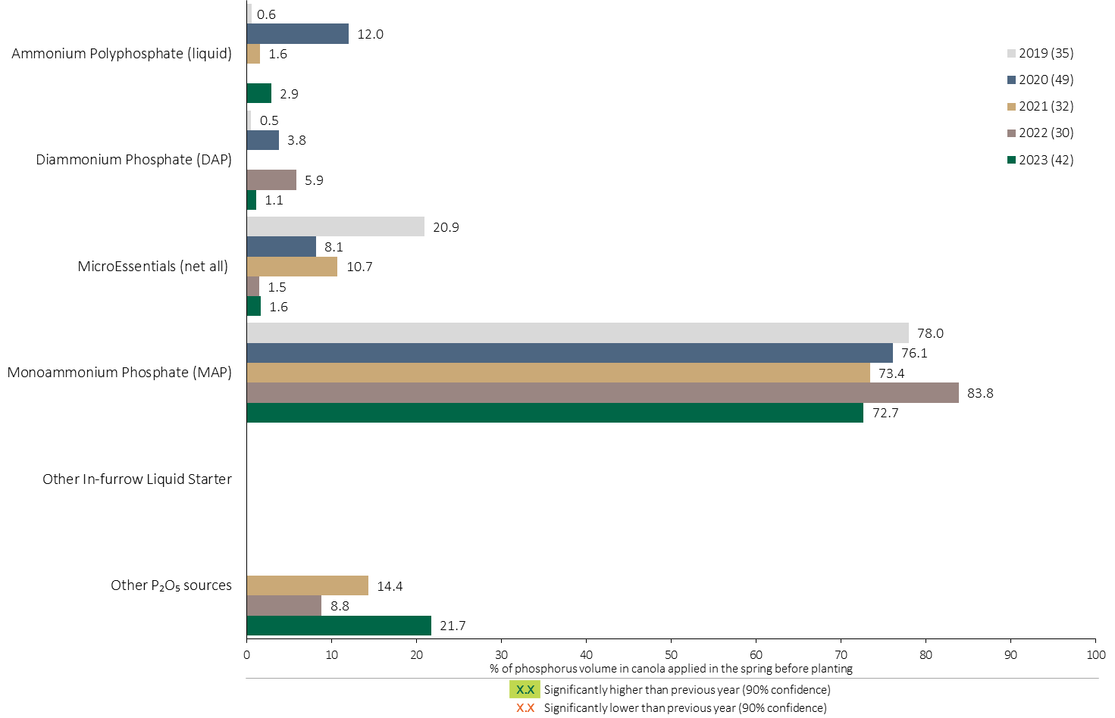
Phosphorus (P₂O₅) Fertilizer Source in Canola - Spring Before Planting
Canola
Use of MAP in the spring before planting edged back to 2021 levels.
Note: Phosphorus (P₂O₅) volume was calculated from all sources of phosphorus contained in all fertilizer types
For each fertilizer type used in either a custom blend or applied as an unblended product, respondents were asked: a) how many acres they applied, and b) the application rate in pounds of actual nutrient/ac. Volumes of each nutrient were calculated by multiplying acres treated times the application rate.
The chart illustrates the % of total phosphorus (P₂O₅) volume applied in the spring before planting that was provided by each fertilizer type. The phosphorus (P₂O₅) volume was calculated from all sources of phosphorus (P₂O₅) contained in all fertilizer types.

Slide 45

Phosphorus (P₂O₅) Fertilizer Source in Canola - At Planting
Canola
Use of DAP increased in 2023.
At planting, MAP share increased in 2023.
Note: Phosphorus (P₂O₅) volume was calculated from all sources of phosphorus contained in all fertilizer types
For each fertilizer type used in either a custom blend or applied as an unblended product, respondents were asked: a) how many acres they applied, and b) the application rate in pounds of actual nutrient/ac. Volumes of each nutrient were calculated by multiplying acres treated times the application rate.
The chart illustrates the % of total phosphorus (P₂O₅) volume applied in the spring at planting that was provided by each fertilizer type. The phosphorus (P₂O₅) volume was calculated from all sources of phosphorus (P₂O₅) contained in all fertilizer types.

Slide 46
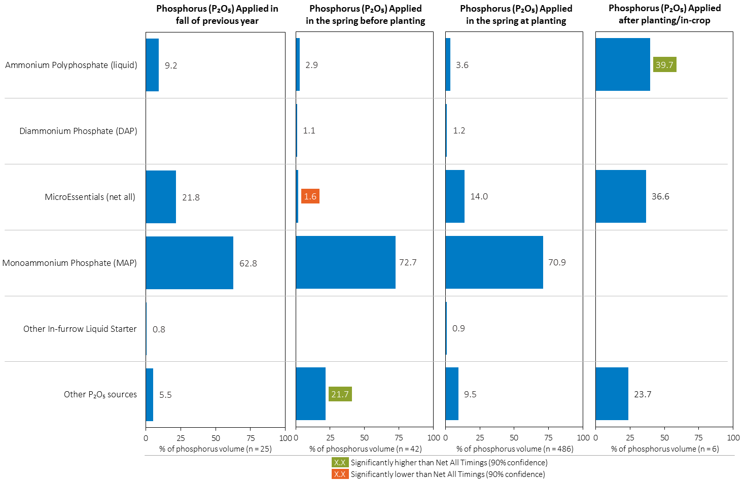
Phosphorus (P₂O₅) Fertilizer Source in Canola by Timing
Canola
Note: Phosphorus (P₂O₅) volume was calculated from all sources of phosphorus contained in all fertilizer types
For each fertilizer type used in either a custom blend or applied as an unblended product, respondents were asked: a) how many acres they applied, and b) the application rate in pounds of actual nutrient/ac. Volumes of each nutrient were calculated by multiplying acres treated times the application rate.
Separately for each application timing, the graphs illustrate the % of total phosphorus (P₂O₅) volume applied in canola that came from each fertilizer source.
Total pounds of actual phosphorus (P₂O₅) applied was calculated based on all sources of phosphorus (P₂O₅) from all fertilizer types.

Slide 47
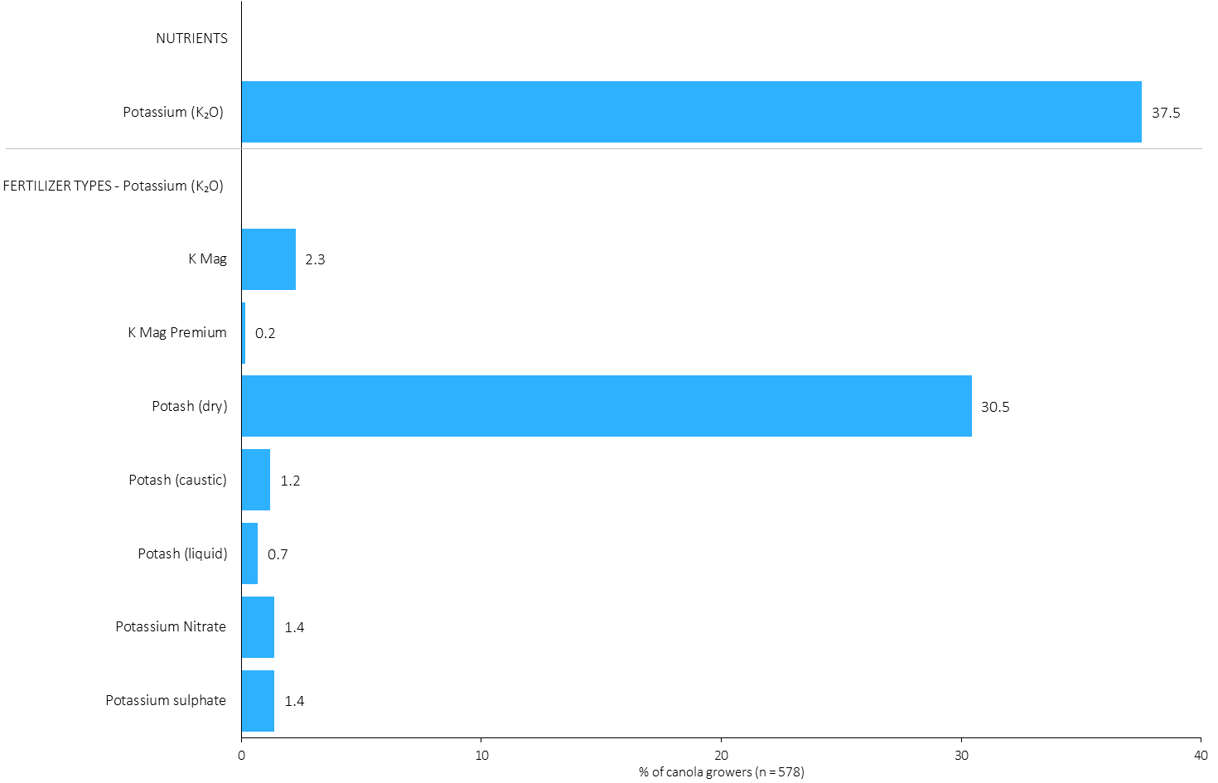
% of Canola Growers Using Each Potassium (K₂O) Source in 2023
Canola
31% of canola growers used dry potash in 2023.
Note: Nutrients were defined based on any fertilizer type that contains the nutrient.
Respondents were asked: “For your 2023 canola crop, did you apply fertilizer or manure at each timing? – and given the options of a) Applied in fall of previous year, b) in the spring before planting, c) in the spring at planting and d) after planting/in-crop. For your 2023 canola crop, which fertilizer types did you apply at each timing?
The chart illustrates the % of canola growers who indicated that they used this nutrient and each fertilizer type in canola in 2023.
Nutrients were defined based on any fertilizer type that contains the nutrient.

Slide 48
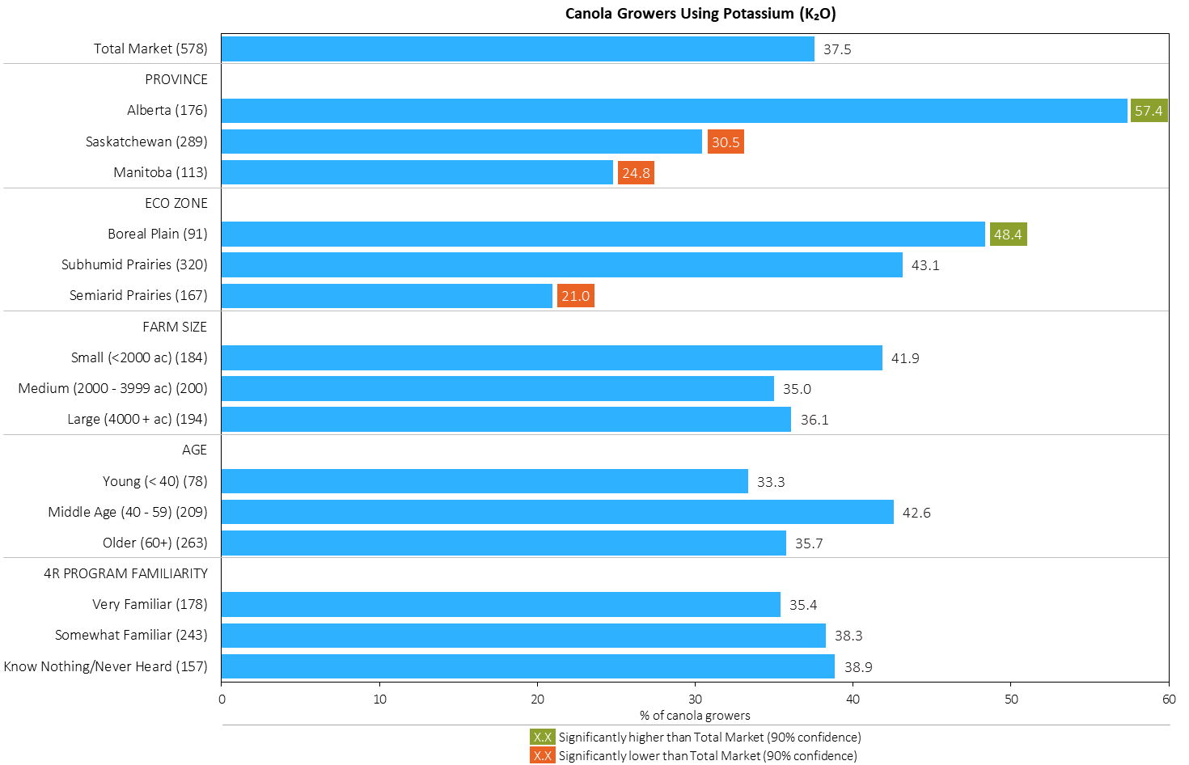
% of Canola Growers Using Potassium (K₂O) in 2023
Canola
MAP
Note: Nutrients were defined based on any fertilizer type that contains the nutrient.
Respondents were asked: “For your 2023 canola crop, did you apply fertilizer or manure at each timing? – and given the options of a) Applied in fall of previous year, b) in the spring before planting, c) in the spring at planting and d) after planting/in-crop. For your 2023 canola crop, which fertilizer types did you apply at each timing?
The chart illustrates the % of canola growers who indicated that they used this nutrient in canola in 2023 by province, eco zone, farm size, age and 4R familiarity.
Nutrients were defined based on any fertilizer type that contains the nutrient.

Slide 49
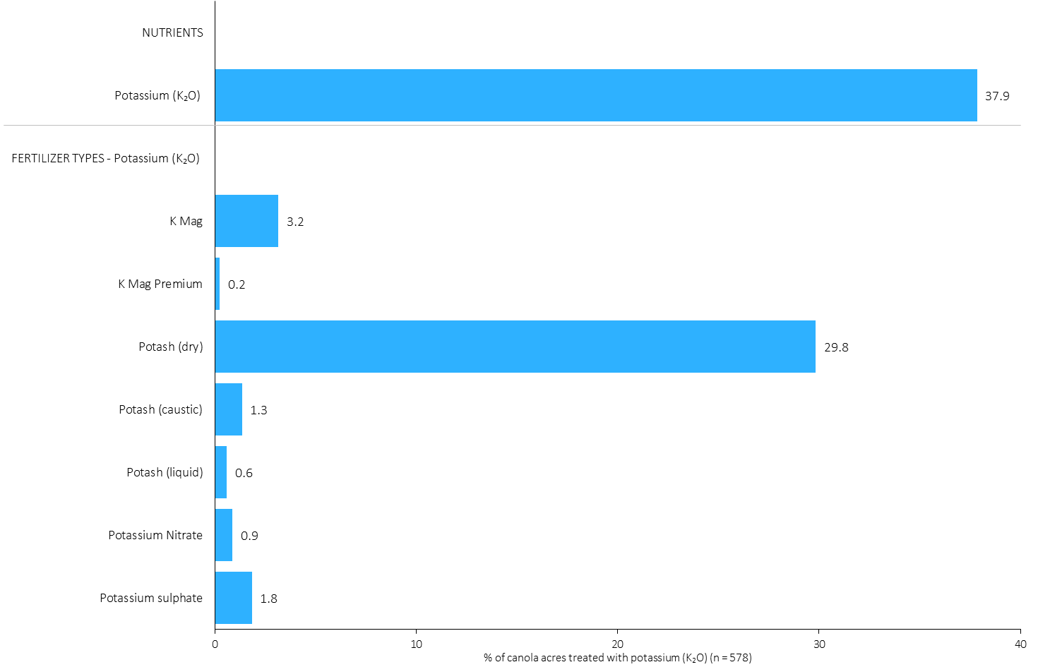
Acres Treated With Each Potassium (K₂O) Source in Canola in 2023
Canola
Canola Summary 
30% of canola acres received an application of dry potash in 2023.
Note: Nutrients were defined based on the primary component of each fertilizer type
For each application timing, respondents were asked: “Of your [xxx] acres of canola, how many acres of each fertilizer type did you apply?”
The chart illustrates the % of total canola acres that were treated with this nutrient and each fertilizer type in 2023.
Nutrients were defined based on the primary component (see adjacent fertilizer types by clicking on the “A” button).

Slide 50
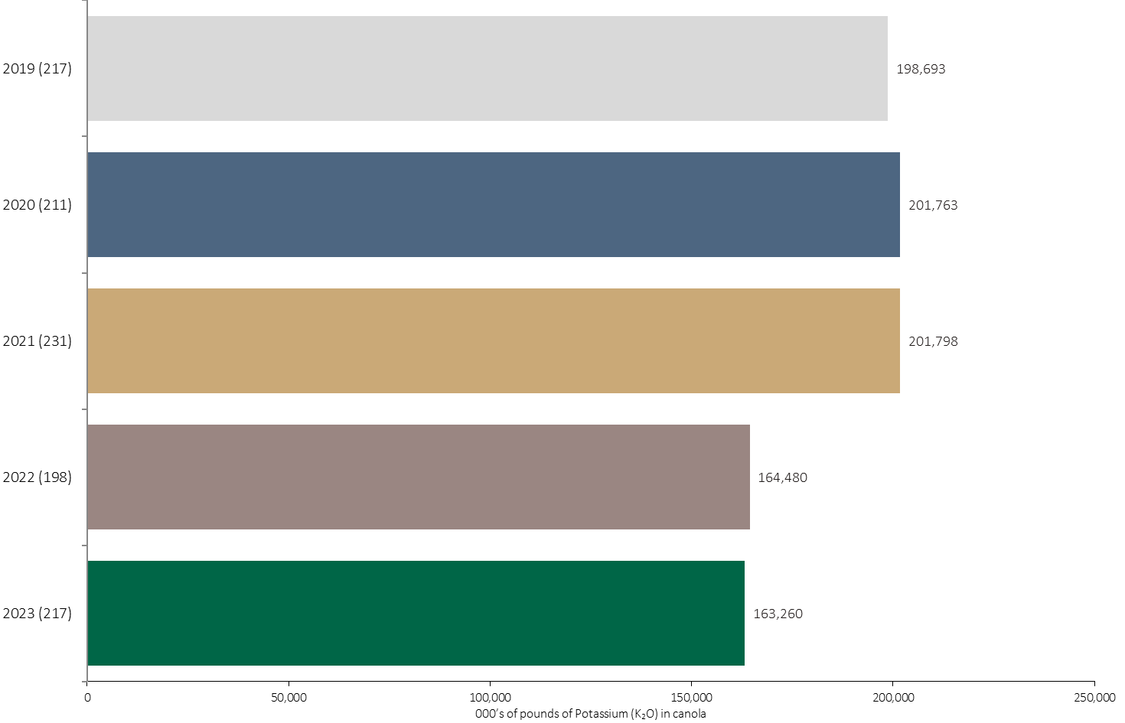
Potassium (K₂O) Volume in Canola
Canola
An estimated 163 million pounds of K₂O was used in canola in 2023.
Note: Potassium (K₂O) volume was calculated from all sources of potassium contained in all fertilizer types
For each fertilizer type used in either a custom blend or applied as an unblended product, respondents were asked: a) how many acres they applied, and b) the application rate in pounds of actual nutrient/ac. Volumes of each nutrient were calculated by multiplying acres treated times the application rate.
The chart illustrates the total potassium (K₂O) volume (000’s of pounds) that was used in each year. The potassium (K₂O) volume was calculated from all sources of potassium (K₂O) contained in all fertilizer types.

Slide 51
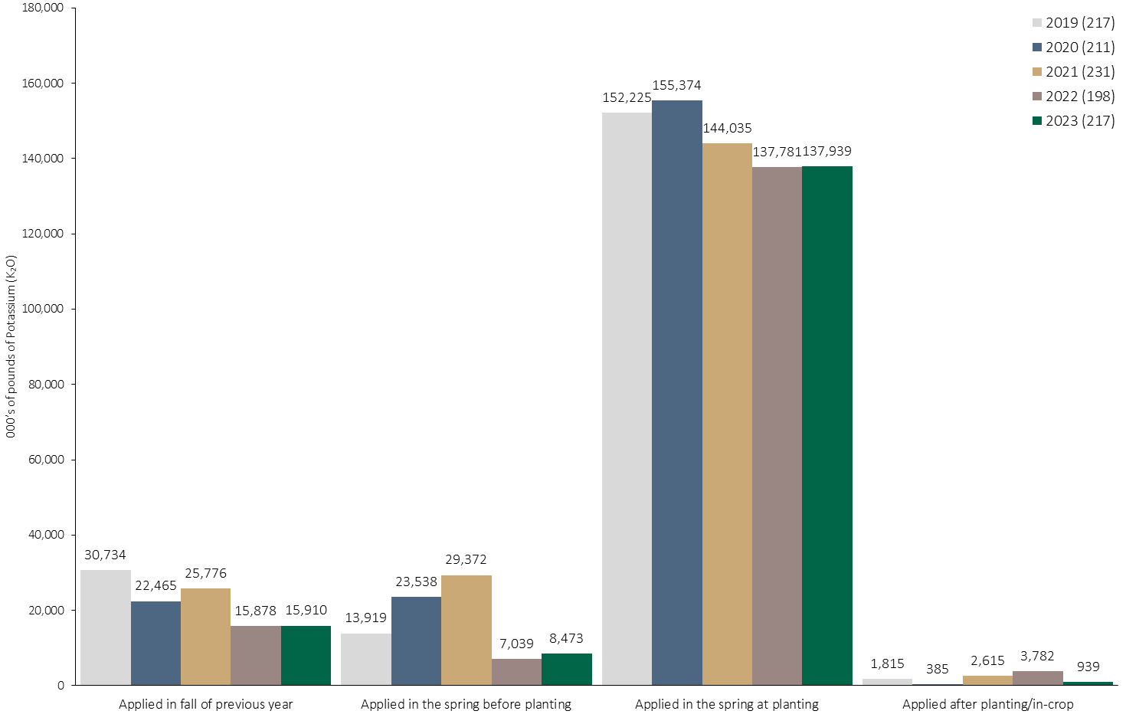
Potassium (K₂O) Volume in Canola by Timing
Canola
Note: Potassium (K₂O) volume was calculated from all sources of potassium contained in all fertilizer types
For each fertilizer type used in either a custom blend or applied as an unblended product, respondents were asked: a) how many acres they applied, and b) the application rate in pounds of actual nutrient/ac. Volumes of each nutrient were calculated by multiplying acres treated times the application rate.
The chart illustrates the total potassium (K₂O) volume (000’s of pounds) that was used in each year by application timing. The potassium (K₂O) volume was calculated from all sources of potassium (K₂O) contained in all fertilizer types.

Slide 52
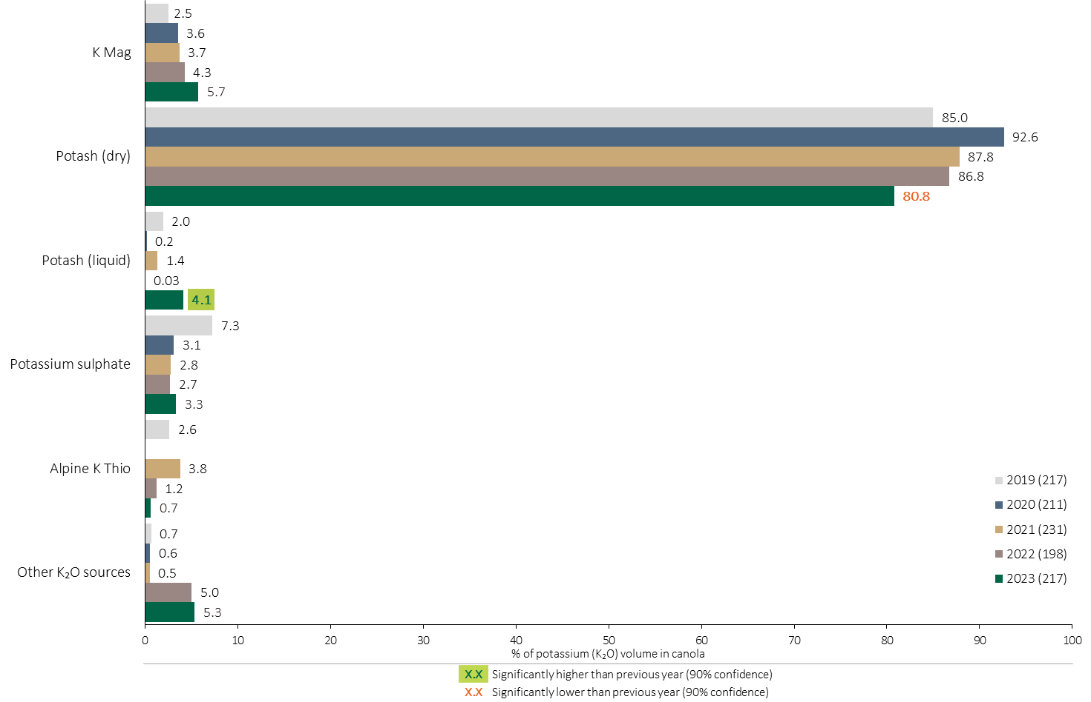
Potassium (K₂O) Fertilizer Source in Canola - All Timings
Canola
Canola Summary 
Overall use of dry Potash declined in 2023.
Use of liquid Potash increased in 2023.
Note: Potassium (K₂O) volume was calculated from all sources of potassium contained in all fertilizer types
For each fertilizer type used in either a custom blend or applied as an unblended product, respondents were asked: a) how many acres they applied, and b) the application rate in pounds of actual nutrient/ac. Volumes of each nutrient were calculated by multiplying acres treated times the application rate.
The chart illustrates the % of total potassium (K₂O) volume applied at all timings that was provided by each fertilizer type. The potassium (K₂O) volume was calculated from all sources of potassium (K₂O) contained in all fertilizer types.

Slide 53
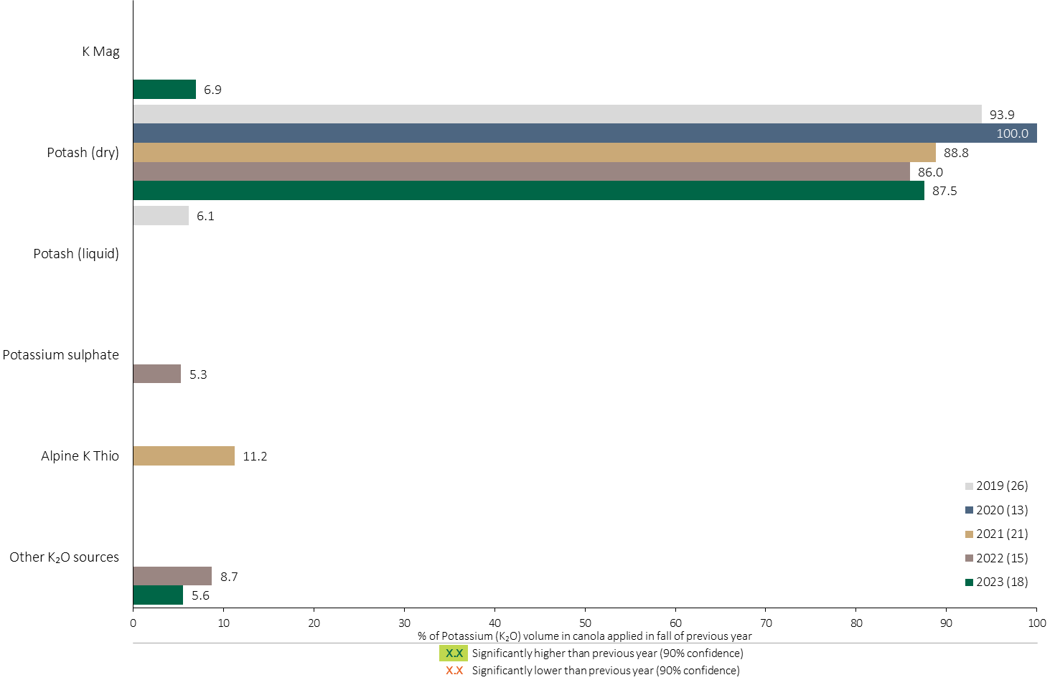
Potassium (K₂O) Fertilizer Source in Canola - Fall Timing
Canola
Note: Potassium (K₂O) volume was calculated from all sources of potassium contained in all fertilizer types
For each fertilizer type used in either a custom blend or applied as an unblended product, respondents were asked: a) how many acres they applied, and b) the application rate in pounds of actual nutrient/ac. Volumes of each nutrient were calculated by multiplying acres treated times the application rate.
The chart illustrates the % of total potassium (K₂O) volume applied at the fall timing that was provided by each fertilizer type. The potassium (K₂O) volume was calculated from all sources of potassium (K₂O) contained in all fertilizer types.

Slide 54
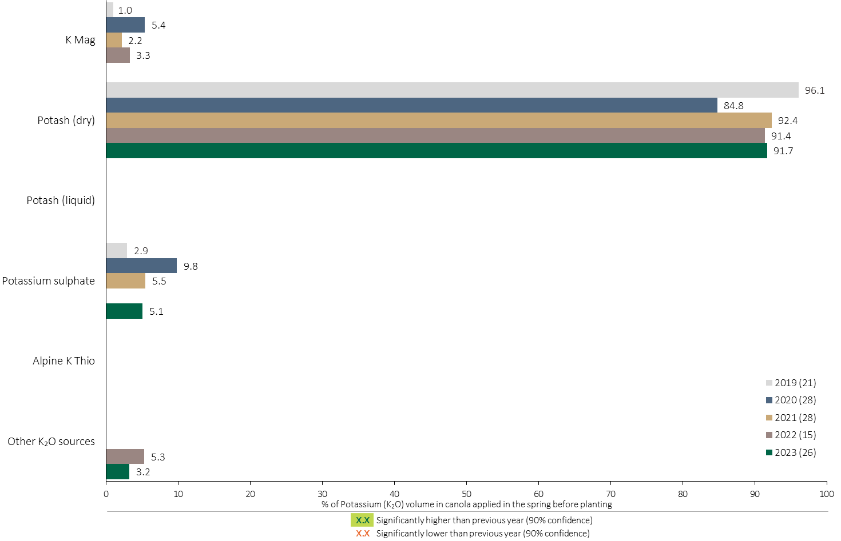
Potassium (K₂O) Fertilizer Source in Canola - Spring Before Planting
Canola
Note: Potassium (K₂O) volume was calculated from all sources of potassium contained in all fertilizer types
For each fertilizer type used in either a custom blend or applied as an unblended product, respondents were asked: a) how many acres they applied, and b) the application rate in pounds of actual nutrient/ac. Volumes of each nutrient were calculated by multiplying acres treated times the application rate.
The chart illustrates the % of total potassium (K₂O) volume applied in the spring before planting that was provided by each fertilizer type. The potassium (K₂O) volume was calculated from all sources of potassium (K₂O) contained in all fertilizer types.

Slide 55
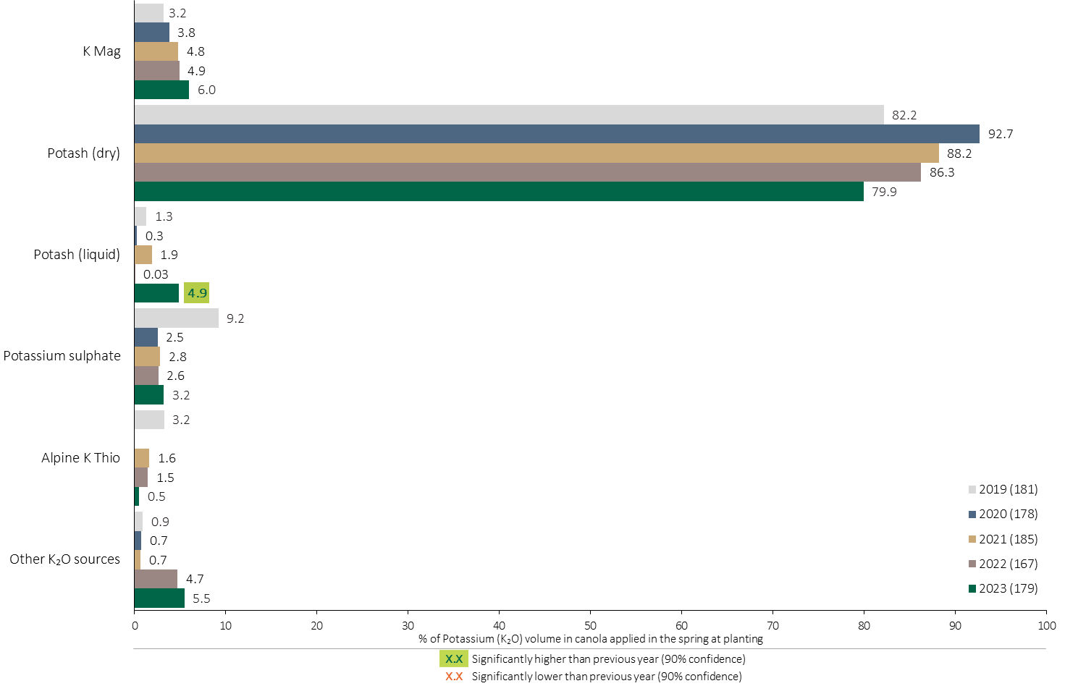
Potassium (K₂O) Fertilizer Source in Canola - At Planting
Canola
Use of dry Potash at planting continued to trend lower.
Use of liquid Potash at planting increased in 2023.
Note: Potassium (K₂O) volume was calculated from all sources of potassium contained in all fertilizer types
For each fertilizer type used in either a custom blend or applied as an unblended product, respondents were asked: a) how many acres they applied, and b) the application rate in pounds of actual nutrient/ac. Volumes of each nutrient were calculated by multiplying acres treated times the application rate.
The chart illustrates the % of total potassium (K₂O) volume applied in the spring at planting that was provided by each fertilizer type. The potassium (K₂O) volume was calculated from all sources of potassium (K₂O) contained in all fertilizer types.

Slide 56

Potassium (K₂O) Fertilizer Source in Canola by Timing
Canola
Note: Potassium (K₂O) volume was calculated from all sources of potassium contained in all fertilizer types
For each fertilizer type used in either a custom blend or applied as an unblended product, respondents were asked: a) how many acres they applied, and b) the application rate in pounds of actual nutrient/ac. Volumes of each nutrient were calculated by multiplying acres treated times the application rate.
Separately for each application timing, the graphs illustrate the % of total potassium (K₂O) volume applied in canola that came from each fertilizer source.
Total pounds of actual potassium (K₂O) applied was calculated based on all sources of potassium (K₂O) from all fertilizer types.

Slide 57

% of Canola Growers Using Each Sulphur Source in 2023
Canola
32% of canola growers used ammonium sulphate in 2023.
Note: Nutrients were defined based on any fertilizer type that contains the nutrient.
Respondents were asked: “For your 2023 canola crop, did you apply fertilizer or manure at each timing? – and given the options of a) Applied in fall of previous year, b) in the spring before planting, c) in the spring at planting and d) after planting/in-crop. For your 2023 canola crop, which fertilizer types did you apply at each timing?
The chart illustrates the % of canola growers who indicated that they used this nutrient and each fertilizer type in canola in 2023.
Nutrients were defined based on any fertilizer type that contains the nutrient.

Slide 58

% of Canola Growers Using Sulphur in 2023
Canola
MAP
Note: Nutrients were defined based on any fertilizer type that contains the nutrient.
Respondents were asked: “For your 2023 canola crop, did you apply fertilizer or manure at each timing? – and given the options of a) Applied in fall of previous year, b) in the spring before planting, c) in the spring at planting and d) after planting/in-crop. For your 2023 canola crop, which fertilizer types did you apply at each timing?
The chart illustrates the % of canola growers who indicated that they used this nutrient in canola in 2023 by province, eco zone, farm size, age and 4R familiarity.
Nutrients were defined based on any fertilizer type that contains the nutrient.

Slide 59

Acres Treated With Each Sulphur Source in Canola in 2023
Canola
Canola Summary 
30% of canola acres received an application of ammonium sulphate in 2023.
Note: Nutrients were defined based on the primary component of each fertilizer type
For each application timing, respondents were asked: “Of your [xxx] acres of canola, how many acres of each fertilizer type did you apply?”
The chart illustrates the % of total canola acres that were treated with this nutrient and each fertilizer type in 2023.
Nutrients were defined based on the primary component (see adjacent fertilizer types by clicking on the “A” button).

Slide 60

Sulphur Volume in Canola
Canola
An estimated 404 million pounds of Sulphur was used in canola in 2023.
Note: Sulphur volume was calculated from all sources of sulphur contained in all fertilizer types
For each fertilizer type used in either a custom blend or applied as an unblended product, respondents were asked: a) how many acres they applied, and b) the application rate in pounds of actual nutrient/ac. Volumes of each nutrient were calculated by multiplying acres treated times the application rate.
The chart illustrates the total sulphur volume (000’s of pounds) that was used in each year. The sulphur volume was calculated from all sources of sulphur contained in all fertilizer types.

Slide 61

Sulphur Volume in Canola by Timing
Canola
Note: Sulphur volume was calculated from all sources of sulphur contained in all fertilizer types
For each fertilizer type used in either a custom blend or applied as an unblended product, respondents were asked: a) how many acres they applied, and b) the application rate in pounds of actual nutrient/ac. Volumes of each nutrient were calculated by multiplying acres treated times the application rate.
The chart illustrates the total sulphur volume (000’s of pounds) that was used in each year by application timing. The sulphur volume was calculated from all sources of sulphur contained in all fertilizer types.

Slide 62

Sulphur Fertilizer Source in Canola - All Timings
Use of MicroEssentials edged higher in 2023, as a % of total Sulphur volume.
Canola
Use of ammonium sulphate was stable in 2023.
Canola Summary 
Note: Sulphur volume was calculated from all sources of sulphur contained in all fertilizer types
For each fertilizer type used in either a custom blend or applied as an unblended product, respondents were asked: a) how many acres they applied, and b) the application rate in pounds of actual nutrient/ac. Volumes of each nutrient were calculated by multiplying acres treated times the application rate.
The chart illustrates the % of total sulphur volume applied at all timings that was provided by each fertilizer type. The sulphur volume was calculated from all sources of sulphur contained in all fertilizer types.

Slide 63

Sulphur Fertilizer Source in Canola - Fall Timing
Canola
Use of Ammonium Sulphate in the fall edged lower in 2023.
Increased use of NutraSul90 at the fall timing in 2023.
Note: Sulphur volume was calculated from all sources of sulphur contained in all fertilizer types
For each fertilizer type used in either a custom blend or applied as an unblended product, respondents were asked: a) how many acres they applied, and b) the application rate in pounds of actual nutrient/ac. Volumes of each nutrient were calculated by multiplying acres treated times the application rate.
The chart illustrates the % of total sulphur volume applied at the fall timing that was provided by each fertilizer type. The sulphur volume was calculated from all sources of sulphur contained in all fertilizer types.

Slide 64

Sulphur Fertilizer Source in Canola - Spring Before Planting
Canola
Note: Sulphur volume was calculated from all sources of sulphur contained in all fertilizer types
For each fertilizer type used in either a custom blend or applied as an unblended product, respondents were asked: a) how many acres they applied, and b) the application rate in pounds of actual nutrient/ac. Volumes of each nutrient were calculated by multiplying acres treated times the application rate.
The chart illustrates the % of total sulphur volume applied in the spring before planting that was provided by each fertilizer type. The sulphur volume was calculated from all sources of sulphur contained in all fertilizer types.

Slide 65

Sulphur Fertilizer Source in Canola - At Planting
Use of MicroEssentials at planting increased in 2023.
Canola
Use of Ammonium sulphate fines and NutraSul90 at planting declined in 2023.
Note: Sulphur volume was calculated from all sources of sulphur contained in all fertilizer types
For each fertilizer type used in either a custom blend or applied as an unblended product, respondents were asked: a) how many acres they applied, and b) the application rate in pounds of actual nutrient/ac. Volumes of each nutrient were calculated by multiplying acres treated times the application rate.
The chart illustrates the % of total sulphur volume applied in the spring at planting that was provided by each fertilizer type. The sulphur volume was calculated from all sources of sulphur contained in all fertilizer types.

Slide 66

Sulphur Fertilizer Source in Canola by Timing
Canola
Note: Sulphur volume was calculated from all sources of sulphur contained in all fertilizer types
For each fertilizer type used in either a custom blend or applied as an unblended product, respondents were asked: a) how many acres they applied, and b) the application rate in pounds of actual nutrient/ac. Volumes of each nutrient were calculated by multiplying acres treated times the application rate.
Separately for each application timing, the graphs illustrate the % of total sulphur volume applied in canola that came from each fertilizer source.
Total pounds of actual sulphur applied was calculated based on all sources of sulphur from all fertilizer types.

Slide 67

Nitrogen Placement in Canola - % Crop Acres
Canola
Note: Nutrients were defined based on the primary component of each fertilizer type
For each application timing, respondents were asked: “Of your [xxx] acres of canola, how many acres of each fertilizer type did you apply?”
For Nitrogen, the chart illustrates the % of total canola acres that was applied using each placement at each timing.
Nitrogen was defined based on it being the primary component (see adjacent fertilizer types by clicking on the “A” button).

Slide 68

Nitrogen Placement in Canola - % Nutrient Volume Applied at All Timings
Canola
Canola Summary 
Note: Nutrient volume was calculated from all sources of the nutrient contained in all fertilizer types
For each fertilizer type used in either a custom blend or applied as an unblended product, respondents were asked: a) how many acres they applied, and b) the application rate in pounds of actual nutrient/ac. Volumes of each nutrient were calculated by multiplying acres treated times the application rate.
For Nitrogen, the graph illustrates the % of total nutrient volume applied in canola that was applied at each timing/placement (i.e. across all timings, the sum of percentages = 100%).
Total pounds of actual nutrient applied was calculated based on all sources of the nutrient from all fertilizer types.

Slide 69

Phosphorus (P₂O₅) Placement in Canola - % Crop Acres
Canola
Note: Nutrients were defined based on the primary component of each fertilizer type
For each application timing, respondents were asked: “Of your [xxx] acres of canola, how many acres of each fertilizer type did you apply?”
For Phosphorus, the chart illustrates the % of total canola acres that was applied using each placement at each timing.
Phosphorus was defined based on it being the primary component (see adjacent fertilizer types by clicking on the “A” button).

Slide 70

Phosphorus (P₂O₅) Placement in Canola - % Nutrient Volume Applied at All Timings
Canola
Canola Summary 
Note: Nutrient volume was calculated from all sources of the nutrient contained in all fertilizer types
For each fertilizer type used in either a custom blend or applied as an unblended product, respondents were asked: a) how many acres they applied, and b) the application rate in pounds of actual nutrient/ac. Volumes of each nutrient were calculated by multiplying acres treated times the application rate.
For Phosphorus, the graph illustrates the % of total nutrient volume applied in canola that was applied at each timing/placement (i.e. across all timings, the sum of percentages = 100%).
Total pounds of actual nutrient applied was calculated based on all sources of the nutrient from all fertilizer types.

Slide 71

Potassium (K₂O) Placement in Canola - % Crop Acres
Canola
Note: Nutrients were defined based on the primary component of each fertilizer type
For each application timing, respondents were asked: “Of your [xxx] acres of canola, how many acres of each fertilizer type did you apply?”
For Potassium, the chart illustrates the % of total canola acres that was applied using each placement at each timing.
Potassium was defined based on it being the primary component (see adjacent fertilizer types by clicking on the “A” button).

Slide 72

Potassium (K₂O) Placement in Canola - % Nutrient Volume Applied at All Timings
Canola
Canola Summary 
Note: Nutrient volume was calculated from all sources of the nutrient contained in all fertilizer types
For each fertilizer type used in either a custom blend or applied as an unblended product, respondents were asked: a) how many acres they applied, and b) the application rate in pounds of actual nutrient/ac. Volumes of each nutrient were calculated by multiplying acres treated times the application rate.
For Potassium, the graph illustrates the % of total nutrient volume applied in canola that was applied at each timing/placement (i.e. across all timings, the sum of percentages = 100%).
Total pounds of actual nutrient applied was calculated based on all sources of the nutrient from all fertilizer types.

Slide 73

Sulphur Placement in Canola - % Crop Acres
Canola
Note: Nutrients were defined based on the primary component of each fertilizer type
For each application timing, respondents were asked: “Of your [xxx] acres of canola, how many acres of each fertilizer type did you apply?”
For Sulphur, the chart illustrates the % of total canola acres that was applied using each placement at each timing.
Sulphur was defined based on it being the primary component (see adjacent fertilizer types by clicking on the “A” button).

Slide 74

Sulphur Placement in Canola - % Nutrient Volume Applied at All Timings
Canola
Canola Summary 
Note: Nutrient volume was calculated from all sources of the nutrient contained in all fertilizer types
For each fertilizer type used in either a custom blend or applied as an unblended product, respondents were asked: a) how many acres they applied, and b) the application rate in pounds of actual nutrient/ac. Volumes of each nutrient were calculated by multiplying acres treated times the application rate.
For Sulphur, the graph illustrates the % of total nutrient volume applied in canola that was applied at each timing/placement (i.e. across all timings, the sum of percentages = 100%).
Total pounds of actual nutrient applied was calculated based on all sources of the nutrient from all fertilizer types.

Slide 75

Average Nitrogen Rates in Canola
Average Nitrogen rates increased in 2023.
Canola
Canola Summary 
Note: Nitrogen volume was calculated from all sources of nitrogen contained in all fertilizer types
Note: Rates include growers who did not apply any nitrogen
For each fertilizer type used in either a custom blend or applied as an unblended product, respondents were asked: a) how many acres they applied, and b) the application rate in pounds of actual nutrient/ac. Volumes of each nutrient were calculated by multiplying acres treated times the application rate.
The chart illustrates the average rate of nitrogen applied in each year expressed in pounds of actual nitrogen per acre.

Slide 76

Nitrogen Rates in Canola - Average Rate in 2023
Canola
MAP
Note: Nitrogen volume was calculated from all sources of nitrogen contained in all fertilizer types
Note: Rates include growers who did not apply any nitrogen
For each fertilizer type used in either a custom blend or applied as an unblended product, respondents were asked: a) how many acres they applied, and b) the application rate in pounds of actual nutrient/ac. Volumes of each nutrient were calculated by multiplying acres treated times the application rate.
Separately by province, eco zone, farm size, age and 4R familiarity, the graph illustrates the average nitrogen application rate in pounds of nitrogen per acre (including untreated canola acres).

Slide 77

Nitrogen Rates in Canola - Rate Ranges in 2023
Canola
Note: Nitrogen volume was calculated from all sources of nitrogen contained in all fertilizer types
For each fertilizer type used in either a custom blend or applied as an unblended product, respondents were asked: a) how many acres they applied, and b) the application rate in pounds of actual nutrient/ac. Volumes of each nutrient were calculated by multiplying acres treated times the application rate.
The graph on the left illustrates the % of canola acres that were treated with nitrogen at an application rate that fell within each rate range. The graph on the right illustrates the cumulative % of canola acres that were treated with nitrogen at an application rate that fell within each rate range.

Slide 78

Nitrogen Rate Ranges in Canola - % of Volume in 2023
Canola
71% of the N volume was applied between 80 – 155 lbs./ac.
Note: Nitrogen volume was calculated from all sources of nitrogen contained in all fertilizer types
For each fertilizer type used in either a custom blend or applied as an unblended product, respondents were asked: a) how many acres they applied, and b) the application rate in pounds of actual nutrient/ac. Volumes of each nutrient were calculated by multiplying acres treated times the application rate.
The chart illustrates the % of nitrogen volume that was applied in canola within each rate range.
Total pounds of actual nitrogen applied was calculated based on all sources of nitrogen from all fertilizer types.

Slide 79

Average Nitrogen Rates in Canola - By Timing
Canola
Canola Summary 
Nitrogen rates both before planting and at planting edged higher in 2023.
Nitrogen rates after planting edged lower in 2023.
Note: Nitrogen volume was calculated from all sources of nitrogen contained in all fertilizer types
Note: Rates exclude growers who did not apply any nitrogen
For each fertilizer type used in either a custom blend or applied as an unblended product, respondents were asked: a) how many acres they applied, and b) the application rate in pounds of actual nutrient/ac. Volumes of each nutrient were calculated by multiplying acres treated times the application rate.
The chart illustrates the average rate of Nitrogen applied at each application timing in each year expressed in pounds of actual Nitrogen per acre.
Note: Rates exclude non-users of Nitrogen.

Slide 80

Average Phosphorus (P₂O₅) Rates in Canola
Phosphorus (P₂O₅) rates edged higher in 2023.
Canola
Canola Summary 
Note: Phosphorus (P₂O₅) volume was calculated from all sources of phosphorus contained in all fertilizer types
Note: Rates include growers who did not apply any phosphorus
For each fertilizer type used in either a custom blend or applied as an unblended product, respondents were asked: a) how many acres they applied, and b) the application rate in pounds of actual nutrient/ac. Volumes of each nutrient were calculated by multiplying acres treated times the application rate.
The chart illustrates the average rate of Phosphorus (P₂O₅) applied in each year expressed in pounds of actual Phosphorus (P₂O₅) per acre.
Note: Rates include non-users of Phosphorus (P₂O₅).

Slide 81

Phosphorus (P₂O₅) Rates in Canola - Average Rate in 2023
Canola
MAP
Note: Phosphorus (P₂O₅) volume was calculated from all sources of phosphorus contained in all fertilizer types
Note: Rates include growers who did not apply any phosphorus
For each fertilizer type used in either a custom blend or applied as an unblended product, respondents were asked: a) how many acres they applied, and b) the application rate in pounds of actual nutrient/ac. Volumes of each nutrient were calculated by multiplying acres treated times the application rate.
Separately by province, eco zone, farm size, age and 4R familiarity, the graph illustrates the average Phosphorus (P₂O₅) application rate in pounds of Phosphorus (P₂O₅) per acre (including untreated canola acres).

Slide 82

Phosphorus (P₂O₅) Rates in Canola - Rate Ranges in 2023
Canola
Canola Summary 
The most common P₂O₅ rate was between 30 – 35 pounds/acre.
Note: Phosphorus (P₂O₅) volume was calculated from all sources of phosphorus contained in all fertilizer types
For each fertilizer type used in either a custom blend or applied as an unblended product, respondents were asked: a) how many acres they applied, and b) the application rate in pounds of actual nutrient/ac. Volumes of each nutrient were calculated by multiplying acres treated times the application rate.
The graph on the left illustrates the % of canola acres that were treated with phosphorus (P₂O₅) at an application rate that fell within each rate range. The graph on the right illustrates the cumulative % of canola acres that were treated with phosphorus (P₂O₅) at an application rate that fell within each rate range.

Slide 83

Phosphorus (P₂O₅) Rate Ranges in Canola - % of Volume in 2023
Canola
75% of the P₂O₅ volume was applied between 20 - 55 lbs./ac.
Note: Phosphorus (P₂O₅) volume was calculated from all sources of phosphorus contained in all fertilizer types
For each fertilizer type used in either a custom blend or applied as an unblended product, respondents were asked: a) how many acres they applied, and b) the application rate in pounds of actual nutrient/ac. Volumes of each nutrient were calculated by multiplying acres treated times the application rate.
The chart illustrates the % of phosphorus (P₂O₅) volume that was applied in canola within each rate range.
Total pounds of actual phosphorus (P₂O₅) applied was calculated based on all sources of phosphorus (P₂O₅) from all fertilizer types.

Slide 84

Average Phosphorus (P₂O₅) Rates in Canola - By Timing
Canola
Note: Phosphorus (P₂O₅) volume was calculated from all sources of phosphorus contained in all fertilizer types
Note: Rates exclude growers who did not apply any phosphorus
For each fertilizer type used in either a custom blend or applied as an unblended product, respondents were asked: a) how many acres they applied, and b) the application rate in pounds of actual nutrient/ac. Volumes of each nutrient were calculated by multiplying acres treated times the application rate.
The chart illustrates the average rate of Phosphorus (P₂O₅) applied at each application timing in each year expressed in pounds of actual Phosphorus (P₂O₅) per acre.
Note: Rates exclude non-users of Phosphorus (P₂O₅).

Slide 85

Average Potassium (K₂O) Rates in Canola
Canola
Average Potassium (K₂O) rates in 2023 were similar to 2022.
Canola Summary 
Note: Potassium (K₂O) volume was calculated from all sources of potassium contained in all fertilizer types
Note: Rates include growers who did not apply any potassium
For each fertilizer type used in either a custom blend or applied as an unblended product, respondents were asked: a) how many acres they applied, and b) the application rate in pounds of actual nutrient/ac. Volumes of each nutrient were calculated by multiplying acres treated times the application rate.
The chart illustrates the average rate of Potassium (K₂O) applied in each year expressed in pounds of actual Potassium (K₂O) per acre.
Note: Rates include non-users of Potassium (K₂O).

Slide 86

Potassium (K₂O) Rates in Canola - Average Rate in 2023
Canola
Alberta farmers used higher K₂O rates.
MAP
Note: Potassium (K₂O) volume was calculated from all sources of potassium contained in all fertilizer types
Note: Rates include growers who did not apply any potassium
For each fertilizer type used in either a custom blend or applied as an unblended product, respondents were asked: a) how many acres they applied, and b) the application rate in pounds of actual nutrient/ac. Volumes of each nutrient were calculated by multiplying acres treated times the application rate.
Separately by province, eco zone, farm size, age and 4R familiarity, the graph illustrates the average potassium (K₂O) application rate in pounds of potassium (K₂O) per acre (including untreated canola acres).

Slide 87

Potassium (K₂O) Rates in Canola - Rate Ranges in 2023
Canola
63% of canola acres did not receive any Potassium in 2023.
Canola Summary 
Note: Potassium (K₂O) volume was calculated from all sources of potassium contained in all fertilizer types
For each fertilizer type used in either a custom blend or applied as an unblended product, respondents were asked: a) how many acres they applied, and b) the application rate in pounds of actual nutrient/ac. Volumes of each nutrient were calculated by multiplying acres treated times the application rate.
The graph on the left illustrates the % of canola acres that were treated with potassium (K₂O) at an application rate that fell within each rate range. The graph on the right illustrates the cumulative % of canola acres that were treated with potassium (K₂O) at an application rate that fell within each rate range.

Slide 88

Potassium (K₂O) Rate Ranges in Canola - % of Volume in 2023
Canola
Two spikes in K₂O rates at 10-14.9 pounds and 50+ pounds.
Note: Potassium (K₂O) volume was calculated from all sources of potassium contained in all fertilizer types
For each fertilizer type used in either a custom blend or applied as an unblended product, respondents were asked: a) how many acres they applied, and b) the application rate in pounds of actual nutrient/ac. Volumes of each nutrient were calculated by multiplying acres treated times the application rate.
The chart illustrates the % of potassium (K₂O) volume that was applied in canola within each rate range.
Total pounds of actual potassium (K₂O) applied was calculated based on all sources of potassium (K₂O) from all fertilizer types.

Slide 89

Average Potassium (K₂O) Rates in Canola - By Timing
Canola
Note: Potassium (K₂O) volume was calculated from all sources of potassium contained in all fertilizer types
Note: Rates exclude growers who did not apply any potassium
For each fertilizer type used in either a custom blend or applied as an unblended product, respondents were asked: a) how many acres they applied, and b) the application rate in pounds of actual nutrient/ac. Volumes of each nutrient were calculated by multiplying acres treated times the application rate.
The chart illustrates the average rate of Potassium (K₂O) applied at each application timing in each year expressed in pounds of actual Potassium (K₂O) per acre.
Note: Rates exclude non-users of Potassium (K₂O).

Slide 90

Average Sulphur Rates in Canola
Canola
Sulphur rates in 2023 were similar to 2022.
Canola Summary 
Note: Sulphur volume was calculated from all sources of sulphur contained in all fertilizer types
Note: Rates include growers who did not apply any sulphur
For each fertilizer type used in either a custom blend or applied as an unblended product, respondents were asked: a) how many acres they applied, and b) the application rate in pounds of actual nutrient/ac. Volumes of each nutrient were calculated by multiplying acres treated times the application rate.
The chart illustrates the average rate of Sulphur applied in each year expressed in pounds of actual Sulphur per acre.
Note: Rates include non-users of Sulphur.

Slide 91

Sulphur Rates in Canola - Average Rate in 2023
Canola
Growers in the Semiarid Prairies tend to use lower S rates.
MAP
Note: Sulphur volume was calculated from all sources of sulphur contained in all fertilizer types
For each fertilizer type used in either a custom blend or applied as an unblended product, respondents were asked: a) how many acres they applied, and b) the application rate in pounds of actual nutrient/ac. Volumes of each nutrient were calculated by multiplying acres treated times the application rate.
Separately by province, eco zone, farm size, age and 4R familiarity, the graph illustrates the average sulphur application rate in pounds of sulphur per acre (including untreated canola acres).

Slide 92

Sulphur Rates in Canola - Rate Ranges in 2023
Canola
Canola Summary 
Note: Sulphur volume was calculated from all sources of sulphur contained in all fertilizer types
For each fertilizer type used in either a custom blend or applied as an unblended product, respondents were asked: a) how many acres they applied, and b) the application rate in pounds of actual nutrient/ac. Volumes of each nutrient were calculated by multiplying acres treated times the application rate.
The graph on the left illustrates the % of canola acres that were treated with sulphur at an application rate that fell within each rate range. The graph on the right illustrates the cumulative % of canola acres that were treated with sulphur at an application rate that fell within each rate range.

Slide 93

Sulphur Rate Ranges in Canola - % of Volume in 2023
Canola
63% of the S volume was applied between 15 – 34.9 lbs./ac.
Note: Sulphur volume was calculated from all sources of sulphur contained in all fertilizer types
For each fertilizer type used in either a custom blend or applied as an unblended product, respondents were asked: a) how many acres they applied, and b) the application rate in pounds of actual nutrient/ac. Volumes of each nutrient were calculated by multiplying acres treated times the application rate.
The chart illustrates the % of sulphur volume that was applied in canola within each rate range.
Total pounds of actual sulphur applied was calculated based on all sources of sulphur from all fertilizer types.

Slide 94

Average Sulphur Rates in Canola - By Timing
Canola
Sulphur rates when applied at planting have been fairly consistent over the years.
Note: Sulphur volume was calculated from all sources of sulphur contained in all fertilizer types
Note: Rates exclude growers who did not apply any sulphur
For each fertilizer type used in either a custom blend or applied as an unblended product, respondents were asked: a) how many acres they applied, and b) the application rate in pounds of actual nutrient/ac. Volumes of each nutrient were calculated by multiplying acres treated times the application rate.
The chart illustrates the average rate of Sulphur applied at each application timing in each year expressed in pounds of actual Sulphur per acre.
Note: Rates exclude non-users of Sulphur.

Slide 95

Fertilizer Program in Canola
Canola
Two thirds of canola growers say they use the same fertilizer program on all of their canola fields.
Respondents were asked: “For your fertilizer application on your 2023 canola crop, did you: a) use variable rate technology based on prescription maps on all of your canola acres, b) use variable rate technology based on prescription maps on some of your canola acres, c) tailor your fertilizer program on a field-by-field basis or d) use exactly the same fertilizer program for all canola fields on the farm?
The graph illustrates the % of canola growers who followed each fertilizer program in their 2023 canola crop.

Slide 96

Trend in Fertilizer Program in Canola
Canola
Significantly more growers used variable rates on all of their fields in 2023.
Significantly fewer growers tailored their fertilizer program field by field.
Respondents were asked: “For your fertilizer application on your 2023 canola crop, did you: a) use variable rate technology based on prescription maps on all of your canola acres, b) use variable rate technology based on prescription maps on some of your canola acres, c) tailor your fertilizer program on a field-by-field basis or d) use exactly the same fertilizer program for all canola fields on the farm?
The graph illustrates the % of canola growers who followed each fertilizer program in their canola crop in each year.

Slide 97

Fertilizer Program in Canola – Rates Set by Expected Crop Yield
Canola
Some growers may be confused by the definition of ‘fertilizer program.’ 40% indicated they use the same program for all fields despite also setting rates by field.
Respondents were asked: “For your fertilizer application on your 2023 canola crop, did you: a) use variable rate technology based on prescription maps on all of your canola acres, b) use variable rate technology based on prescription maps on some of your canola acres, c) tailor your fertilizer program on a field-by-field basis or d) use exactly the same fertilizer program for all canola fields on the farm?
The graph illustrates the % of canola growers who followed each fertilizer program in their canola crop in each year.

Slide 98

Fertilizer Program in Canola - by Sub-Group
Canola
Large farms, young growers and those very familiar with 4R were more likely to have used variable rates.
MAP
Respondents were asked: “For your fertilizer application on your 2023 canola crop, did you: a) use variable rate technology based on prescription maps on all of your canola acres, b) use variable rate technology based on prescription maps on some of your canola acres, c) tailor your fertilizer program on a field-by-field basis or d) use exactly the same fertilizer program for all canola fields on the farm?
Separately by province, eco zone, farm size, age and 4R familiarity, the graph on the left illustrates the % of canola growers who used variable rates on some or all of their canola fields. The graph in the middle illustrates the % of canola growers who tailored their fertilizer program on a field-by-field basis. The graph on the right illustrates the % of canola growers who used the same fertilizer program on all of their canola fields.

Slide 99

Use of Variable Rates by Fertilizer Type
Canola
Users of each fertilizer type who used variable rates on some or all of their fields were asked: "For which of the following fertilizer types/blends did you use variable rates?"
The chart illustrates the % of users of each fertilizer type who used variable rates when they applied that fertilizer type.

Slide 100

Consistency Criteria for Canola
LEVEL 1 – NITROGEN
RATE Must meet the following criteria for N rate determination:
- Do one or more of the following:
- Soil test for N every year
- Nutrient balance calculation
- CCA/Qualified agronomist recommendation
- Follow provincial recommendations
- Use variable rate prescription maps
- Use on farm research
TIMING Must not do any of the following:
- Apply UAN or Ammonium nitrate in the fall
- Apply NH3 or Urea in the fall before October 15
- Apply any N fertilizer in winter on snow covered or frozen ground
PLACEMENT Must not do any of the following:
- Apply Urea in the fall on the surface with no incorporation
- Apply NH3, Urea, UAN or AN preplant on the surface with no incorporation
- Apply NH3, Urea, UAN or AN at planting on the surface with no incorporation
LEVEL 1 – PHOSPHORUS
RATE Must meet the following criteria for P rate determination:
- Soil test at least every 4 years AND
- Do one or more of the following:
    - Soil test
- Nutrient balance calculation
- CCA/Qualified agronomist recommendation
- Follow provincial recommendations
- Use variable rate prescription maps
- Use on farm research
TIMING Must not do any of the following:
- Apply any P fertilizer in winter on snow covered or frozen ground
PLACEMENT Must not do any of the following:
- Apply any P fertilizer in the fall on the surface with no incorporation
- Apply any P fertilizer preplant on the surface with no incorporation
- Apply any P fertilizer at planting on the surface with no incorporation
Canola
The % Level 1 compliant canola acres declined in 2023.
CONSISTENCY CRITERIA
Level 2 compliance continues to trend higher.
Level 1 consistency means that the grower’s on-farm practices meet the requirements for 4R best management practices as defined by Fertilizer Canada.
Level 2 compliance means that, in addition to meeting the Level 1 criteria, the grower also works with a 4R designated agronomist.
The upper charts illustrate Level 1 Consistency with 4R best management practices expressed as the % of canola acres and canola acres (000s). The lower charts illustrate Level 2 Consistency expressed as the % of canola acres and canola acres (000s).
LEVEL 2 Must work with a 4R Designated Agronomist

Slide 101

Reasons for Not Meeting 4R Consistency Criteria
Canola
In 2023, more canola acres did not meet 4R consistency criteria because of Nitrogen rate and placement criteria.
In 2023, more canola acres did not meet one or more 4R consistency criteria.
Respondents were asked a series of questions about their fertilizer use practices. Those practices were matched against the 4R consistency criteria that were developed by Fertilizer Canada.
The chart illustrates the reasons for not meeting the 4R Consistency Criteria, expressed as a % of total planted acres of this crop.

Slide 102

Do Not Meet 4R Consistency Criteria in 2023
Canola
Growers in Saskatchewan more often did not meet 4R consistency criteria.
Small to mid-sized farms and those who lack knowledge of 4R more often do not meet 4R Consistency Criteria.
Respondents were asked a series of questions about their fertilizer use practices. Those practices were matched against the 4R consistency criteria that were developed by Fertilizer Canada.
The chart illustrates the % of total planted acres of this crop that did not meet the 4R consistency criteria across various geographic and demographic segments.

Slide 103

Use of Nitrogen Fixing Crop in Previous Year - Canola
Canola
More growers in the Semiarid Prairies grew a N-fixing crop in 2022.
Large farms were more likely to have grown a N-Fixing crop in 2022.
Growers with limited 4R knowledge were less likely to have grown a N-fixing crop.
MAP
Respondents were asked: “Thinking of your 2023 canola crop, in the year prior (2022) did you grow a nitrogen fixing crop on: a) all of your 2023 canola fields, b) some of your 2023 canola fields, or c) none of your 2023 canola fields? (Nitrogen fixing crops include peas, beans, corn for grains, chickpeas, oats, and forage legumes)."
The graph on the left illustrates the % of canola growers who planted a nitrogen fixing crop in 2022 on all of their 2023 canola fields, some of their 2023 canola fields or none of their 2023 canola fields. Separately by province, eco zone, farm size, age and 4R familiarity, the graph on the right illustrates the % of canola growers who planted a nitrogen fixing crop in 2022 on some or all of their 2023 canola fields.

Slide 104

Trend in Use of Nitrogen Fixing Crop in Previous Year - Canola
Canola
No changes to the number of canola growers reporting a nitrogen fixing crop in some or all of their fields in 2023.
Respondents were asked: “Thinking of your 2023 canola crop, in the year prior (2022) did you grow a nitrogen fixing crop on: a) all of your 2023 canola fields, b) some of your 2023 canola fields, or c) none of your 2023 canola fields? (Nitrogen fixing crops include peas, beans, corn for grains, chickpeas, oats, and forage legumes).“
The chart illustrates the % of canola growers who planted a nitrogen fixing crop in the prior year on all of their canola fields, some of their canola fields or none of their canola fields.

Slide 105

Rates Set By Field Based On Expected Crop Yield
Canola
Growers in Manitoba more often set rates by field.
41% of canola growers set rates by field in 2023.
Large farms more often set rates by field.
4R knowledge is linked to setting rates by field.
MAP
Respondents were asked: "Do you set specific rates for each canola field based on expected crop yield?"
The chart on the left illustrates the % of canola growers who set rates for each field based on expected crop yield in each year. Separately for various geographic and demographic segments, the chart on the right illustrates the % of canola growers who set rates based on expected yields.

Slide 106

Approaches Used to Decide Fertilizer Rate in Canola
Canola
Respondents who used a fertilizer type containing each nutrient were asked: “For each nutrient, which approaches did you use to decide the amount of fertilizer to apply to your canola in 2023? (Please check all that apply.)”
Separately by nutrient type, the graphs illustrate the % of nutrient users who used each approach to decide their application rate in canola in 2023.

Slide 107

Trend in Approaches Used to Decide Nitrogen Rate in Canola
Canola
More N users relied on provincial recommendations and variable rate prescription maps in 2023.
Respondents who used a fertilizer type containing each nutrient were asked: “For each nutrient, which approaches did you use to decide the amount of fertilizer to apply to your canola in 2023? (Please check all that apply.)”
Separately by nutrient type, the graphs illustrate the % of Nitrogen users who used each approach to decide their application rate in canola in 2021 to 2023.

Slide 108

Trend in Approaches Used to Decide Phosphorus Rate in Canola
Canola
More P₂O₅ users relied on variable rate prescription maps in 2023.
Respondents who used a fertilizer type containing each nutrient were asked: “For each nutrient, which approaches did you use to decide the amount of fertilizer to apply to your canola in 2023? (Please check all that apply.)”
Separately by nutrient type, the graphs illustrate the % of Phosphorus users who used each approach to decide their application rate in 2021 to 2023.

Slide 109

Main Person Who Determined Fertilizer Rate
Canola
The more familiar growers are with 4R the less likely they were to rely on their retailer.
Respondents were asked: "Who was the main person who determined what fertilizer application rate you should use for your canola in 2023?"
The chart illustrates the % of canola growers who indicated each person who determined their fertilizer application rate in 2023.

Slide 110

Linkage of Who Makes Rate Decisions on 4R Consistency Compliance - Canola
Canola
When fertilizer rate decisions are made on farm, 4R Consistency is lower.
Respondents were asked: "Who is the main person who determined what fertilizer application rate you should use for your Canola?”
The chart illustrates the % of crop acres that meet Level 1 and Level 2 4R consistency criteria based on who made the fertilizer rate decision in each year.

Slide 111

Trend in Linkage of Who Makes Rate Decisions on 4R Consistency Compliance
- Canola
Canola
Level 1 compliance declined in 2023 among those who used an independent consultant or made fertilizer decisions on farm.
Respondents were asked: "Who is the main person who determined what fertilizer application rate you should use for your Spring Wheat?"
The chart illustrates the % of crop acres that meet Level 1 and Level 2 4R consistency criteria based on who made the fertilizer rate decision in each year.

Slide 112

Professional Designation of Person Who Determined Fertilizer Rate
Canola
Respondents were asked: "Did the person who determined your fertilizer application rate hold any of the following professional designations?"
Separately for each type of person who determined the fertilizer application rate, the charts illustrate the professional designation of those people.

Slide 113

Importance of Professional Designation
Canola
35% of those growers who use an ICA to provide fertilizer rate recommendations indicated the professional designation is extremely important.
Respondents were asked: "How important is it to you that the person providing your fertilizer application rate recommendation has a professional designation (i.e. CCA, P.Ag.)"
Separately for each type of person who determined the fertilizer application rate, the chart illustrates the level of importance for having a professional designation.

Slide 114

Deviation from Recommended Application Rate
Canola
Respondents were asked: "Did you decide to increase or decrease your fertilizer application rate in canola above or below the recommended rate?"
The pie chart illustrates the % of respondents who went above the recommended rate, below the recommended rate or applied the recommended rate. Separately for various geographic and demographic segments, the chart on the right illustrates the % of respondents who decreased their application rate below the recommended rate.

Slide 115

Reasons for Increasing Above Recommended Application Rate
Canola
Respondents who increased their fertilizer rate above the recommended rate were asked: "What were the reasons that you increased your fertilizer application rate in canola above the recommended rate?"
The chart illustrates the main reason and other reasons for applying more than the recommended rate in 2023.

Slide 116

Reasons for Decreasing Below Recommended Application Rate
44% of those who decreased their fertilizer rates said the main reason was fertilizer prices.
Canola
Respondents who decreased their fertilizer rate below the recommended rate were asked: "What were the reasons that you decreased your fertilizer application rate in canola below the recommended rate?"
The chart illustrates the main reason and other reasons for applying less than the recommended rate in 2023.

Slide 117

Use of Nitrogen Stabilizers in Canola - By Fertilizer Type
Canola
28% of canola acres treated with 28% UAN had a nitrogen stabilizer applied with the UAN in 2023.
Note: This analysis excludes ESN and SuperU
Separately for each timing, users of primary nitrogen fertilizers were asked: "Which of the following nitrogen stabilizers did you use?"
The chart illustrates the use of any nitrogen stabilizer on each nitrogen fertilizer type, expressed as the % of acres treated with each primary nitrogen fertilizer type.

Slide 118

Use of Nitrogen Stabilizers in Canola - By Application Timing
Canola
14% of fall-applied N-fertilizer had a nitrogen stabilizer applied.
Note: This analysis excludes ESN and SuperU
Separately for each timing, users of primary nitrogen fertilizers were asked: "Which of the following nitrogen stabilizers did you use?"
The chart illustrates the use of any nitrogen stabilizer on any nitrogen fertilizer type at each application timing, expressed as the % of acres of any primary nitrogen fertilizer type that was treated with any nitrogen stabilizer.

Slide 119

Use of Individual Nitrogen Stabilizers in Canola
Canola
Note: This analysis excludes ESN and SuperU
Separately for each timing, users of primary nitrogen fertilizers were asked: "Which of the following nitrogen stabilizers did you use?"
The chart illustrates the use of each nitrogen stabilizer product on any nitrogen fertilizer type at any timing, expressed as the % of acres of any primary nitrogen fertilizer type that was treated with each nitrogen stabilizer product.

Slide 120

Use of Nitrogen Stabilizers by Geographic/Demographic Segment
Canola
Nitrogen stabilizers were used less on small farms.
Those familiar with 4R were slightly more likely to use a stabilizer.
MAP
Note: This analysis excludes ESN and SuperU
Separately for each timing, users of primary nitrogen fertilizers were asked: "Which of the following nitrogen stabilizers did you use? "
Separately for each geographic and demographic segment, the chart illustrates the use of any nitrogen stabilizer on any nitrogen fertilizer type, expressed as the % of acres of any primary nitrogen fertilizer type that was treated with any nitrogen stabilizer.

Slide 121

Use of EEFs by Timing - % of Nitrogen Volume
20% of total N volume was applied in a protected form.
Canola
All respondents were asked: "Which of the following fertilizer types did you apply (the list included ESN and SuperU)?"
Respondents who used any other primary Nitrogen fertilizer (excluding ESN and SuperU) were asked: "Which of the following nitrogen stabilizers did you use?"
Separately for each application timing, the chart illustrates the % of primary Nitrogen fertilizer volume that was treated with each type of EEF.

Slide 122

Use of EEFS by Placement - % of Nitrogen Volume - Net All Timings
Canola
Respondents were asked: "Which of the following fertilizer types did you apply (the list included ESN and SuperU)"
Respondents who used any primary Nitrogen fertilizer (excluding ESN and SuperU) were asked: "Which of the following nitrogen stabilizers did you use?"
Separately for each EEF type, the chart illustrates the % of primary Nitrogen fertilizer volume that was applied with an EEF using each placement.

Slide 123

Target vs. Actual Yield in Canola
Target yields are consistently about 50 bu/ac.
Canola
Actual yields were about 8 bu/ac below targeted yields in 2023.
Respondents were asked: “What was your target yield for your canola in 2023 (respondents had the option to report that they did not have a target yield)? What was the average yield for your canola in 2023?
The graph illustrates the average target yield and the average actual yield reported in each year.

Slide 124

Target vs. Actual Yield in Canola in 2023
Canola
MAP
Respondents were asked: “What was your target yield for your canola in 2023 (respondents had the option to report that they did not have a target yield)? What was the average yield for your canola in 2023?
Separately by province, eco zone, farm size, age and 4R familiarity, the graph on the left illustrates the average target yield in 2023. The middle graph illustrates the average actual yield in 2023. The graph on the right illustrates the gap between the target yield and the actual yield.

Slide 125

Nitrogen Use Efficiency
Canola
The chart illustrates Canola nitrogen use efficiency based on average actual yields and target yields. The NUE was calculated by dividing the total volume of nitrogen applied across all timings in Canola by the average actual yield and target yield.

Slide 126

Factors Considered When Setting Target Yield
Canola
Respondents who set a target yield were asked: "Which of the following factors did you consider when you set your target yield for canola in 2023?"
The chart illustrates the main factor and other factors considered when setting the target yield in canola.

Slide 127

Use of Micro/Secondary Nutrients - % of Growers Using
Canola
Use of zinc decreased in 2023.
Separately for each timing, respondents were asked: “Did you use any of the following micro/secondary nutrients for your 2023 canola crop – boron, calcium, copper, magnesium, manganese, molybdenum, zinc?”
The chart illustrates the % of canola growers who used each micronutrient in each year.

Slide 128

Application Method for Micro/Secondary Nutrients
Canola
Respondents who used a micro or secondary nutrient were asked: "How were the micronutrients/secondary nutrients that you used in canola at [TIMING] applied? If you used more than one method, indicate the most common method that you used.
The chart illustrates the % of micro/secondary nutrient users who used each application method on a net basis for all application timings.

Slide 129

Formulation Type for Soil Applied Micro/Secondary Nutrients
Canola
44% of soil-applied Boron was granular.
Respondents who soil-applied a micro or secondary nutrient were asked: "For your soil applied micronutrients/secondary nutrients, what was the formulation?"
The chart illustrates the % of soil-applied micro/secondary nutrient users who indicated that they used each formulation type.

Slide 130

Method Used to Determine Need for Micro/Secondary Nutrients
Canola
Respondents who used a micro or secondary nutrient were asked: "How did you determine that you needed to apply [MICRONUTRIENT] in 2023?"
The chart illustrates the % of micro/secondary nutrient users who indicated that they used each method to determine the need for the micro/secondary nutrient.

Slide 131

Custom Application by Fertilizer Source
Canola
Respondents were asked: "For each fertilizer type that was applied [TIMING], was it custom applied?"
Separately for each fertilizer type, the chart illustrates the % of fertilizer type users who self-applied versus custom-applied the fertilizer type.

Slide 132

Custom Application by Fertilizer Source
Canola
Respondents were asked: "For each fertilizer type that was applied [TIMING], was it custom applied?"
Separately for each fertilizer type, the chart illustrates the % of fertilizer type users who self-applied versus custom-applied the fertilizer type.

Slide 133

Tillage Practices - % of planted acres
The majority of planted acres were zero till.
Canola
MAP
Respondents were asked: "For your tillage practices, what percent of your canola acres in 2023 was zero till, min-till and conventional tillage?
Zero till means there were no dedicated tillage operations and a reasonably low disturbance one-pass seeding opener.
Min-till means there was one tillage operation in addition to the seeding operation or a higher disturbance opener on the seeding equipment.
Conventional tillage means there were multiple tillage operations to prepare the seedbed.
Separately for various geographic and demographic segments, the chart illustrates the % of canola acres with each tillage practice.

Slide 134

Field Passes Used
Canola
Respondents were asked: "In those fields where you planted canola in 2023, which of the following field passes did you do?"
The chart illustrates the % of canola growers who completed each field pass.

Slide 135

Type of Seeding Equipment
Canola
31% of canola growers used a mid-row seeding equipment.
Respondents were asked: "For those fields where you planted canola in 2023, what type of seeding equipment did you use?"
The chart illustrates the % of canola growers who used each type of seeding equipment.

Slide 136

Opener Width
Canola
28% of canola growers used a 1-inch opener width.
Respondents were asked: "For the seeding equipment that you used to plant canola in 2023, what was the opener width?
The chart illustrates the % of canola growers who used seeding equipment with each opener width.

Slide 137

Row Spacing
Canola
Respondents were asked: "For your canola in 2023, what was the row spacing?"
The chart illustrates the % of canola growers who used each row spacing.

Slide 138

Seed Bed Utilization
Canola
Growers in Alberta and the boreal plains were more likely to have a higher seed bed utilization.
Growers who don’t know anything about 4R were more likely to have a higher seed bed utilization.
Respondents were asked: "For the seeding equipment that you used to plant canola in 2023, what was the opener width? For your canola in 2023, what was the row spacing?"
Seed bed utilization was calculated using the following formula: opener width divided by row spacing times 100.

Slide 139

Use of Biostimulants
Canola
Growers in Manitoba, small farms, older farmers and those unfamiliar with 4R were less likely to have used a biostimulant.
Respondents were asked: "Biostimulants contain substances or microorganisms whose marketed function when applied to plants or in the root zone is to stimulate natural processes to enhance nutrient uptake, nutrient use efficiency, tolerance to environmental stress, and/or crop quality. Examples include seaweed extracts, humic/fulvic acid, plant hormones, beneficial bacteria, or fungi, but not Bio-Pesticide products. Did you use a biostimulant product on your canola in the 2023 season?
The chart illustrates the % of growers who used a biostimulant in 2023.

Slide 140

Use of Nitrogen Fixing Biostimulants
Canola
Respondents who used a biostimulant were asked: "Was the biostimulant that you applied in canola in 2023 a nitrogen fixing product?
The chart illustrates the % of growers who used a nitrogen fixing biostimulant in 2023.

Slide 141
Spring Wheat
Fertilizer Timing
Fertilizer Source
Fertilizer Placement
Nitrogen Rates
Phosphorus Rates
Potassium Rates
Sulphur Rates
Answering Key Questions:
What are the most common application timings for each nutrient and fertilizer type?
What nutrients and fertilizer types are being used?
What are the most common placements for each nutrient and fertilizer type?
What rates are being applied?
To what extent do farmers vary their fertilizer program from field to field?
To what extent are farmers incorporating nitrogen fixing crops into their rotation?
How do farmers decide what fertilizer rate to apply?
How extensively are nitrogen stabilized products being used?
How do actual yields compare to target yields?
How many growers are applying micro or secondary nutrients?
How do fertilizer practices compare on owned versus rented land?
How did weather conditions impact fertilizer practices?
What tillage practices were used?
To what extent were biostimulants used?
Fertilizer Program
Use of Variable Rates by Fertilizer Type
Consistency with 4R Practices
Reasons for Not Meeting Consistency Criteria
Nitrogen Fixing Crop in Previous Year
Rates Set By Field
Approaches Used To Decide Fertilizer Rate
Main Person Who Determined Rate
Rate Decisions on 4R Consistency Compliance
Professional Designation
Importance of Professional Designation
Deviation from Recommended Rate
Reasons for Increasing Rate
Reasons for Decreasing Rate
Use of Nitrogen Stabilizers
Use of EEFs by Timing
Target Yield vs. Actual Yield
Nitrogen Use Efficiency
Factors Considered When Setting Target Yield
Use of Micro/Secondary Nutrients
Custom Application by Timing
Tillage Practices
Seeding Details
Use of Biostimulants
Use of Nitrogen Fixing Biostimulants
In SLIDESHOW VIEW, click on any title or button on the above slide to navigate to the section.
Use the icons in the side-bar of each slide for convenient navigation and quick access to more information:
DETAILED DATA
Escape from Slideshow View to NORMAL VIEW; then click to open a worksheet with detailed data.
ATTRIBUTES
Click to see the full attribute statement behind abbreviations used in charts.
BACK TO LIST
Click to return to the list of several similar charts.
INFORMATION
Click for a pop-up that explains the slide. Click again to hide.
SECTION NAVIGATION
Click to return to the navigation slide for the section you are in.
NAVIGATION
Click to return to this study navigation slide.

Slide 142

Fertilizer Applications in Spring Wheat - % Growers
Spring Wheat
A higher % of spring wheat growers applied fertilizer both in the fall and before planting in 2023.
Approximately 85% of spring wheat growers applied fertilizer at planting, a decrease from 2022.
Respondents were asked: “For your 2023 spring wheat crop, did you apply fertilizer at each timing? – and given the options of a) Applied in fall of previous year, b) in the spring before planting, c) in the spring at planting and d) after planting/in-crop.
The chart illustrates the % of respondents who applied fertilizer at each timing.

Slide 143

Fertilizer Applications in Spring Wheat - % Growers by Timing in 2023
Spring Wheat
MAP
Respondents were asked: “For your 2023 spring wheat crop, did you apply fertilizer at each timing? – and given the options of a) Applied in fall of previous year, b) in the spring before planting, c) in the spring at planting and d) after planting/in-crop.
Separately by province, eco zone, farm size, age and 4R program familiarity, the charts illustrate the % of spring wheat growers who applied fertilizer at each timing.

Slide 144

Manure Applications in Spring Wheat - % Growers
Spring Wheat
Applications of manure in spring wheat appear to be trending lower.
Respondents were asked: “For your 2023 spring wheat crop, did you apply manure at each timing? – and given the options of a) Applied in fall of previous year, b) in the spring before planting, c) in the spring at planting and d) after planting/in-crop.
The chart illustrates the % of respondents who applied manure at each timing.

Slide 145

Manure Applications in Spring Wheat - % Growers by Timing in 2023
Spring Wheat
MAP
Respondents were asked: “For your 2023 spring wheat crop, did you apply manure at each timing? – and given the options of a) Applied in fall of previous year, b) in the spring before planting, c) in the spring at planting and d) after planting/in-crop.
Separately by province, eco zone, farm size, age and 4R program familiarity, the charts illustrate the % of canola growers who applied manure at each timing.

Slide 146

Nitrogen Timing in Spring Wheat - % Crop Acres
Spring Wheat
A higher % of spring wheat acres were treated with a Nitrogen fertilizer in the fall compared to 2022.
Note: Nitrogen only includes those fertilizer types where nitrogen is the primary component.
For each application timing, respondents were asked: “Of your [xxx] acres of spring wheat, how many acres of each fertilizer type did you apply?”
The chart illustrates the % of total spring wheat acres that were treated with a primary Nitrogen fertilizer at each timing in each year. A list of Primary Nitrogen fertilizers can be accessed by clicking on the “A” button. Significant changes from 2022 to 2023 are highlighted.

Slide 147

Nitrogen Timing in Spring Wheat in 2023 (% of Crop Acres)
Spring Wheat
MAP
Note: Nitrogen only includes those fertilizer types where nitrogen is the primary component.
For each application timing, respondents were asked: “Of your [xxx] acres of spring wheat, how many acres of each fertilizer type did you apply?”
Separately for each timing, the charts illustrate the % of total spring wheat acres that was treated with a primary nitrogen fertilizer by province, eco zone, farm size, age and 4R program familiarity.
Nitrogen only includes those fertilizer types where nitrogen is the primary component. A list can be accessed by clicking on the “A” button.

Slide 148

Phosphorus (P₂O₅) Timing in Spring Wheat - % Crop Acres
Spring Wheat
Consistently, 83% of spring wheat acres were treated with a Phosphorus fertilizer at planting.
Note: Phosphorus only includes those fertilizer types where phosphorus is the primary component.
For each application timing, respondents were asked: “Of your [xxx] acres of spring wheat, how many acres of each fertilizer type did you apply?”
The chart illustrates the % of total spring wheat acres that were treated with a primary Phosphorus fertilizer at each timing in each year. A list of Primary Phosphorus fertilizers can be accessed by clicking on the “A” button. Significant changes from 2022 to 2023 are highlighted.

Slide 149

Phosphorus (P₂O₅) Timing in Spring Wheat in 2023 (% of Crop Acres)
Spring Wheat
MAP
Note: Phosphorus only includes those fertilizer types where phosphorus is the primary component.
For each application timing, respondents were asked: “Of your [xxx] acres of spring wheat, how many acres of each fertilizer type did you apply?”
Separately for each timing, the charts illustrate the % of total spring wheat acres that was treated with a primary phosphorus fertilizer by province, eco zone, farm size, age and 4R program familiarity.
Phosphorus only includes those fertilizer types where phosphorus is the primary component. A list can be accessed by clicking on the “A” button.

Slide 150

Potassium (K₂O) Timing in Spring Wheat - % Crop Acres
Spring Wheat
Note: Potassium only includes those fertilizer types where potassium is the primary component.
For each application timing, respondents were asked: “Of your [xxx] acres of spring wheat, how many acres of each fertilizer type did you apply?”
The chart illustrates the % of total spring wheat acres that were treated with a primary Potassium fertilizer at each timing in each year. A list of Primary Potassium fertilizers can be accessed by clicking on the “A” button. Significant changes from 2022 to 2023 are highlighted.

Slide 151

Potassium (K₂O) Timing in Spring Wheat in 2023 (% of Crop Acres)
Spring Wheat
MAP
Note: Potassium only includes those fertilizer types where potassium is the primary component.
For each application timing, respondents were asked: “Of your [xxx] acres of spring wheat, how many acres of each fertilizer type did you apply?”
Separately for each timing, the charts illustrate the % of total spring wheat acres that was treated with a primary potassium fertilizer by province, eco zone, farm size, age and 4R program familiarity.
Potassium only includes those fertilizer types where potassium is the primary component. A list can be accessed by clicking on the “A” button.

Slide 152

Sulphur Timing in Spring Wheat - % Crop Acres
Spring Wheat
Note: Sulphur only includes those fertilizer types where sulphur is the primary component.
For each application timing, respondents were asked: “Of your [xxx] acres of spring wheat, how many acres of each fertilizer type did you apply?”
The chart illustrates the % of total spring wheat acres that were treated with a primary Sulphur fertilizer at each timing in each year. A list of Primary Sulphur fertilizers can be accessed by clicking on the “A” button. Significant changes from 2022 to 2023 are highlighted.

Slide 153

Sulphur Timing in Spring Wheat in 2023 (% of Crop Acres)
Spring Wheat
MAP
Note: Sulphur only includes those fertilizer types where sulphur is the primary component.
For each application timing, respondents were asked: “Of your [xxx] acres of spring wheat, how many acres of each fertilizer type did you apply?”
Separately for each timing, the charts illustrate the % of total spring wheat acres that was treated with a primary sulphur fertilizer by province, eco zone, farm size, age and 4R program familiarity.
Sulphur only includes those fertilizer types where sulphur is the primary component. A list can be accessed by clicking on the “A” button.

Slide 154

Nitrogen Timing in Spring Wheat - % of Volume
Spring Wheat
Spring Wheat Summary 
A higher % of N volume was applied both in the fall and in the spring before planting, compared to 2022.
The % of N volume applied at planting declined in 2023.
Note: Nitrogen volume was calculated from all sources of nitrogen contained in all fertilizer types
For each fertilizer type used in either a custom blend or applied as an unblended product, respondents were asked: a) how many acres they applied, and b) the application rate in pounds of actual nutrient/ac. Volumes of each nutrient were calculated by multiplying acres treated times the application rate.
The graph illustrates the % of total Nitrogen volume applied in spring wheat that was applied at each timing in each year.
Total pounds of actual Nitrogen applied was calculated based on all sources of Nitrogen from all fertilizer types.

Slide 155

Nitrogen Timing in Spring Wheat in 2023 (% of Volume)
Spring Wheat
MAP
Note: Nitrogen volume was calculated from all sources of nitrogen contained in all fertilizer types
For each fertilizer type used in either a custom blend or applied as an unblended product, respondents were asked: a) how many acres they applied, and b) the application rate in pounds of actual nutrient/ac. Volumes of each nutrient were calculated by multiplying acres treated times the application rate.
Separately for each timing, the charts illustrate the % of total nitrogen volume that was applied by province, eco zone, farm size, age and 4R program familiarity.
Total pounds of actual nitrogen applied was calculated based on all sources of nitrogen from all fertilizer types.

Slide 156

Phosphorus (P₂O₅) Timing in Spring Wheat - % of Volume
Spring Wheat
Spring Wheat Summary 
About 90% of total Phosphorus volume applied in spring wheat was applied at planting.
Note: Phosphorus (P₂O₅) volume was calculated from all sources of phosphorus contained in all fertilizer types
For each fertilizer type used in either a custom blend or applied as an unblended product, respondents were asked: a) how many acres they applied, and b) the application rate in pounds of actual nutrient/ac. Volumes of each nutrient were calculated by multiplying acres treated times the application rate.
The graph illustrates the % of total Phosphorus (P₂O₅) volume applied in spring wheat that was applied at each timing in each year.
Total pounds of actual Phosphorus (P₂O₅) applied was calculated based on all sources of Phosphorus (P₂O₅) from all fertilizer types.

Slide 157

Phosphorus (P₂O₅) Timing in Spring Wheat in 2023 (% of Volume)
Spring Wheat
MAP
Note: Phosphorus (P₂O₅) volume was calculated from all sources of phosphorus contained in all fertilizer types
For each fertilizer type used in either a custom blend or applied as an unblended product, respondents were asked: a) how many acres they applied, and b) the application rate in pounds of actual nutrient/ac. Volumes of each nutrient were calculated by multiplying acres treated times the application rate.
Separately for each timing, the charts illustrate the % of total Phosphorus (P₂O₅) volume that was applied by province, eco zone, farm size, age and 4R program familiarity.
Total pounds of actual Phosphorus (P₂O₅) applied was calculated based on all sources of Phosphorus (P₂O₅) from all fertilizer types.

Slide 158

Potassium (K₂O) Timing in Spring Wheat - % of Volume
Spring Wheat
Spring Wheat Summary 
91% of Potassium (K₂O) volume was applied in the spring at planting in 2023.
Note: Potassium (K₂O) volume was calculated from all sources of potassium contained in all fertilizer types
For each fertilizer type used in either a custom blend or applied as an unblended product, respondents were asked: a) how many acres they applied, and b) the application rate in pounds of actual nutrient/ac. Volumes of each nutrient were calculated by multiplying acres treated times the application rate.
The graph illustrates the % of total Potassium (K₂O) volume applied in spring wheat that was applied at each timing in each year.
Total pounds of actual Potassium (K₂O) applied was calculated based on all sources of Potassium (K₂O) from all fertilizer types.

Slide 159

Potassium (K₂O) Timing in Spring Wheat in 2023 (% of Volume)
Spring Wheat
MAP
Note: Potassium (K₂O) volume was calculated from all sources of potassium contained in all fertilizer types
For each fertilizer type used in either a custom blend or applied as an unblended product, respondents were asked: a) how many acres they applied, and b) the application rate in pounds of actual nutrient/ac. Volumes of each nutrient were calculated by multiplying acres treated times the application rate.
Separately for each timing, the charts illustrate the % of total Potassium (K₂O) volume that was applied by province, eco zone, farm size, age and 4R program familiarity.
Total pounds of actual potassium (K₂O) applied was calculated based on all sources of potassium (K₂O) from all fertilizer types.

Slide 160

Sulphur Timing in Spring Wheat - % of Volume
Spring Wheat
Spring Wheat Summary 
86% of Sulphur volume in spring wheat was applied at planting in 2023.
Note: Sulphur volume was calculated from all sources of sulphur contained in all fertilizer types
For each fertilizer type used in either a custom blend or applied as an unblended product, respondents were asked: a) how many acres they applied, and b) the application rate in pounds of actual nutrient/ac. Volumes of each nutrient were calculated by multiplying acres treated times the application rate.
The graph illustrates the % of total Sulphur volume applied in spring wheat that was applied at each timing in each year.
Total pounds of actual Sulphur applied was calculated based on all sources of Sulphur from all fertilizer types.

Slide 161

Sulphur Timing in Spring Wheat in 2023 (% of Volume)
Spring Wheat
MAP
Note: Sulphur volume was calculated from all sources of sulphur contained in all fertilizer types
For each fertilizer type used in either a custom blend or applied as an unblended product, respondents were asked: a) how many acres they applied, and b) the application rate in pounds of actual nutrient/ac. Volumes of each nutrient were calculated by multiplying acres treated times the application rate.
Separately for each timing, the charts illustrate the % of total sulphur volume that was applied by province, eco zone, farm size, age and 4R program familiarity.
Total pounds of actual sulphur applied was calculated based on all sources of sulphur from all fertilizer types.

Slide 162

% of Spring Wheat Growers Using Each Nitrogen Source in 2023
Spring Wheat
25% of spring wheat growers used Anhydrous ammonia in 2023.
Note: Nutrients were defined based on any fertilizer type that contains the nutrient.
Respondents were asked: “For your 2023 spring wheat crop, did you apply fertilizer or manure at each timing? – and given the options of a) Applied in fall of previous year, b) in the spring before planting, c) in the spring at planting and d) after planting/in-crop. For your 2023 spring wheat crop, which fertilizer types did you apply at each timing?
The chart illustrates the % of spring wheat growers who indicated that they used this nutrient and each fertilizer type in spring wheat in 2023.
Nutrients were defined based on any fertilizer type that contains the nutrient.

Slide 163

% of Spring Wheat Growers Using Nitrogen n 2023
Spring Wheat
MAP
Note: Nutrients were defined based on any fertilizer type that contains the nutrient.
Respondents were asked: “For your 2023 spring wheat crop, did you apply fertilizer or manure at each timing? – and given the options of a) Applied in fall of previous year, b) in the spring before planting, c) in the spring at planting and d) after planting/in-crop. For your 2023 spring wheat crop, which fertilizer types did you apply at each timing?
The chart illustrates the % of spring wheat growers who indicated that they used this nutrient in spring wheat in 2023 by province, eco zone, farm size, age and 4R familiarity.
Nutrients were defined based on any fertilizer type that contains the nutrient.

Slide 164

Acres Treated With Each Nitrogen Source in Spring Wheat in 2023
Spring Wheat
Multiple Nitrogen fertilizers were applied on some spring wheat acres.
Spring Wheat Summary 
67% of spring wheat acres received an application of urea in 2023.
Note: Nutrients were defined based on the primary component of each fertilizer type
For each application timing, respondents were asked: “Of your [xxx] acres of spring wheat, how many acres of each fertilizer type did you apply?”
The chart illustrates the % of total spring wheat acres that were treated with this nutrient and each fertilizer type in 2023.
Nutrients were defined based on the primary component (see adjacent fertilizer types by clicking on the “A” button).

Slide 165

Nitrogen Volume in Spring Wheat
Spring Wheat
An estimated 1.8 billion pounds of N was used in spring wheat in 2023.
Note: Nitrogen volume was calculated from all sources of nitrogen contained in all fertilizer types
For each fertilizer type used in either a custom blend or applied as an unblended product, respondents were asked: a) how many acres they applied, and b) the application rate in pounds of actual nutrient/ac. Volumes of each nutrient were calculated by multiplying acres treated times the application rate.
The chart illustrates the total nitrogen volume (000’s of pounds) that was used in each year. The nitrogen volume was calculated from all sources of nitrogen contained in all fertilizer types.

Slide 166

Nitrogen Volume in Spring Wheat by Timing
Spring Wheat
Note: Nitrogen volume was calculated from all sources of nitrogen contained in all fertilizer types
For each fertilizer type used in either a custom blend or applied as an unblended product, respondents were asked: a) how many acres they applied, and b) the application rate in pounds of actual nutrient/ac. Volumes of each nutrient were calculated by multiplying acres treated times the application rate.
The chart illustrates the total nitrogen volume (000’s of pounds) that was used in each year by application timing. The nitrogen volume was calculated from all sources of nitrogen contained in all fertilizer types.

Slide 167

Nitrogen Fertilizer Source in Spring Wheat - All Timings
Spring Wheat
Spring Wheat Summary 
Use of Urea was stable in 2023.
Note: Nitrogen volume was calculated from all sources of nitrogen contained in all fertilizer types
For each fertilizer type used in either a custom blend or applied as an unblended product, respondents were asked: a) how many acres they applied, and b) the application rate in pounds of actual nutrient/ac. Volumes of each nutrient were calculated by multiplying acres treated times the application rate.
The chart illustrates the % of total nitrogen volume applied at all timings that was provided by each fertilizer type. The nitrogen volume was calculated from all sources of nitrogen contained in all fertilizer types.

Slide 168

Nitrogen Fertilizer Source in Spring Wheat - Fall Timing
Spring Wheat
Use of Anhydrous ammonia declined in 2023, as a % of total N volume at the fall timing.
Use of both ESN/SuperU and UAN in the fall increased in 2023.
Note: Nitrogen volume was calculated from all sources of nitrogen contained in all fertilizer types
For each fertilizer type used in either a custom blend or applied as an unblended product, respondents were asked: a) how many acres they applied, and b) the application rate in pounds of actual nutrient/ac. Volumes of each nutrient were calculated by multiplying acres treated times the application rate.
The chart illustrates the % of total nitrogen volume applied in the fall of the previous year that was provided by each fertilizer type. The nitrogen volume was calculated from all sources of nitrogen contained in all fertilizer types.

Slide 169

Nitrogen Fertilizer Source in Spring Wheat - Spring Before Planting
Spring Wheat
Use of Urea continues to trend higher as a % of total N volume applied in the spring before planting.
Use of UAN before planting increased in 2023.
Use of Other N sources before planting declined in 2023.
Note: Nitrogen volume was calculated from all sources of nitrogen contained in all fertilizer types
For each fertilizer type used in either a custom blend or applied as an unblended product, respondents were asked: a) how many acres they applied, and b) the application rate in pounds of actual nutrient/ac. Volumes of each nutrient were calculated by multiplying acres treated times the application rate.
The chart illustrates the % of total nitrogen volume applied in the spring before planting that was provided by each fertilizer type. The nitrogen volume was calculated from all sources of nitrogen contained in all fertilizer types.

Slide 170

Nitrogen Fertilizer Source in Spring Wheat - At Planting
Spring Wheat
Use of anhydrous ammonia at planting declined in 2023.
Urea represents 64% of the total N volume applied in the spring at planting.
Note: Nitrogen volume was calculated from all sources of nitrogen contained in all fertilizer types
For each fertilizer type used in either a custom blend or applied as an unblended product, respondents were asked: a) how many acres they applied, and b) the application rate in pounds of actual nutrient/ac. Volumes of each nutrient were calculated by multiplying acres treated times the application rate.
The chart illustrates the % of total nitrogen volume applied in the spring at planting that was provided by each fertilizer type. The nitrogen volume was calculated from all sources of nitrogen contained in all fertilizer types.

Slide 171

Nitrogen Fertilizer Source in Spring Wheat - In-Crop
Spring Wheat
UAN edged higher to 35% of total N volume applied in-crop in 2023.
Note: Nitrogen volume was calculated from all sources of nitrogen contained in all fertilizer types
For each fertilizer type used in either a custom blend or applied as an unblended product, respondents were asked: a) how many acres they applied, and b) the application rate in pounds of actual nutrient/ac. Volumes of each nutrient were calculated by multiplying acres treated times the application rate.
The chart illustrates the % of total nitrogen volume applied after planting/in-crop that was provided by each fertilizer type. The nitrogen volume was calculated from all sources of nitrogen contained in all fertilizer types.

Slide 172

Nitrogen Fertilizer Source in Spring Wheat by Timing
Spring Wheat
Note: Nitrogen volume was calculated from all sources of nitrogen contained in all fertilizer types
For each fertilizer type used in either a custom blend or applied as an unblended product, respondents were asked: a) how many acres they applied, and b) the application rate in pounds of actual nutrient/ac. Volumes of each nutrient were calculated by multiplying acres treated times the application rate.
Separately for each application timing, the graphs illustrate the % of total nitrogen volume applied in spring wheat that came from each fertilizer source.
Total pounds of actual nitrogen applied was calculated based on all sources of nitrogen from all fertilizer types.

Slide 173

% of Spring Wheat Growers Using Each Phosphorus (P₂O₅) Source in 2023
Spring Wheat
72% of spring wheat growers used MAP in 2023.
Note: Nutrients were defined based on any fertilizer type that contains the nutrient.
Respondents were asked: “For your 2023 spring wheat crop, did you apply fertilizer or manure at each timing? – and given the options of a) Applied in fall of previous year, b) in the spring before planting, c) in the spring at planting and d) after planting/in-crop. For your 2023 spring wheat crop, which fertilizer types did you apply at each timing?
The chart illustrates the % of spring wheat growers who indicated that they used this nutrient and each fertilizer type in spring wheat in 2023.
Nutrients were defined based on any fertilizer type that contains the nutrient.

Slide 174

% of Spring Wheat Growers Using Phosphorus (P₂O₅) n 2023
Spring Wheat
MAP
Note: Nutrients were defined based on any fertilizer type that contains the nutrient.
Respondents were asked: “For your 2023 spring wheat crop, did you apply fertilizer or manure at each timing? – and given the options of a) Applied in fall of previous year, b) in the spring before planting, c) in the spring at planting and d) after planting/in-crop. For your 2023 spring wheat crop, which fertilizer types did you apply at each timing?
The chart illustrates the % of spring wheat growers who indicated that they used this nutrient in spring wheat in 2023 by province, eco zone, farm size, age and 4R familiarity.
Nutrients were defined based on any fertilizer type that contains the nutrient.

Slide 175

Acres Treated With Each Phosphorus (P₂O₅) Source in Spring Wheat in 2023
Spring Wheat
Spring Wheat Summary 
70% of spring wheat acres were treated with MAP in 2023.
Note: Nutrients were defined based on the primary component of each fertilizer type
For each application timing, respondents were asked: “Of your [xxx] acres of spring wheat, how many acres of each fertilizer type did you apply?”
The chart illustrates the % of total spring wheat acres that were treated with this nutrient and each fertilizer type in 2023.
Nutrients were defined based on the primary component (see adjacent fertilizer types by clicking on the “A” button).

Slide 176

Phosphorus (P₂O₅) Volume in Spring Wheat
Spring Wheat
An estimated 576 million pounds of P₂O₅ was used in spring wheat in 2023.
Note: Phosphorus (P₂O₅) volume was calculated from all sources of phosphorus contained in all fertilizer types
For each fertilizer type used in either a custom blend or applied as an unblended product, respondents were asked: a) how many acres they applied, and b) the application rate in pounds of actual nutrient/ac. Volumes of each nutrient were calculated by multiplying acres treated times the application rate.
The chart illustrates the total phosphorus (P₂O₅) volume (000’s of pounds) that was used in each year. The phosphorus (P₂O₅) volume was calculated from all sources of phosphorus (P₂O₅) contained in all fertilizer types.

Slide 177

Phosphorus (P₂O₅) Volume in Spring Wheat by Timing
Spring Wheat
Note: Phosphorus (P₂O₅) volume was calculated from all sources of phosphorus contained in all fertilizer types
For each fertilizer type used in either a custom blend or applied as an unblended product, respondents were asked: a) how many acres they applied, and b) the application rate in pounds of actual nutrient/ac. Volumes of each nutrient were calculated by multiplying acres treated times the application rate.
The chart illustrates the total phosphorus (P₂O₅) volume (000’s of pounds) that was used in each year by application timing. The phosphorus (P₂O₅) volume was calculated from all sources of phosphorus (P₂O₅) contained in all fertilizer types.

Slide 178

Phosphorus (P₂O₅) Fertilizer Source in Spring Wheat - All Timings
Spring Wheat
Use of liquid ammonium polyphosphate increased in 2023.
Spring Wheat Summary 
Use of MAP increased in 2023, as a % of total Phosphorus (P₂O₅) volume.
Use of both rock phosphate and other P fertilizers declined in 2023.
Note: Phosphorus (P₂O₅) volume was calculated from all sources of phosphorus contained in all fertilizer types
For each fertilizer type used in either a custom blend or applied as an unblended product, respondents were asked: a) how many acres they applied, and b) the application rate in pounds of actual nutrient/ac. Volumes of each nutrient were calculated by multiplying acres treated times the application rate.
The chart illustrates the % of total phosphorus (P₂O₅) volume applied at all timings that was provided by each fertilizer type. The phosphorus (P₂O₅) volume was calculated from all sources of phosphorus (P₂O₅) contained in all fertilizer types.

Slide 179

Phosphorus (P₂O₅) Fertilizer Source in Spring Wheat - Fall Timing
Spring Wheat
Note: Phosphorus (P₂O₅) volume was calculated from all sources of phosphorus contained in all fertilizer types
For each fertilizer type used in either a custom blend or applied as an unblended product, respondents were asked: a) how many acres they applied, and b) the application rate in pounds of actual nutrient/ac. Volumes of each nutrient were calculated by multiplying acres treated times the application rate.
The chart illustrates the % of total phosphorus (P₂O₅) volume applied at the fall timing that was provided by each fertilizer type. The phosphorus (P₂O₅) volume was calculated from all sources of phosphorus (P₂O₅) contained in all fertilizer types.

Slide 180

Phosphorus (P₂O₅) Fertilizer Source in Spring Wheat - Spring Before Planting
Spring Wheat
MAP was the primary source of Phosphorus (P₂O₅) applied before planting in 2023.
Note: Phosphorus (P₂O₅) volume was calculated from all sources of phosphorus contained in all fertilizer types
For each fertilizer type used in either a custom blend or applied as an unblended product, respondents were asked: a) how many acres they applied, and b) the application rate in pounds of actual nutrient/ac. Volumes of each nutrient were calculated by multiplying acres treated times the application rate.
The chart illustrates the % of total phosphorus (P₂O₅) volume applied in the spring before planting that was provided by each fertilizer type. The phosphorus (P₂O₅) volume was calculated from all sources of phosphorus (P₂O₅) contained in all fertilizer types.

Slide 181

Phosphorus (P₂O₅) Fertilizer Source in Spring Wheat - At Planting
Spring Wheat
Use of MAP increased in 2023 as a % of total Phosphorus (P₂O₅) volume applied at planting.
Note: Phosphorus (P₂O₅) volume was calculated from all sources of phosphorus contained in all fertilizer types
For each fertilizer type used in either a custom blend or applied as an unblended product, respondents were asked: a) how many acres they applied, and b) the application rate in pounds of actual nutrient/ac. Volumes of each nutrient were calculated by multiplying acres treated times the application rate.
The chart illustrates the % of total phosphorus (P₂O₅) volume applied in the spring at planting that was provided by each fertilizer type. The phosphorus (P₂O₅) volume was calculated from all sources of phosphorus (P₂O₅) contained in all fertilizer types.

Slide 182

Phosphorus (P₂O₅) Fertilizer Source in Spring Wheat by Timing
Spring Wheat
Note: Phosphorus (P₂O₅) volume was calculated from all sources of phosphorus contained in all fertilizer types
For each fertilizer type used in either a custom blend or applied as an unblended product, respondents were asked: a) how many acres they applied, and b) the application rate in pounds of actual nutrient/ac. Volumes of each nutrient were calculated by multiplying acres treated times the application rate.
Separately for each application timing, the graphs illustrate the % of total phosphorus (P₂O₅) volume applied in spring wheat that came from each fertilizer source.
Total pounds of actual phosphorus (P₂O₅) applied was calculated based on all sources of phosphorus (P₂O₅) from all fertilizer types.

Slide 183

% of Spring Wheat Growers Using Each Potassium (K₂O) Source in 2023
Spring Wheat
35% of spring wheat growers used dry potash in 2023.
Note: Nutrients were defined based on any fertilizer type that contains the nutrient.
Respondents were asked: “For your 2023 spring wheat crop, did you apply fertilizer or manure at each timing? – and given the options of a) Applied in fall of previous year, b) in the spring before planting, c) in the spring at planting and d) after planting/in-crop. For your 2023 spring wheat crop, which fertilizer types did you apply at each timing?
The chart illustrates the % of spring wheat growers who indicated that they used this nutrient and each fertilizer type in spring wheat in 2023.
Nutrients were defined based on any fertilizer type that contains the nutrient.

Slide 184

% of Spring Wheat Growers Using Potassium (K₂O) n 2023
Spring Wheat
Growers in Alberta, the Boreal Plain and Subhumid Prairies were more likely to apply potassium.
MAP
Note: Nutrients were defined based on any fertilizer type that contains the nutrient.
Respondents were asked: “For your 2023 spring wheat crop, did you apply fertilizer or manure at each timing? – and given the options of a) Applied in fall of previous year, b) in the spring before planting, c) in the spring at planting and d) after planting/in-crop. For your 2023 spring wheat crop, which fertilizer types did you apply at each timing?
The chart illustrates the % of spring wheat growers who indicated that they used this nutrient in spring wheat in 2023 by province, eco zone, farm size, age and 4R familiarity.
Nutrients were defined based on any fertilizer type that contains the nutrient.

Slide 185

Acres Treated With Each Potassium (K₂O) Source in Spring Wheat in 2023
Spring Wheat
Spring Wheat Summary 
32% of spring wheat acres received an application of dry potash in 2023.
Note: Nutrients were defined based on the primary component of each fertilizer type
For each application timing, respondents were asked: “Of your [xxx] acres of spring wheat, how many acres of each fertilizer type did you apply?”
The chart illustrates the % of total spring wheat acres that were treated with this nutrient and each fertilizer type in 2023.
Nutrients were defined based on the primary component (see adjacent fertilizer types by clicking on the “A” button).

Slide 186

Potassium (K₂O) Volume in Spring Wheat
Spring Wheat
An estimated 125 million pounds of K₂O was used in spring wheat in 2023.
Note: Potassium (K₂O) volume was calculated from all sources of potassium contained in all fertilizer types
For each fertilizer type used in either a custom blend or applied as an unblended product, respondents were asked: a) how many acres they applied, and b) the application rate in pounds of actual nutrient/ac. Volumes of each nutrient were calculated by multiplying acres treated times the application rate.
The chart illustrates the total potassium (K₂O) volume (000’s of pounds) that was used in each year. The potassium (K₂O) volume was calculated from all sources of potassium (K₂O) contained in all fertilizer types.

Slide 187

Potassium (K₂O) Volume in Spring Wheat by Timing
Spring Wheat
Note: Potassium (K₂O) volume was calculated from all sources of potassium contained in all fertilizer types
For each fertilizer type used in either a custom blend or applied as an unblended product, respondents were asked: a) how many acres they applied, and b) the application rate in pounds of actual nutrient/ac. Volumes of each nutrient were calculated by multiplying acres treated times the application rate.
The chart illustrates the total potassium (K₂O) volume (000’s of pounds) that was used in each year by application timing. The potassium (K₂O) volume was calculated from all sources of potassium (K₂O) contained in all fertilizer types.

Slide 188

Potassium (K₂O) Fertilizer Source in Spring Wheat - All Timings
Spring Wheat
Spring Wheat Summary 
Use of Potash in spring wheat was stable in 2023.
Note: Potassium (K₂O) volume was calculated from all sources of potassium contained in all fertilizer types
For each fertilizer type used in either a custom blend or applied as an unblended product, respondents were asked: a) how many acres they applied, and b) the application rate in pounds of actual nutrient/ac. Volumes of each nutrient were calculated by multiplying acres treated times the application rate.
The chart illustrates the % of total potassium (K₂O) volume applied at all timings that was provided by each fertilizer type. The potassium (K₂O) volume was calculated from all sources of potassium (K₂O) contained in all fertilizer types.

Slide 189

Potassium (K₂O) Fertilizer Source in Spring Wheat - Fall Timing
Spring Wheat
Note: Potassium (K₂O) volume was calculated from all sources of potassium contained in all fertilizer types
For each fertilizer type used in either a custom blend or applied as an unblended product, respondents were asked: a) how many acres they applied, and b) the application rate in pounds of actual nutrient/ac. Volumes of each nutrient were calculated by multiplying acres treated times the application rate.
The chart illustrates the % of total potassium (K₂O) volume applied at the fall timing that was provided by each fertilizer type. The potassium (K₂O) volume was calculated from all sources of potassium (K₂O) contained in all fertilizer types.

Slide 190

Potassium (K₂O) Fertilizer Source in Spring Wheat - Spring Before Planting
Spring Wheat
Note: Potassium (K₂O) volume was calculated from all sources of potassium contained in all fertilizer types
For each fertilizer type used in either a custom blend or applied as an unblended product, respondents were asked: a) how many acres they applied, and b) the application rate in pounds of actual nutrient/ac. Volumes of each nutrient were calculated by multiplying acres treated times the application rate.
The chart illustrates the % of total potassium (K₂O) volume applied in the spring before planting that was provided by each fertilizer type. The potassium (K₂O) volume was calculated from all sources of potassium (K₂O) contained in all fertilizer types.

Slide 191

Potassium (K₂O) Fertilizer Source in Spring Wheat - At Planting
Spring Wheat
Use of dry Potash at planting was stable in 2023.
Note: Potassium (K₂O) volume was calculated from all sources of potassium contained in all fertilizer types
For each fertilizer type used in either a custom blend or applied as an unblended product, respondents were asked: a) how many acres they applied, and b) the application rate in pounds of actual nutrient/ac. Volumes of each nutrient were calculated by multiplying acres treated times the application rate.
The chart illustrates the % of total potassium (K₂O) volume applied in the spring at planting that was provided by each fertilizer type. The potassium (K₂O) volume was calculated from all sources of potassium (K₂O) contained in all fertilizer types.

Slide 192

Potassium (K₂O) Fertilizer Source in Spring Wheat by Timing
Spring Wheat
Note: Potassium (K₂O) volume was calculated from all sources of potassium contained in all fertilizer types
For each fertilizer type used in either a custom blend or applied as an unblended product, respondents were asked: a) how many acres they applied, and b) the application rate in pounds of actual nutrient/ac. Volumes of each nutrient were calculated by multiplying acres treated times the application rate.
Separately for each application timing, the graphs illustrate the % of total potassium (K₂O) volume applied in spring wheat that came from each fertilizer source.
Total pounds of actual potassium (K₂O) applied was calculated based on all sources of potassium (K₂O) from all fertilizer types.

Slide 193

% of Spring Wheat Growers Using Each Sulphur Source in 2023
Spring Wheat
11% of spring wheat growers used ammonium sulphate in 2023.
Note: Nutrients were defined based on any fertilizer type that contains the nutrient.
Respondents were asked: “For your 2023 spring wheat crop, did you apply fertilizer or manure at each timing? – and given the options of a) Applied in fall of previous year, b) in the spring before planting, c) in the spring at planting and d) after planting/in-crop. For your 2023 spring wheat crop, which fertilizer types did you apply at each timing?
The chart illustrates the % of spring wheat growers who indicated that they used this nutrient and each fertilizer type in spring wheat in 2023.
Nutrients were defined based on any fertilizer type that contains the nutrient.

Slide 194

% of Spring Wheat Growers Using Sulphur in 2023
Spring Wheat
Spring wheat growers in Alberta were more likely to apply sulphur.
MAP
Note: Nutrients were defined based on any fertilizer type that contains the nutrient.
Respondents were asked: “For your 2023 spring wheat crop, did you apply fertilizer or manure at each timing? – and given the options of a) Applied in fall of previous year, b) in the spring before planting, c) in the spring at planting and d) after planting/in-crop. For your 2023 spring wheat crop, which fertilizer types did you apply at each timing?
The chart illustrates the % of spring wheat growers who indicated that they used this nutrient in spring wheat in 2023 by province, eco zone, farm size, age and 4R familiarity.
Nutrients were defined based on any fertilizer type that contains the nutrient.

Slide 195

Acres Treated With Each Sulphur Source in Spring Wheat in 2023
Spring Wheat
Spring Wheat Summary 
11% of spring wheat acres were treated with ammonium sulphate in 2023.
Note: Nutrients were defined based on the primary component of each fertilizer type
For each application timing, respondents were asked: “Of your [xxx] acres of spring wheat, how many acres of each fertilizer type did you apply?”
The chart illustrates the % of total spring wheat acres that were treated with this nutrient and each fertilizer type in 2023.
Nutrients were defined based on the primary component (see adjacent fertilizer types by clicking on the “A” button).

Slide 196

Sulphur Volume in Spring Wheat
Spring Wheat
An estimated 100 million pounds of Sulphur was used in spring wheat in 2023.
Note: Sulphur volume was calculated from all sources of sulphur contained in all fertilizer types
For each fertilizer type used in either a custom blend or applied as an unblended product, respondents were asked: a) how many acres they applied, and b) the application rate in pounds of actual nutrient/ac. Volumes of each nutrient were calculated by multiplying acres treated times the application rate.
The chart illustrates the total sulphur volume (000’s of pounds) that was used in each year. The sulphur volume was calculated from all sources of sulphur contained in all fertilizer types.

Slide 197

Sulphur Volume in Spring Wheat by Timing
Spring Wheat
Note: Sulphur volume was calculated from all sources of sulphur contained in all fertilizer types
For each fertilizer type used in either a custom blend or applied as an unblended product, respondents were asked: a) how many acres they applied, and b) the application rate in pounds of actual nutrient/ac. Volumes of each nutrient were calculated by multiplying acres treated times the application rate.
The chart illustrates the total sulphur volume (000’s of pounds) that was used in each year by application timing. The sulphur volume was calculated from all sources of sulphur contained in all fertilizer types.

Slide 198

Sulphur Fertilizer Source in Spring Wheat - All Timings
Use of MicroEssentials as a % of total Sulphur volume increased in 2023.
Spring Wheat
Spring Wheat Summary 
Increased use of Ammonium thiosulphate in 2023.
Increased use of Super S in 2023 as a % of total Sulphur volume.
Decreased use of other Sulphur sources in 2023.
Note: Sulphur volume was calculated from all sources of sulphur contained in all fertilizer types
For each fertilizer type used in either a custom blend or applied as an unblended product, respondents were asked: a) how many acres they applied, and b) the application rate in pounds of actual nutrient/ac. Volumes of each nutrient were calculated by multiplying acres treated times the application rate.
The chart illustrates the % of total sulphur volume applied at all timings that was provided by each fertilizer type. The sulphur volume was calculated from all sources of sulphur contained in all fertilizer types.

Slide 199

Sulphur Fertilizer Source in Spring Wheat - Fall Timing
Spring Wheat
Increased use of NutraSul90 in the fall as % of total S volume.
Note: Sulphur volume was calculated from all sources of sulphur contained in all fertilizer types
For each fertilizer type used in either a custom blend or applied as an unblended product, respondents were asked: a) how many acres they applied, and b) the application rate in pounds of actual nutrient/ac. Volumes of each nutrient were calculated by multiplying acres treated times the application rate.
The chart illustrates the % of total sulphur volume applied at the fall timing that was provided by each fertilizer type. The sulphur volume was calculated from all sources of sulphur contained in all fertilizer types.

Slide 200

Sulphur Fertilizer Source in Spring Wheat - Spring Before Planting
Spring Wheat
Note: Sulphur volume was calculated from all sources of sulphur contained in all fertilizer types
For each fertilizer type used in either a custom blend or applied as an unblended product, respondents were asked: a) how many acres they applied, and b) the application rate in pounds of actual nutrient/ac. Volumes of each nutrient were calculated by multiplying acres treated times the application rate.
The chart illustrates the % of total sulphur volume applied in the spring before planting that was provided by each fertilizer type. The sulphur volume was calculated from all sources of sulphur contained in all fertilizer types.

Slide 201

Sulphur Fertilizer Source in Spring Wheat - At Planting
Increased use of MicroEssentials at planting in 2023.
Spring Wheat
Increased use Super S at planting in 2023.
Note: Sulphur volume was calculated from all sources of sulphur contained in all fertilizer types
For each fertilizer type used in either a custom blend or applied as an unblended product, respondents were asked: a) how many acres they applied, and b) the application rate in pounds of actual nutrient/ac. Volumes of each nutrient were calculated by multiplying acres treated times the application rate.
The chart illustrates the % of total sulphur volume applied in the spring at planting that was provided by each fertilizer type. The sulphur volume was calculated from all sources of sulphur contained in all fertilizer types.

Slide 202

Sulphur Fertilizer Source in Spring Wheat by Timing
Spring Wheat
Note: Sulphur volume was calculated from all sources of sulphur contained in all fertilizer types
For each fertilizer type used in either a custom blend or applied as an unblended product, respondents were asked: a) how many acres they applied, and b) the application rate in pounds of actual nutrient/ac. Volumes of each nutrient were calculated by multiplying acres treated times the application rate.
Separately for each application timing, the graphs illustrate the % of total sulphur volume applied in spring wheat that came from each fertilizer source.
Total pounds of actual sulphur applied was calculated based on all sources of sulphur from all fertilizer types.

Slide 203

Nitrogen Placement in Spring Wheat - % Crop Acres
Spring Wheat
Note: Nutrients were defined based on the primary component of each fertilizer type
For each application timing, respondents were asked: “Of your [xxx] acres of spring wheat, how many acres of each fertilizer type did you apply?”
For Nitrogen, the chart illustrates the % of total spring wheat acres that was applied using each placement at each timing.
Nitrogen was defined based on it being the primary component (see adjacent fertilizer types by clicking on the “A” button).

Slide 204

Nitrogen Placement in Spring Wheat - % Nutrient Volume Applied at All Timings
Spring Wheat
Spring Wheat Summary 
Note: Nutrient volume was calculated from all sources of the nutrient contained in all fertilizer types
For each fertilizer type used in either a custom blend or applied as an unblended product, respondents were asked: a) how many acres they applied, and b) the application rate in pounds of actual nutrient/ac. Volumes of each nutrient were calculated by multiplying acres treated times the application rate.
For Nitrogen, the graph illustrates the % of total nutrient volume applied in spring wheat that was applied at each timing/placement (i.e. across all timings, the sum of percentages = 100%).
Total pounds of actual nutrient applied was calculated based on all sources of the nutrient from all fertilizer types.

Slide 205

Phosphorus (P₂O₅) Placement in Spring Wheat - % Crop Acres
Spring Wheat
Note: Nutrients were defined based on the primary component of each fertilizer type
For each application timing, respondents were asked: “Of your [xxx] acres of spring wheat, how many acres of each fertilizer type did you apply?”
For Phosphorus, the chart illustrates the % of total spring wheat acres that was applied using each placement at each timing.
Phosphorus was defined based on it being the primary component (see adjacent fertilizer types by clicking on the “A” button).

Slide 206

Phosphorus (P₂O₅) Placement in Spring Wheat - % Nutrient Volume Applied at All Timings
Spring Wheat
Spring Wheat Summary 
Note: Nutrient volume was calculated from all sources of the nutrient contained in all fertilizer types
For each fertilizer type used in either a custom blend or applied as an unblended product, respondents were asked: a) how many acres they applied, and b) the application rate in pounds of actual nutrient/ac. Volumes of each nutrient were calculated by multiplying acres treated times the application rate.
For Phosphorus, the graph illustrates the % of total nutrient volume applied in spring wheat that was applied at each timing/placement (i.e. across all timings, the sum of percentages = 100%).
Total pounds of actual nutrient applied was calculated based on all sources of the nutrient from all fertilizer types.

Slide 207

Potassium (K₂O) Placement in Spring Wheat - % Crop Acres
Spring Wheat
Note: Nutrients were defined based on the primary component of each fertilizer type
For each application timing, respondents were asked: “Of your [xxx] acres of spring wheat, how many acres of each fertilizer type did you apply?”
For Potassium, the chart illustrates the % of total spring wheat acres that was applied using each placement at each timing.
Potassium was defined based on it being the primary component (see adjacent fertilizer types by clicking on the “A” button).

Slide 208

Potassium (K₂O) Placement in Spring Wheat - % Nutrient Volume Applied at All Timings
Spring Wheat
Spring Wheat Summary 
Note: Nutrient volume was calculated from all sources of the nutrient contained in all fertilizer types
For each fertilizer type used in either a custom blend or applied as an unblended product, respondents were asked: a) how many acres they applied, and b) the application rate in pounds of actual nutrient/ac. Volumes of each nutrient were calculated by multiplying acres treated times the application rate.
For Potassium, the graph illustrates the % of total nutrient volume applied in spring wheat that was applied at each timing/placement (i.e. across all timings, the sum of percentages = 100%).
Total pounds of actual nutrient applied was calculated based on all sources of the nutrient from all fertilizer types.

Slide 209

Sulphur Placement in Spring Wheat - % Crop Acres
Spring Wheat
Note: Nutrients were defined based on the primary component of each fertilizer type
For each application timing, respondents were asked: “Of your [xxx] acres of spring wheat, how many acres of each fertilizer type did you apply?”
For Sulphur, the chart illustrates the % of total spring wheat acres that was applied using each placement at each timing.
Sulphur was defined based on it being the primary component (see adjacent fertilizer types by clicking on the “A” button).

Slide 210

Sulphur Placement in Spring Wheat - % Nutrient Volume Applied at All Timings
Spring Wheat
Spring Wheat Summary 
Note: Nutrient volume was calculated from all sources of the nutrient contained in all fertilizer types
For each fertilizer type used in either a custom blend or applied as an unblended product, respondents were asked: a) how many acres they applied, and b) the application rate in pounds of actual nutrient/ac. Volumes of each nutrient were calculated by multiplying acres treated times the application rate.
For Sulphur, the graph illustrates the % of total nutrient volume applied in spring wheat that was applied at each timing/placement (i.e. across all timings, the sum of percentages = 100%).
Total pounds of actual nutrient applied was calculated based on all sources of the nutrient from all fertilizer types.

Slide 211

Average Nitrogen Rates in Spring Wheat
Average Nitrogen rates were higher in 2023 compared to 2022.
Spring Wheat
Spring Wheat Summary 
Note: Nitrogen volume was calculated from all sources of nitrogen contained in all fertilizer types
Note: Rates include growers who did not apply any nitrogen
For each fertilizer type used in either a custom blend or applied as an unblended product, respondents were asked: a) how many acres they applied, and b) the application rate in pounds of actual nutrient/ac. Volumes of each nutrient were calculated by multiplying acres treated times the application rate.
The chart illustrates the average rate of nitrogen applied in each year expressed in pounds of actual nitrogen per acre.

Slide 212

Nitrogen Rates in Spring Wheat - Average Rate in 2023
Manitoba growers tend to use higher N rates.
Spring Wheat
MAP
Note: Nitrogen volume was calculated from all sources of nitrogen contained in all fertilizer types
Note: Rates include growers who did not apply any nitrogen
For each fertilizer type used in either a custom blend or applied as an unblended product, respondents were asked: a) how many acres they applied, and b) the application rate in pounds of actual nutrient/ac. Volumes of each nutrient were calculated by multiplying acres treated times the application rate.
Separately by province, eco zone, farm size, age and 4R familiarity, the graph illustrates the average nitrogen application rate in pounds of nitrogen per acre (including untreated spring wheat acres).

Slide 213

Nitrogen Rates in Spring Wheat - Rate Ranges in 2023
Spring Wheat
The most common Nitrogen rate was between 85 to 89.9 pounds/acre.
Note: Nitrogen volume was calculated from all sources of nitrogen contained in all fertilizer types
For each fertilizer type used in either a custom blend or applied as an unblended product, respondents were asked: a) how many acres they applied, and b) the application rate in pounds of actual nutrient/ac. Volumes of each nutrient were calculated by multiplying acres treated times the application rate.
The graph on the left illustrates the % of spring wheat acres that were treated with nitrogen at an application rate that fell within each rate range. The graph on the right illustrates the cumulative % of spring wheat acres that were treated with nitrogen at an application rate that fell within each rate range.

Slide 214

Nitrogen Rate Ranges in Spring Wheat - % of Volume in 2023
Spring Wheat
70% of the N volume was applied between 75 - 134.9 lbs./ac.
Note: Nitrogen volume was calculated from all sources of nitrogen contained in all fertilizer types
For each fertilizer type used in either a custom blend or applied as an unblended product, respondents were asked: a) how many acres they applied, and b) the application rate in pounds of actual nutrient/ac. Volumes of each nutrient were calculated by multiplying acres treated times the application rate.
The chart illustrates the % of nitrogen volume that was applied in spring wheat within each rate range.
Total pounds of actual nitrogen applied was calculated based on all sources of nitrogen from all fertilizer types.

Slide 215

Average Nitrogen Rates in Spring Wheat - By Timing
Spring Wheat
Spring Wheat Summary 
Nitrogen rates before planting were higher in 2023.
Note: Nitrogen volume was calculated from all sources of nitrogen contained in all fertilizer types
Note: Rates exclude growers who did not apply any nitrogen
For each fertilizer type used in either a custom blend or applied as an unblended product, respondents were asked: a) how many acres they applied, and b) the application rate in pounds of actual nutrient/ac. Volumes of each nutrient were calculated by multiplying acres treated times the application rate.
The chart illustrates the average rate of Nitrogen applied at each application timing in each year expressed in pounds of actual Nitrogen per acre.
Note: Rates exclude non-users of Nitrogen.

Slide 216

Average Phosphorus (P₂O₅) Rates in Spring Wheat
Phosphorus (P₂O₅) rates were stable in 2023.
Spring Wheat
Spring Wheat Summary 
Note: Phosphorus (P₂O₅) volume was calculated from all sources of phosphorus contained in all fertilizer types
Note: Rates include growers who did not apply any phosphorus
For each fertilizer type used in either a custom blend or applied as an unblended product, respondents were asked: a) how many acres they applied, and b) the application rate in pounds of actual nutrient/ac. Volumes of each nutrient were calculated by multiplying acres treated times the application rate.
The chart illustrates the average rate of Phosphorus (P₂O₅) applied in each year expressed in pounds of actual Phosphorus (P₂O₅) per acre.
Note: Rates include non-users of Phosphorus (P₂O₅).

Slide 217

Phosphorus (P₂O₅) Rates in Spring Wheat - Average Rate in 2023
Spring Wheat
Medium size farms tended to apply higher phosphorous rates.
MAP
Note: Phosphorus (P₂O₅) volume was calculated from all sources of phosphorus contained in all fertilizer types
Note: Rates include growers who did not apply any phosphorus
For each fertilizer type used in either a custom blend or applied as an unblended product, respondents were asked: a) how many acres they applied, and b) the application rate in pounds of actual nutrient/ac. Volumes of each nutrient were calculated by multiplying acres treated times the application rate.
Separately by province, eco zone, farm size, age and 4R familiarity, the graph illustrates the average Phosphorus (P₂O₅) application rate in pounds of Phosphorus (P₂O₅) per acre (including untreated spring wheat acres).

Slide 218

Phosphorus (P₂O₅) Rates in Spring Wheat - Rate Ranges in 2023
Spring Wheat
The most common Phosphorus (P₂O₅) rate was between 30 – 34.9 lbs./acre.
Spring Wheat Summary 
Note: Phosphorus (P₂O₅) volume was calculated from all sources of phosphorus contained in all fertilizer types
For each fertilizer type used in either a custom blend or applied as an unblended product, respondents were asked: a) how many acres they applied, and b) the application rate in pounds of actual nutrient/ac. Volumes of each nutrient were calculated by multiplying acres treated times the application rate.
The graph on the left illustrates the % of spring wheat acres that were treated with phosphorus (P₂O₅) at an application rate that fell within each rate range. The graph on the right illustrates the cumulative % of spring wheat acres that were treated with phosphorus (P₂O₅) at an application rate that fell within each rate range.

Slide 219

Phosphorus (P₂O₅) Rate Ranges in Spring Wheat - % of Volume in 2023
Spring Wheat
81% of the P₂O₅ volume was applied between 25 – 54.9 lbs./ac.
Note: Phosphorus (P₂O₅) volume was calculated from all sources of phosphorus contained in all fertilizer types
For each fertilizer type used in either a custom blend or applied as an unblended product, respondents were asked: a) how many acres they applied, and b) the application rate in pounds of actual nutrient/ac. Volumes of each nutrient were calculated by multiplying acres treated times the application rate.
The chart illustrates the % of phosphorus (P₂O₅) volume that was applied in spring wheat within each rate range.
Total pounds of actual phosphorus (P₂O₅) applied was calculated based on all sources of phosphorus (P₂O₅) from all fertilizer types.

Slide 220

Average Phosphorus (P₂O₅) Rates in Spring Wheat - By Timing
Spring Wheat
Note: Phosphorus (P₂O₅) volume was calculated from all sources of phosphorus contained in all fertilizer types
Note: Rates exclude growers who did not apply any phosphorus
For each fertilizer type used in either a custom blend or applied as an unblended product, respondents were asked: a) how many acres they applied, and b) the application rate in pounds of actual nutrient/ac. Volumes of each nutrient were calculated by multiplying acres treated times the application rate.
The chart illustrates the average rate of Phosphorus (P₂O₅) applied at each application timing in each year expressed in pounds of actual Phosphorus (P₂O₅) per acre.
Note: Rates exclude non-users of Phosphorus (P₂O₅).

Slide 221

Average Potassium (K₂O) Rates in Spring Wheat
Spring Wheat
Average Potassium (K₂O) rates were slightly lower in 2023.
Spring Wheat Summary 
Note: Potassium (K₂O) volume was calculated from all sources of potassium contained in all fertilizer types
Note: Rates include growers who did not apply any potassium
For each fertilizer type used in either a custom blend or applied as an unblended product, respondents were asked: a) how many acres they applied, and b) the application rate in pounds of actual nutrient/ac. Volumes of each nutrient were calculated by multiplying acres treated times the application rate.
The chart illustrates the average rate of Potassium (K₂O) applied in each year expressed in pounds of actual Potassium (K₂O) per acre.
Note: Rates include non-users of Potassium (K₂O).

Slide 222

Potassium (K₂O) Rates in Spring Wheat - Average Rate in 2023
Spring Wheat
Growers in the Boreal Plain and Subhumid Prairies applied higher K₂O rates.
MAP
Note: Potassium (K₂O) volume was calculated from all sources of potassium contained in all fertilizer types
Note: Rates include growers who did not apply any potassium
For each fertilizer type used in either a custom blend or applied as an unblended product, respondents were asked: a) how many acres they applied, and b) the application rate in pounds of actual nutrient/ac. Volumes of each nutrient were calculated by multiplying acres treated times the application rate.
Separately by province, eco zone, farm size, age and 4R familiarity, the graph illustrates the average potassium (K₂O) application rate in pounds of potassium (K₂O) per acre (including untreated spring wheat acres).

Slide 223

Potassium (K₂O) Rates in Spring Wheat - Rate Ranges in 2023
Spring Wheat
61% of spring wheat acres did not receive any Potassium in 2023.
Spring Wheat Summary 
Note: Potassium (K₂O) volume was calculated from all sources of potassium contained in all fertilizer types
For each fertilizer type used in either a custom blend or applied as an unblended product, respondents were asked: a) how many acres they applied, and b) the application rate in pounds of actual nutrient/ac. Volumes of each nutrient were calculated by multiplying acres treated times the application rate.
The graph on the left illustrates the % of spring wheat acres that were treated with potassium (K₂O) at an application rate that fell within each rate range. The graph on the right illustrates the cumulative % of spring wheat acres that were treated with potassium (K₂O) at an application rate that fell within each rate range.

Slide 224

Potassium (K₂O) Rate Ranges in Spring Wheat - % of Volume in 2023
Spring Wheat
60% of the K₂O volume was applied between 10 – 24.9 lbs./ac
Note: Potassium (K₂O) volume was calculated from all sources of potassium contained in all fertilizer types
For each fertilizer type used in either a custom blend or applied as an unblended product, respondents were asked: a) how many acres they applied, and b) the application rate in pounds of actual nutrient/ac. Volumes of each nutrient were calculated by multiplying acres treated times the application rate.
The chart illustrates the % of potassium (K₂O) volume that was applied in spring wheat within each rate range.
Total pounds of actual potassium (K₂O) applied was calculated based on all sources of potassium (K₂O) from all fertilizer types.

Slide 225

Average Potassium (K₂O) Rates in Spring Wheat - By Timing
Spring Wheat
Note: Potassium (K₂O) volume was calculated from all sources of potassium contained in all fertilizer types
Note: Rates exclude growers who did not apply any potassium
For each fertilizer type used in either a custom blend or applied as an unblended product, respondents were asked: a) how many acres they applied, and b) the application rate in pounds of actual nutrient/ac. Volumes of each nutrient were calculated by multiplying acres treated times the application rate.
The chart illustrates the average rate of Potassium (K₂O) applied at each application timing in each year expressed in pounds of actual Potassium (K₂O) per acre.
Note: Rates exclude non-users of Potassium (K₂O).

Slide 226

Average Sulphur Rates in Spring Wheat
Spring Wheat
Spring Wheat Summary 
Sulphur rates edged lower in 2023.
Note: Sulphur volume was calculated from all sources of sulphur contained in all fertilizer types
Note: Rates include growers who did not apply any sulphur
For each fertilizer type used in either a custom blend or applied as an unblended product, respondents were asked: a) how many acres they applied, and b) the application rate in pounds of actual nutrient/ac. Volumes of each nutrient were calculated by multiplying acres treated times the application rate.
The chart illustrates the average rate of Sulphur applied in each year expressed in pounds of actual Sulphur per acre.
Note: Rates include non-users of Sulphur.

Slide 227

Sulphur Rates in Spring Wheat - Average Rate in 2023
Spring Wheat
Manitoba growers tend to use slightly lower S rates.
MAP
Note: Sulphur volume was calculated from all sources of sulphur contained in all fertilizer types
For each fertilizer type used in either a custom blend or applied as an unblended product, respondents were asked: a) how many acres they applied, and b) the application rate in pounds of actual nutrient/ac. Volumes of each nutrient were calculated by multiplying acres treated times the application rate.
Separately by province, eco zone, farm size, age and 4R familiarity, the graph illustrates the average sulphur application rate in pounds of sulphur per acre (including untreated spring wheat acres).

Slide 228

Sulphur Rates in Spring Wheat - Rate Ranges in 2023
Spring Wheat
60% of spring wheat acres did not receive any Sulphur in 2023.
Spring Wheat Summary 
Note: Sulphur volume was calculated from all sources of sulphur contained in all fertilizer types
For each fertilizer type used in either a custom blend or applied as an unblended product, respondents were asked: a) how many acres they applied, and b) the application rate in pounds of actual nutrient/ac. Volumes of each nutrient were calculated by multiplying acres treated times the application rate.
The graph on the left illustrates the % of spring wheat acres that were treated with sulphur at an application rate that fell within each rate range. The graph on the right illustrates the cumulative % of spring wheat acres that were treated with sulphur at an application rate that fell within each rate range.

Slide 229

Sulphur Rate Ranges in Spring Wheat - % of Volume in 2023
Spring Wheat
80% of the S volume was applied between 5 – 24.9 lbs./ac.
Note: Sulphur volume was calculated from all sources of sulphur contained in all fertilizer types
For each fertilizer type used in either a custom blend or applied as an unblended product, respondents were asked: a) how many acres they applied, and b) the application rate in pounds of actual nutrient/ac. Volumes of each nutrient were calculated by multiplying acres treated times the application rate.
The chart illustrates the % of sulphur volume that was applied in spring wheat within each rate range.
Total pounds of actual sulphur applied was calculated based on all sources of sulphur from all fertilizer types.

Slide 230

Average Sulphur Rates in Spring Wheat - By Timing
Spring Wheat
Note: Sulphur volume was calculated from all sources of sulphur contained in all fertilizer types
Note: Rates exclude growers who did not apply any sulphur
For each fertilizer type used in either a custom blend or applied as an unblended product, respondents were asked: a) how many acres they applied, and b) the application rate in pounds of actual nutrient/ac. Volumes of each nutrient were calculated by multiplying acres treated times the application rate.
The chart illustrates the average rate of Sulphur applied at each application timing in each year expressed in pounds of actual Sulphur per acre.
Note: Rates exclude non-users of Sulphur.

Slide 231

Fertilizer Program in Spring Wheat
Spring Wheat
Two thirds of spring wheat growers say they use the same fertilizer program on all of their spring wheat fields.
Respondents were asked: “For your fertilizer application on your 2023 spring wheat crop, did you: a) use variable rate technology based on prescription maps on all of your spring wheat acres, b) use variable rate technology based on prescription maps on some of your spring wheat acres, c) tailor your fertilizer program on a field-by-field basis or d) use exactly the same fertilizer program for all spring wheat fields on the farm?
The graph illustrates the % of spring wheat growers who followed each fertilizer program in their 2023 spring wheat crop.

Slide 232

Trend in Fertilizer Program in Spring Wheat
Spring Wheat
Fewer spring wheat growers tailored their program field by field in 2023.
Respondents were asked: “For your fertilizer application on your 2023 spring wheat crop, did you: a) use variable rate technology based on prescription maps on all of your spring wheat acres, b) use variable rate technology based on prescription maps on some of your spring wheat acres, c) tailor your fertilizer program on a field-by-field basis or d) use exactly the same fertilizer program for all spring wheat fields on the farm?
The graph illustrates the % of spring wheat growers who followed each fertilizer program in their spring wheat crop in each year.

Slide 233

Fertilizer Program in Spring Wheat - by Sub-Group
Spring Wheat
Large farms, young farmers and those familiar with 4R were more likely to use variable rates.
MAP
Respondents were asked: “For your fertilizer application on your 2023 spring wheat crop, did you: a) use variable rate technology based on prescription maps on all of your spring wheat acres, b) use variable rate technology based on prescription maps on some of your spring wheat acres, c) tailor your fertilizer program on a field-by-field basis or d) use exactly the same fertilizer program for all spring wheat fields on the farm?
Separately by province, eco zone, farm size, age and 4R familiarity, the graph on the left illustrates the % of spring wheat growers who used variable rates on some or all of their spring wheat fields. The graph in the middle illustrates the % of spring wheat growers who tailored their fertilizer program on a field-by-field basis. The graph on the right illustrates the % of spring wheat growers who used the same fertilizer program on all of their spring wheat fields.

Slide 234

Use of Variable Rates by Fertilizer Type
Spring Wheat
Users of each fertilizer type who used variable rates on some or all of their fields were asked: "For which of the following fertilizer types/blends did you use variable rates?"
The chart illustrates the % of users of each fertilizer type who used variable rates when they applied that fertilizer type.

Slide 235

Consistency Criteria for Spring Wheat
LEVEL 1 – NITROGEN
RATE Must meet the following criteria for N rate determination:
- Do one or more of the following:
- Soil test for N every year
- Nutrient balance calculation
- CCA/Qualified agronomist recommendation
- Follow provincial recommendations
- Use variable rate prescription maps
- Use on farm research
TIMING Must not do any of the following:
- Apply UAN or Ammonium nitrate in the fall
- Apply NH3 or Urea in the fall before October 15
- Apply any N fertilizer in winter on snow covered or frozen ground
PLACEMENT Must not do any of the following:
- Apply Urea in the fall on the surface with no incorporation
- Apply NH3, Urea, UAN or AN preplant on the surface with no incorporation
- Apply NH3, Urea, UAN or AN at planting on the surface with no incorporation
LEVEL 1 – PHOSPHORUS
RATE Must meet the following criteria for P rate determination:
- Soil test at least every 4 years AND
- Do one or more of the following:
- Soil test
- Nutrient balance calculation
- CCA/Qualified agronomist recommendation
- Follow provincial recommendations
- Use variable rate prescription maps
- Use on farm research
TIMING Must not do any of the following:
- Apply any P fertilizer in winter on snow covered or frozen ground
PLACEMENT Must not do any of the following:
- Apply any P fertilizer in the fall on the surface with no incorporation
- Apply any P fertilizer preplant on the surface with no incorporation
- Apply any P fertilizer at planting on the surface with no incorporation
Spring Wheat
The % of spring wheat acres with Level 1 Compliance declined in 2023.
CONSISTENCY CRITERIA
Level 2 compliant acres were stable in 2023.
Level 1 consistency means that the grower’s on-farm practices meet the requirements for 4R best management practices as defined by Fertilizer Canada.
Level 2 compliance means that, in addition to meeting the Level 1 criteria, the grower also works with a 4R designated agronomist.
The upper charts illustrate Level 1 Consistency with 4R best management practices expressed as the % of spring wheat acres and spring wheat acres (000s). The lower charts illustrate Level 2 Consistency expressed as the % of spring wheat acres and spring wheat acres (000s).
LEVEL 2 Must work with a 4R Designated Agronomist

Slide 236

Reasons for Not Meeting 4R Consistency Criteria
Failure to meet N rate criteria continues to be main reason for non-compliance.
Spring Wheat
In 2023, more spring wheat acres did not meet one or more 4R consistency criteria.
Respondents were asked a series of questions about their fertilizer use practices. Those practices were matched against the 4R consistency criteria that were developed by Fertilizer Canada.
The chart illustrates the reasons for not meeting the 4R Consistency Criteria, expressed as a % of total planted acres of this crop.

Slide 237

Do Not Meet 4R Consistency Criteria in 2023
Spring Wheat
Saskatchewan spring wheat acres more often do not meet 4R Consistency Criteria.
Small to mid-sized farms, more often do not meet 4R Consistency Criteria.
Those unfamiliar with, more often do not meet 4R Consistency Criteria.
Respondents were asked a series of questions about their fertilizer use practices. Those practices were matched against the 4R consistency criteria that were developed by Fertilizer Canada.
The chart illustrates the % of total planted acres of this crop that did not meet the 4R consistency criteria across various geographic and demographic segments.

Slide 238

Use of Nitrogen Fixing Crop in Previous Year - Spring Wheat
Spring Wheat
Growers in the Semiarid Prairies, young farmers and those familiar with 4R were more likely to have grown a N-fixing crop in the previous year.
MAP
Respondents were asked: “Thinking of your 2023 spring wheat crop, in the year prior (2022) did you grow a nitrogen fixing crop on: a) all of your 2023 spring wheat fields, b) some of your 2023 spring wheat fields, or c) none of your 2023 spring wheat fields? (Nitrogen fixing crops include peas, beans, corn for grains, chickpeas, oats, and forage legumes)."
The graph on the left illustrates the % of spring wheat growers who planted a nitrogen fixing crop in 2022 on all of their 2023 spring wheat fields, some of their 2023 spring wheat fields or none of their 2023 spring wheat fields. Separately by province, eco zone, farm size, age and 4R familiarity, the graph on the right illustrates the % of spring wheat growers who planted a nitrogen fixing crop in 2022 on some or all of their 2023 spring wheat fields.

Slide 239

Trend in Use of Nitrogen Fixing Crop in Previous Year - Spring Wheat
No changes to the number of spring wheat growers who grew N-fixing crops.
Spring Wheat
Respondents were asked: “Thinking of your 2023 spring wheat crop, in the year prior (2022) did you grow a nitrogen fixing crop on: a) all of your 2023 spring wheat fields, b) some of your 2023 spring wheat fields, or c) none of your 2023 spring wheat fields? (Nitrogen fixing crops include peas, beans, corn for grains, chickpeas, oats, and forage legumes).“
The chart illustrates the % of spring wheat growers who planted a nitrogen fixing crop in the prior year on all of their spring wheat fields, some of their spring wheat fields or none of their spring wheat fields.

Slide 240

Rates Set By Field Based On Expected Crop Yield
Spring Wheat
Growers in Manitoba were more likely to set rates by field.
46% of spring wheat growers set rates by field.
Large farms more often set rates by field.
4R knowledge is linked to setting rates by field.
MAP
Respondents were asked: "Do you set specific rates for each spring wheat field based on expected crop yield?"
The chart on the left illustrates the % of spring wheat growers who set rates based on expected yield in each year. Separately for various geographic and demographic segments, the chart on the right illustrates the % of spring wheat growers who set rates based on expected yields.

Slide 241

Approaches Used to Decide Fertilizer Rate in Spring Wheat
Spring Wheat
Respondents who used a fertilizer type containing each nutrient were asked: “For each nutrient, which approaches did you use to decide the amount of fertilizer to apply to your spring wheat in 2023? (Please check all that apply.)”
Separately by nutrient type, the graphs illustrate the % of nutrient users who used each approach to decide their application rate in spring wheat in 2023.

Slide 242

Trend in Approaches Used to Decide Nitrogen Rate in Spring Wheat
Spring Wheat
More N users relied on provincial recommendations and variable rate prescription maps to decide rates in 2023.
Respondents who used a fertilizer type containing each nutrient were asked: “For each nutrient, which approaches did you use to decide the amount of fertilizer to apply to your spring wheat in 2023? (Please check all that apply.)”
Separately by nutrient type, the graphs illustrate the % of Nitrogen users who used each approach to decide their application rate in spring wheat in 2021 to 2023.

Slide 243

Trend in Approaches Used to Decide Phosphorus Rate in Spring Wheat
Spring Wheat
Respondents who used a fertilizer type containing each nutrient were asked: “For each nutrient, which approaches did you use to decide the amount of fertilizer to apply to your spring wheat in 2023? (Please check all that apply.)”
Separately by nutrient type, the graphs illustrate the % of Phosphorus users who used each approach to decide their application rate in spring wheat in 2021 to 2023.

Slide 244

Main Person Who Determined Fertilizer Rate
Spring Wheat
Large farms and those very familiar with 4R were less likely to rely on their ag retailer to set rates.
Respondents were asked: "Who was the main person who determined what fertilizer application rate you should use for your spring wheat in 2023?"
The chart illustrates the % of spring wheat growers who indicated each person who determined their fertilizer application rate in 2023.

Slide 245

Linkage of Who Makes Rate Decisions on 4R Consistency Compliance
- Spring Wheat
Spring Wheat
When fertilizer rate decisions are made on farm, 4R Consistency is lower.
Respondents were asked: "Who is the main person who determined what fertilizer application rate you should use for your Spring Wheat?" The chart illustrates the % of crop acres that meet Level 1 and Level 2 4R consistency criteria based on who made the fertilizer rate decision.

Slide 246

Trend in Linkage of Who Makes Rate Decisions on 4R Consistency Compliance
- Spring Wheat
Spring Wheat
Level 1 compliance declined in 2023 among those who made fertilizer decisions on farm in 2023.
Respondents were asked: "Who is the main person who determined what fertilizer application rate you should use for your Spring Wheat?"
The chart illustrates the % of crop acres that meet Level 1 and Level 2 4R consistency criteria based on who made the fertilizer rate decision in each year.

Slide 247

Professional Designation of Person Who Determined Fertilizer Rate
Spring Wheat
Respondents were asked: "Did the person who determined your fertilizer application rate hold any of the following professional designations?"
Separately for each type of person who determined the fertilizer application rate, the charts illustrate the professional designation of those people.

Slide 248

Importance of Professional Designation
Spring Wheat
55% of those growers who use an Ag Retailer to provide fertilizer rate recommendations indicated the professional designation is important.
Respondents were asked: "How important is it to you that the person providing your fertilizer application rate recommendation has a professional designation (i.e. CCA, P.Ag.)"
Separately for each type of person who determined the fertilizer application rate, the chart illustrates the level of importance for having a professional designation.

Slide 249

Deviation from Recommended Application Rate
Spring Wheat
Manitoba growers were less likely to decrease below recommended rates.
Young growers were less likely to decrease below recommended rates.
Respondents were asked: "Did you decide to increase or decrease your fertilizer application rate in spring wheat above or below the recommended rate?"
The pie chart illustrates the % of respondents who went above the recommended rate, below the recommended rate or applied the recommended rate. Separately for various geographic and demographic segments, the chart on the right illustrates the % of respondents who decreased their application rate below the recommended rate.

Slide 250

Reasons for Increasing Above Recommended Application Rate
Spring Wheat
Respondents who increased their fertilizer rate above the recommended rate were asked: "What were the reasons that you increased your fertilizer application rate in spring wheat above the recommended rate?"
The chart illustrates the main reason and other reasons for applying more than the recommended rate in 2023.

Slide 251

Reasons for Decreasing Below Recommended Application Rate
44% of growers say fertilizer prices were the main reason for decreasing their fertilizer rates in 2023.
Spring Wheat
Respondents who decreased their fertilizer rate below the recommended rate were asked: "What were the reasons that you decreased your fertilizer application rate in spring wheat below the recommended rate?"
The chart illustrates the main reason and other reasons for applying less than the recommended rate in 2023.

Slide 252

Use of Nitrogen Stabilizers in Spring Wheat - By Fertilizer Type
Spring Wheat
8% of spring wheat acres treated with Urea had a nitrogen stabilizer applied with the Urea in 2023.
Note: This analysis excludes ESN and SuperU
Separately for each timing, users of primary nitrogen fertilizers were asked: "Which of the following nitrogen stabilizers did you use?"
The chart illustrates the use of any nitrogen stabilizer on each nitrogen fertilizer type, expressed as the % of acres treated with each primary nitrogen fertilizer type.

Slide 253

Use of Nitrogen Stabilizers in Spring Wheat - By Application Timing
Spring Wheat
7% of N-fertilizer acres at planting had a nitrogen stabilizer applied.
Note: This analysis excludes ESN and SuperU
Separately for each timing, users of primary nitrogen fertilizers were asked: "Which of the following nitrogen stabilizers did you use?"
The chart illustrates the use of any nitrogen stabilizer on any nitrogen fertilizer type at each application timing, expressed as the % of acres of any primary nitrogen fertilizer type that was treated with any nitrogen stabilizer.

Slide 254

Use of Individual Nitrogen Stabilizers in Spring Wheat
Spring Wheat
Active Stabilizer Plus was the most commonly used stabilizer; applied on 1.2% of total primary nitrogen fertilizer acres.
Note: This analysis excludes ESN and SuperU
Separately for each timing, users of primary nitrogen fertilizers were asked: "Which of the following nitrogen stabilizers did you use?"
The chart illustrates the use of each nitrogen stabilizer product on any nitrogen fertilizer type at any timing, expressed as the % of acres of any primary nitrogen fertilizer type that was treated with each nitrogen stabilizer product.

Slide 255

Use of Nitrogen Stabilizers by Geographic/Demographic Segment
Spring Wheat
MAP
Note: This analysis excludes ESN and SuperU
Separately for each timing, users of primary nitrogen fertilizers were asked: "Which of the following nitrogen stabilizers did you use? "
Separately for each geographic and demographic segment, the chart illustrates the use of any nitrogen stabilizer on any nitrogen fertilizer type, expressed as the % of acres of any primary nitrogen fertilizer type that was treated with any nitrogen stabilizer.

Slide 256

Use of EEFs by Timing - % of Nitrogen Volume
21% of the N volume was applied in a protected form.
Spring Wheat
All respondents were asked: "Which of the following fertilizer types did you apply (the list included ESN and SuperU)?"
Respondents who used any other primary Nitrogen fertilizer (excluding ESN and SuperU) were asked: "Which of the following nitrogen stabilizers did you use?"
Separately for each application timing, the chart illustrates the % of primary Nitrogen fertilizer volume that was treated with each type of EEF.

Slide 257

Use of EEFS by Placement - % of Nitrogen Volume - Net All Timings
Spring Wheat
Respondents were asked: "Which of the following fertilizer types did you apply (the list included ESN and SuperU)"
Respondents who used any primary Nitrogen fertilizer (excluding ESN and SuperU) were asked: "Which of the following nitrogen stabilizers did you use?"
Separately for each EEF type, the chart illustrates the % of primary Nitrogen fertilizer volume that was applied with an EEF using each placement.

Slide 258

Target vs. Actual Yield in Spring Wheat
Spring Wheat
Actual yields were about 7 bu/ac below targeted yields in 2023.
Respondents were asked: “What was your target yield for your spring wheat in 2023 (respondents had the option to report that they did not have a target yield)? What was the average yield for your spring wheat in 2023?
The graph illustrates the average target yield and the average actual yield reported in each year.

Slide 259

Target vs. Actual Yield in Spring Wheat in 2023
Spring Wheat
MAP
Respondents were asked: “What was your target yield for your spring wheat in 2023 (respondents had the option to report that they did not have a target yield)? What was the average yield for your spring wheat in 2023?
Separately by province, eco zone, farm size, age and 4R familiarity, the graph on the left illustrates the average target yield in 2023. The middle graph illustrates the average actual yield in 2023. The graph on the right illustrates the gap between the target yield and the actual yield.

Slide 260

Nitrogen Use Efficiency
Spring Wheat
The chart illustrates Spring wheat nitrogen use efficiency based on average actual yields and target yields. The NUE was calculated by dividing the total volume of nitrogen applied across all timings in Spring wheat by the average actual yield and target yield.

Slide 261

Factors Considered When Setting Target Yield
Spring Wheat
Respondents who set a target yield were asked: "Which of the following factors did you consider when you set your target yield for spring wheat in 2023?"
The chart illustrates the main factor and other factors considered when setting the target yield in spring wheat.

Slide 262

Use of Micro/Secondary Nutrients - % of Growers Using
Spring Wheat
Copper was the most frequently used micronutrient in 2023.
Less zinc was applied in spring wheat in 2023 compared to 2022.
Separately for each timing, respondents were asked: “Did you use any of the following micro/secondary nutrients for your 2023 spring wheat crop – boron, calcium, copper, magnesium, manganese, molybdenum, zinc?”
The chart illustrates the % of spring wheat growers who used each micronutrient in each year.

Slide 263

Application Method for Micro/Secondary Nutrients
Spring Wheat
Respondents who used a micro or secondary nutrient were asked: "How were the micronutrients/secondary nutrients that you used in spring wheat at [TIMING] applied? If you used more than one method, indicate the most common method that you used.
The chart illustrates the % of micro/secondary nutrient users who used each application method on a net basis for all application timings.

Slide 264

Formulation Type for Soil Applied Micro/Secondary Nutrients
Spring Wheat
Respondents who soil-applied a micro or secondary nutrient were asked: "For your soil applied micronutrients/secondary nutrients, what was the formulation?"
The chart illustrates the % of soil-applied micro/secondary nutrient users who indicated that they used each formulation type.

Slide 265

Method Used to Determine Need for Micro/Secondary Nutrients
Spring Wheat
Respondents who used a micro or secondary nutrient were asked: "How did you determine that you needed to apply [MICRONUTRIENT] in 2023?"
The chart illustrates the % of micro/secondary nutrient users who indicated that they used each method to determine the need for the micro/secondary nutrient.

Slide 266

Custom Application by Fertilizer Source
Spring Wheat
Respondents were asked: "For each fertilizer type that was applied [TIMING], was it custom applied?"
Separately for each fertilizer type, the chart illustrates the % of fertilizer type users who self-applied versus custom-applied the fertilizer type.

Slide 267

Custom Application by Fertilizer Source
Spring Wheat
Respondents were asked: "For each fertilizer type that was applied [TIMING], was it custom applied?"
Separately for each fertilizer type, the chart illustrates the % of fertilizer type users who self-applied versus custom-applied the fertilizer type.

Slide 268

Tillage Practices - % of planted acres
The majority of planted acres were zero till.
Spring Wheat
MAP
Respondents were asked: "For your tillage practices, what percent of your spring wheat acres in 2023 was zero till, min-till and conventional tillage?
Zero till means there were no dedicated tillage operations and a reasonably low disturbance one-pass seeding opener.
Min-till means there was one tillage operation in addition to the seeding operation or a higher disturbance opener on the seeding equipment.
Conventional tillage means there were multiple tillage operations to prepare the seedbed.
Separately for various geographic and demographic segments, the chart illustrates the % of spring wheat acres with each tillage practice.

Slide 269

Field Passes Used
Spring Wheat
Respondents were asked: "In those fields where you planted spring wheat in 2023, which of the following field passes did you do?"
The chart illustrates the % of spring wheat growers who completed each field pass.

Slide 270

Type of Seeding Equipment
Spring Wheat
Respondents were asked: "For those fields where you planted spring wheat in 2023, what type of seeding equipment did you use?"
The chart illustrates the % of spring wheat growers who used each type of seeding equipment.

Slide 271

Opener Width
Spring Wheat
30% of spring wheat growers used a 1-inch opener width.
Respondents were asked: "For the seeding equipment that you used to plant spring wheat in 2023, what was the opener width?
The chart illustrates the % of spring wheat growers who used seeding equipment with each opener width.

Slide 272

Row Spacing
Spring Wheat
10 inches was the most common row spacing.
Respondents were asked: "For your spring wheat in 2023, what was the row spacing?"
The chart illustrates the % of spring wheat growers who used each row spacing.

Slide 273

Seed Bed Utilization
Spring Wheat
Saskatchewan growers were more likely to have a lower seed bed utilization.
Respondents were asked: "For the seeding equipment that you used to plant spring wheat in 2023, what was the opener width? For your spring wheat in 2023, what was the row spacing?"
Seed bed utilization was calculated using the following formula: opener width divided by row spacing times 100.

Slide 274

Use of Biostimulants
Spring Wheat
Small farms, were less likely to use biostimulants.
Respondents were asked: "Biostimulants contain substances or microorganisms whose marketed function when applied to plants or in the root zone is to stimulate natural processes to enhance nutrient uptake, nutrient use efficiency, tolerance to environmental stress, and/or crop quality. Examples include seaweed extracts, humic/fulvic acid, plant hormones, beneficial bacteria, or fungi, but not Bio-Pesticide products. Did you use a biostimulant product on your spring wheat in the 2023 season?
The chart illustrates the % of growers who used a biostimulant in 2023.

Slide 275

Use of Nitrogen Fixing Biostimulants
Spring Wheat
Respondents who used a biostimulant were asked: "Was the biostimulant that you applied in spring wheat in 2023 a nitrogen fixing product?
The chart illustrates the % of growers who used a nitrogen fixing biostimulant in 2023.

Slide 276
General Fertilizer Practices
Sources of Fertilizer Advice
Frequency of Soil Testing Nitrogen
Reasons for Not Soil Testing for N Every Year
Frequency of Soil Testing P, K and S
Answering Key Questions:
Where do farmers get advice about fertilizer management?
How often do they do soil testing?
Why do some farmers not do soil testing for nitrogen every year?
How familiar are farmers with the 4R nutrient stewardship program?
How many growers believe that they comply with 4R nutrient stewardship guidelines?
How many growers are working with a 4R Designated Agronomist or a 4R Nutrient Management Specialty CCA?
How many growers have a 4R Plan in place? What are the benefits?
Why do some farmers not have a 4R Plan for their farm?
Why do some farmers not adopt 4R practices?
What are the sources that farmers would use to get information about the 4R program?
Frequency of Soil Testing - Micronutrients
Frequency of Soil Testing - Electrical Conductivity
Frequency of Soil Testing - Organic Matter
Frequency of Soil Testing - pH
Familiarity with 4R Concept
Growers Who Believe They Comply With 4R
Growers Who Work With a 4R Agronomist/Mgmt Specialty CCA
Growers Who Have A 4R Plan In Place
Benefits Of Having A 4R Plan In Place
Reasons For Not Putting A 4R Plan In Place
Reasons Some Farmers Do Not Adopt 4R Practices
Fee to Prepare 4R Plan
Sources of Fertilizer Information
Programs Used to Measure Environmental Footprint
In SLIDESHOW VIEW, click on any title or button on the above slide to navigate to the section.
Use the icons in the side-bar of each slide for convenient navigation and quick access to more information:
DETAILED DATA
Escape from Slideshow View to NORMAL VIEW; then click to open a worksheet with detailed data.
ATTRIBUTES
Click to see the full attribute statement behind abbreviations used in charts.
BACK TO LIST
Click to return to the list of several similar charts.
INFORMATION
Click for a pop-up that explains the slide. Click again to hide.
SECTION NAVIGATION
Click to return to the navigation slide for the section you are in.
NAVIGATION
Click to return to this study navigation slide.

Slide 277

Sources of Fertilizer Advice
Fewer growers relied on ag retailers for fertilizer advice in 2023.
General Fertilizer Practices
Respondents were asked: “Did you use any of the following for your decisions about fertilizer and nutrient management? (Please check all that apply)”
The chart illustrates the % of total respondents who indicated that they use each source when making decisions about their fertilizer program.

Slide 278

Sources of Fertilizer Advice
General Fertilizer Practices
MAP
Respondents were asked: “Did you use any of the following for your decisions about fertilizer and nutrient management? (Please check all that apply.)”
Separately by province, eco zone, farm size, age category and 4R program familiarity, the graphs illustrate the % of total respondents who get advice about fertilizer management from each source.

Slide 279

Frequency of Soil Testing - Nitrogen
Growers who said they test nitrogen every year is trending higher.
General Fertilizer Practices
Fewer growers in 2023 said they test every 4 or 5 years.
Respondents were asked: “How often does each of your fields typically get soil tested for Nitrogen - a) every year, b) every 2nd year, c) every 3rd year, d) every 4 or 5 years, e) less often than every 4 or 5 years, or f) never?”
The chart illustrates the % of total respondents who reported each frequency of soil testing for nitrogen in each year.

Slide 280

Frequency of Soil Testing - Nitrogen
General Fertilizer Practices
Manitoba growers, large farms, young growers and those very familiar with 4R were more likely to test for N every year.
MAP
Respondents were asked: “How often does each of your fields typically get soil tested for Nitrogen - a) every year, b) every 2nd year, c) every 3rd year, d) every 4 or 5 years, e) less often than every 4 or 5 years, or f) never?”
The graph on the left illustrates the % of total respondents who do soil testing for nitrogen at each frequency level. Separately by province, eco zone, farm size, age category and 4R familiarity, the graph on the right illustrates the % of total respondents who soil test for nitrogen every year.

Slide 281

Reasons for Not Soil Testing for Nitrogen Every Year
Cost is the main reason for not testing for nitrogen every year.
General Fertilizer Practices
Respondents who do not soil test for nitrogen every year were asked: “Please tell us what keeps you from soil testing for nitrogen every year. (Check all that apply.) “
The graph illustrates the % of those respondents who do not soil test for nitrogen every year who reported each reason for not soil testing every year.

Slide 282

Frequency of Soil Testing - Phosphorus
Growers who soil test for P every year is trending higher.
General Fertilizer Practices
Growers who soil test for P every 4 or 5 years decreased in 2023.
Respondents were asked: “How often does each of your fields typically get soil tested for Phosphorus - a) every year, b) every 2nd year, c) every 3rd year, d) every 4 or 5 years, e) less often than every 4 or 5 years, or f) never?”
The chart illustrates the % of total respondents who reported each frequency of soil testing for Phosphorus in each year.

Slide 283

Frequency of Soil Testing - Phosphorus
General Fertilizer Practices
MAP
Respondents were asked: “How often does each of your fields typically get soil tested for Phosphorus - a) every year, b) every 2nd year, c) every 3rd year, d) every 4 or 5 years, e) less often than every 4 or 5 years, or f) never?”
The graph on the left illustrates the % of total respondents who do soil testing for phosphorus at each frequency level. Separately by province, eco zone, farm size, age category and 4R familiarity, the graph on the right illustrates the % of total respondents who soil test for phosphorus at least every 3 years.

Slide 284

Frequency of Soil Testing - Potassium
Growers who soil test for K every year is trending higher.
General Fertilizer Practices
Growers who soil test for potassium every 4 or 5 years decreased in 2023.
Respondents were asked: “How often does each of your fields typically get soil tested for Potassium - a) every year, b) every 2nd year, c) every 3rd year, d) every 4 or 5 years, e) less often than every 4 or 5 years, or f) never?”
The chart illustrates the % of total respondents who reported each frequency of soil testing for Potassium in each year.

Slide 285

Frequency of Soil Testing - Potassium
General Fertilizer Practices
MAP
Respondents were asked: “How often does each of your fields typically get soil tested for Potassium - a) every year, b) every 2nd year, c) every 3rd year, d) every 4 or 5 years, e) less often than every 4 or 5 years, or f) never?”
The graph on the left illustrates the % of total respondents who do soil testing for potassium at each frequency level. Separately by province, eco zone, farm size, age category and 4R familiarity, the graph on the right illustrates the % of total respondents who soil test for potassium at least every 3 years.

Slide 286

Frequency of Soil Testing - Sulphur
Testing for S every year is trending higher.
General Fertilizer Practices
Growers who soil test for sulphur every 4 or 5 years decreased in 2023.
Respondents were asked: “How often does each of your fields typically get soil tested for Sulphur - a) every year, b) every 2nd year, c) every 3rd year, d) every 4 or 5 years, e) less often than every 4 or 5 years, or f) never?”
The chart illustrates the % of total respondents who reported each frequency of soil testing for Sulphur in each year.

Slide 287

Frequency of Soil Testing - Sulphur
General Fertilizer Practices
MAP
Respondents were asked: “How often does each of your fields typically get soil tested for Sulphur - a) every year, b) every 2nd year, c) every 3rd year, d) every 4 or 5 years, e) less often than every 4 or 5 years, or f) never?”
The graph on the left illustrates the % of total respondents who do soil testing for sulphur at each frequency level. Separately by province, eco zone, farm size, age category and 4R familiarity, the graph on the right illustrates the % of total respondents who soil test for sulphur at least every three years.

Slide 288

Frequency of Soil Testing - Micronutrients
General Fertilizer Practices
Growers who soil test infrequently for micronutrients declined in 2023.
Respondents were asked: “How often does each of your fields typically get soil tested for micronutrients - a) every year, b) every 2nd year, c) every 3rd year, d) every 4 or 5 years, e) less often than every 4 or 5 years, or f) never?”
The chart illustrates the % of total respondents who reported each frequency of soil testing for micronutrients in each year.

Slide 289

Frequency of Soil Testing - Micronutrients
General Fertilizer Practices
MAP
Respondents were asked: "How often does each of your fields typically get soil tested for micronutrients?
The chart on the left illustrates the % of total respondents who reported each frequency of soil testing for micronutrients. Separately by province, eco zone, farm size, age category and 4R familiarity, the graph on the right illustrates the % of total respondents who soil test for micronutrients at least every three years.

Slide 290

Frequency of Soil Testing - Electrical Conductivity
Growers who test for EC every year continues to trend higher.
General Fertilizer Practices
Fewer growers said that they test for EC every 4 or 5 years in 2023.
Respondents were asked: “How often does each of your fields typically get soil tested for electrical conductivity - a) every year, b) every 2nd year, c) every 3rd year, d) every 4 or 5 years, e) less often than every 4 or 5 years, or f) never?”
The chart illustrates the % of total respondents who reported each frequency of soil testing for electrical conductivity in each year.

Slide 291

Frequency of Soil Testing - Electrical Conductivity
General Fertilizer Practices
MAP
Respondents were asked: "How often does each of your fields typically get soil tested for electrical conductivity?“
The chart on the left illustrates the % of total respondents who reported each frequency of soil testing for electrical conductivity. Separately by province, eco zone, farm size, age category and 4R familiarity, the graph on the right illustrates the % of total respondents who soil test for electrical conductivity at least every three years.

Slide 292

Frequency of Soil Testing - Organic Matter
General Fertilizer Practices
Fewer Farmers said they test for soil organic matter every 4 or 5 years in 2023.
Respondents were asked: “How often does each of your fields typically get soil tested for organic matter - a) every year, b) every 2nd year, c) every 3rd year, d) every 4 or 5 years, e) less often than every 4 or 5 years, or f) never?”
The chart illustrates the % of total respondents who reported each frequency of soil testing for organic matter in each year.

Slide 293

Frequency of Soil Testing - Organic Matter
General Fertilizer Practices
MAP
Respondents were asked: "How often does each of your fields typically get soil tested for organic matter?
The chart on the left illustrates the % of total respondents who reported each frequency of soil testing for organic matter. Separately by province, eco zone, farm size, age category and 4R familiarity, the graph on the right illustrates the % of total respondents who soil test for organic matter at least every three years.

Slide 294

Frequency of Soil Testing - pH
Farmers who test soil pH every year continues to trend higher.
General Fertilizer Practices
Fewer farmers said they test soil pH every 4 or 5 years in 2023.
Respondents were asked: “How often does each of your fields typically get soil tested for pH - a) every year, b) every 2nd year, c) every 3rd year, d) every 4 or 5 years, e) less often than every 4 or 5 years, or f) never?”
The chart illustrates the % of total respondents who reported each frequency of soil testing for pH in each year.

Slide 295

Frequency of Soil Testing - pH
General Fertilizer Practices
MAP
Respondents were asked: "How often does each of your fields typically get soil tested for pH?
The chart on the left illustrates the % of total respondents who reported each frequency of soil testing for pH. Separately by province, eco zone, farm size, age category and 4R familiarity, the graph on the right illustrates the % of total respondents who soil test for pH at least every three years.

Slide 296

Familiarity With 4R Concept Trends
No significant changes in 4R knowledge in 2023.
General Fertilizer Practices
4R Summary 
The number of growers who say they know nothing about 4R continues to trend lower.
Respondents were asked: “Which of the following best describes how familiar you are with the concept of 4R nutrient stewardship, meaning right source, right rate, right time, right place?”
The chart illustrates the % of total respondents who expressed each level of familiarity with the concept of 4R nutrient stewardship.

Slide 297

Familiarity With 4R Concept
General Fertilizer Practices
4R Summary 
Large farms and young growers were more likely to be very familiar with 4R.
MAP
Respondents were asked: “Which of the following best describes how familiar you are with the concept of 4R nutrient stewardship, meaning right source, right rate, right time, right place?”
The graph on the left illustrates the % of total respondents who are a) very familiar with the 4R nutrient stewardship program, b) somewhat familiar, c) heard about it but don’t know anything about it or d) never heard of it.
Separately by province, eco zone, farm size and age category, the graph on the right illustrates the % of total respondents who are very familiar with the 4R nutrient stewardship program.

Slide 298

Growers Who Believe Their Fertilizer Practices Comply With 4R Nutrient Stewardship
General Fertilizer Practices
The number of growers who say their practices meet 4R requirements continues to trend higher.
4R Summary 
Respondents who do not have a formal 4R Plan in place were asked: "Do you think that your fertilizer practices comply with the guidelines of 4R nutrient stewardship?“ Those respondents with a 4R Plan were assigned a “yes” response.
The chart illustrates the % of respondents who believe that their fertilizer program complies with the 4R nutrient stewardship guidelines.

Slide 299

Growers Who Believe Their Fertilizer Practices Comply With 4R Nutrient Stewardship
General Fertilizer Practices
4R Summary 
Manitoba growers and large farms were more likely to believe their practices were 4R compliant.
MAP
Respondents who do not have a formal 4R Plan in place were asked: "Do you think that your fertilizer practices comply with the guidelines of 4R nutrient stewardship?“ Those respondents with a 4R Plan were assigned a “yes” response.
The chart illustrates the % of respondents in each geographic and demographic segment who believe that their fertilizer program complies with the 4R nutrient stewardship guidelines.

Slide 300

Growers Who Work With A 4R Designated Agronomist
General Fertilizer Practices
The number of growers who work with a 4R Designated Agronomist continues to trend higher.
4R Summary 
Respondents in Western Canada were asked: "Do you work with a 4R Designated Agronomist (that is, the agronomist and fertilizer retailer you work with has undergone training to be designated as competent to advise farmers about 4R Nutrient Stewardship)?"
The chart illustrates the % of respondents who work with a 4R Designated Agronomist.

Slide 301

Growers Who Work With A 4R Designated Agronomist
General Fertilizer Practices
4R Summary 
MAP
Respondents in Western Canada were asked: "Do you work with a 4R Designated Agronomist (that is, the agronomist and fertilizer retailer you work with has undergone training to be designated as competent to advise farmers about 4R Nutrient Stewardship)?"
The chart illustrates the % of respondents in each geographic and demographic segment who work with a 4R Designated Agronomist.

Slide 302

Growers Who Work With A 4R Nutrient Management Specialty CCA
General Fertilizer Practices
A higher number of growers worked with a 4R Nutrient Management Specialty CCA in 2023.
MAP
Respondents in Western Canada were asked: "Do you work with a 4R Nutrient Management Specialty CCA (Certified Crop Advisor) – that is a CCA who focuses their work in the area of nutrient management planning?"
The chart illustrates the % of respondents who work with a 4R Nutrient Management Specialty CCA.

Slide 303

Growers Who Work With A 4R Nutrient Management Specialty CCA
General Fertilizer Practices
MAP
Respondents were asked: "Do you work with a 4R Nutrient Management Specialty CCA (Certified Crop Advisor) – that is a CCA who focuses their work in the area of nutrient management planning?"
Separately for various geographic and demographic segments, the chart illustrates the % of respondents who work with a 4R Nutrient Management Specialty CCA.

Slide 304

Growers Who Have A 4R Plan In Place
General Fertilizer Practices
Significantly more growers had a formal 4R plan in place in 2023.
4R Summary 
The majority of growers do not have 4R Plan in place, but this number declined in 2023.
MAP
Respondents in Western Canada were asked: "Do you have a 4R Plan in place for your farm (that is, a formal plan that has been approved by your 4R Designated Agronomist?)"
The chart illustrates the % of respondents who have/do not have a formal 4R Plan in place.

Slide 305

Growers Who Have A 4R Plan In Place
General Fertilizer Practices
4R Summary 
Large farms and those who are very familiar with 4R were more likely to have a 4R plan in place.
MAP
Respondents in Western Canada were asked: "Do you have a 4R Plan in place for your farm (that is, a formal plan that has been approved by your 4R Designated Agronomist?)"
The chart illustrates the % of respondents in each geographic and demographic segment who have a formal 4R Plan in place.

Slide 306

Benefits Of Having A 4R Plan In Place
Knowing you are using the best environmental stewardship practices was the leading benefit of a 4R Plan.
General Fertilizer Practices
4R Summary 
Respondents with a formal 4R Plan in place were asked: "In your experience, what are the benefits of having a 4R Plan in place? Check all that apply."
The chart illustrates the % of those respondents with a 4R Plan in place who indicated each benefit.

Slide 307

Reasons For Not Putting A 4R Plan In Place
Lack of incentive and lack of proven benefits were the top reasons for not putting a 4R plan in place.
General Fertilizer Practices
4R Summary 
Respondents in Western Canada who have heard of 4R but do not have a 4R Plan in place were asked: "What is the main reason that has prevented you from working with a 4R Designated Agronomist to put a 4R Plan in place for your farm? And what are the other reasons that have prevented you from putting a 4R Plan in place?"
The chart illustrates the % of respondents who have heard of 4R but do not have a 4R Plan in place who indicated each reason for not having a 4R Plan.

Slide 308

Reasons for Not Adopting 4R Practices
Lack of the right equipment was the main reason for not adopting 4R practices.
General Fertilizer Practices
4R Summary 
Respondents who do not think their practices comply with the guidelines of 4R nutrient stewardship were asked: “What is the main reason that has prevented you from adopting 4R nutrient stewardship practices? And what are the other reasons that have prevented you from adopting 4R nutrient stewardship practices?”
The graph illustrates the reasons for not adopting 4R nutrient stewardship practices expressed as a % of respondents who do not think that they comply with 4R nutrient stewardship guidelines.

Slide 309

Fee to Prepare 4R Plan
General Fertilizer Practices
Respondents who have a 4R Plan in place were asked: "Did you pay someone a fee to prepare the 4R Plan?"
The chart illustrates the % of those with a 4R Plan who paid a fee to get the 4R Plan prepared in each year.

Slide 310

Fee to Prepare 4R Plan
General Fertilizer Practices
Respondents who have a 4R Plan in place were asked: "Did you pay someone a fee to prepare the 4R Plan?"
Separately for various geographic and demographic segments, the chart illustrates the % of those with a 4R Plan who paid a fee to get the 4R Plan prepared.

Slide 311

Sources of Information About 4R Nutrient Stewardship Program
General Fertilizer Practices
4R Summary 
Respondents were asked: “From what sources would you be most likely to obtain information about 4R nutrient stewardship? (Please check your main sources - you can select up to three.)”
The graph illustrates the % of total respondents who mentioned each information source.

Slide 312

Programs Used to Measure Environmental Footprint
General Fertilizer Practices
Most growers did not use any program to measure their environmental footprint.
Respondents were asked: "Agricultural practices can have adverse impacts on the environment. Fertilizer loss from the field can result in reduced air and water quality and contribute to greenhouse gas emissions. There are programs growers can use to determine the impact of their on-farm practices on the environment or their “environmental footprint.”
Have you ever used any of the following programs below to determine your environmental footprint? Select all that apply."
The chart illustrates the percent of respondents who indicated they use each of the programs to determine their environmental footprint.

Slide 313
Demographics
Geographic Distribution
Farm Size and Crop Acre Categories
Demographics
Study Methodology & Sample
In SLIDESHOW VIEW, click on any title or button on the above slide to navigate to the section.
Use the icons in the side-bar of each slide for convenient navigation and quick access to more information:
DETAILED DATA
Escape from Slideshow View to NORMAL VIEW; then click to open a worksheet with detailed data.
ATTRIBUTES
Click to see the full attribute statement behind abbreviations used in charts.
BACK TO LIST
Click to return to the list of several similar charts.
INFORMATION
Click for a pop-up that explains the slide. Click again to hide.
SECTION NAVIGATION
Click to return to the navigation slide for the section you are in.
NAVIGATION
Click to return to this study navigation slide.

Slide 314

Geographic Distribution
Demographics
MAP

Slide 315

Farm Size and Crop Acre Categories
Demographics

Slide 316

Demographics
Demographics

Slide 317
Study Methodology & Sample
Data Collection
Online survey:
  Data collected during period of October 30, 2023 to December 26, 2023.
  Average length was 27 minutes.
  Farmers paid $25 to $40 as an incentive for participation.
Questionnaire design:
  Input provided by project technical committee.
  2023 questionnaire modified by Stratus with input from Fertilizer Canada.
  Programmed and tested by Stratus.
Sampling:
  Stratus has large, unbiased database of Canadian farmers (14,000 with valid email address; 4,500 active survey participants).
  Survey invitations distributed by email to random sample. Repeated weekly.
  Screened for:
    Main decision maker for fertilizer use decisions.
    Minimum of 300 acres canola or 300 acres of spring wheat.
  Quotas set by Census Ag Region in proportion to crop acres.
Demographics

Slide 318
Study Methodology & Sample
Demographics
Data Cleaning
Each individual record was reviewed for accuracy:
  Eliminate any obvious duplication in fertilizer types reported as both blended and unblended products.
  Verify that fertilizer blends contained either all dry or all liquid components.
  Calculate rates for minor nutrient components (e.g. N rate in MAP).
  Calculate total pounds of each nutrient for each respondent; clean outliers.
  Check for missing rates for each nutrient; if missing fill with average rate.

Slide 319
^{FERTILIZER USE}
^{Western Canada}
^{CDN 2023}

